Slide 1
Trade Finance and Payment Activities
Ibrahim Khan
Joint Director
Bangladesh Bank

Slide 2
International Trade Payment Mechanism
Cash In Advance (Advance payment made by Importer)
Open Account ( Payment is made after the completion of export)
Documentary Collection (Goods are shipped & documents are sent to importer’s bank by exporter. Banks play role as mediator
Letter of credit(LC)/ Documentary Credit ( Bank provide finance facilities, negotiate,

Slide 3
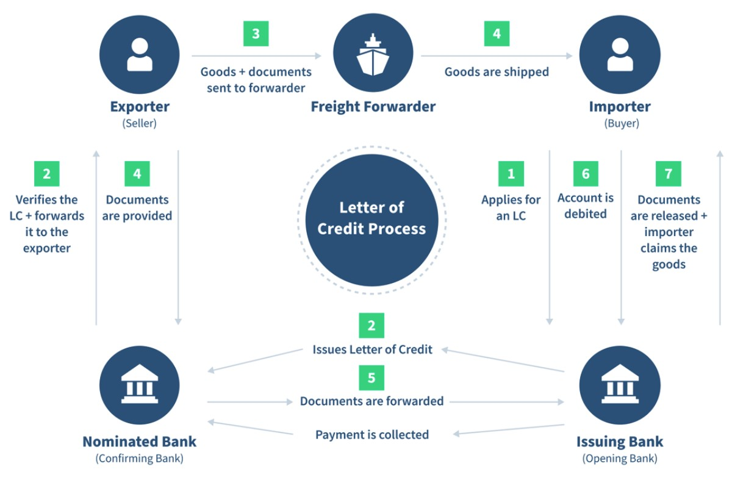

Slide 4
Summery of the articles in the ICC UCP 600
Articles 1-5: General provisions and definitions
Articles 6-13: Liabilities and responsibilities
Articles 14-17: Examination of Documents
Articles 18-28: Documents
Articles 29-33: Miscellaneous provisions
Articles 34-37: Disclaimers
Articles 38-39: Transferable Crdit & Assignment

Slide 5
Common Discrepancy under Documentary Credit/LC
Bill of exchange drawn on a wrong party
Absence of documents called for in the L/C
L/C Expired
Late shipment
Short Shipment
Credit amount exceeded
Marks & numbers differ between documents.
Weights differ between documents
B/L does not evidence whether freight is paid not.

Slide 6
Financial Documents: * Bill of Exchange, * Promissory notes, * Cheques, * Payments receipts or other similar documents used for obtaining the payment of money
Commercial Documents:
Invoices
Transport documents
Documents of title
Other non financial documents

Slide 7
Types of post Import Finance
Loan against trust receipt (LTR),
Loan against import merchandise (LIM),
Time Loan,
Over draft (Export),
Term Loan (BDT & Foreign Currency),

