Slide 1
Welcome to Session on Issues related to audit and inspection of General Banking Operations
Presented by:
Md Zahidur Rahman
Deputy General Manager
Audit & inspection Department
Date: 12 .01.2024

Slide 2
Learning Objective of this Session
Understanding Banking Operations
Issued related to Audit and Inspection of General Banking operation
How to minimize the issues arised.

Slide 3
Banking Operations
…in the case of Works
Bank operations is a collective term referring to the spectrum of banking services provided by a bank to its clients. Bank operations are crucial in providing Banking services and maintaining customer relations, growing finances, and earning profits along the way.
Retail
Banking
Corporate
Banking
Banking
operations
Investment
Banking
Central
Banking

Slide 4
General Banking Operations
…in the case of Works
Everyday transaction of banking system is the main operation which is handled by general banking sections. It has to meet the customers demand for daily banking services such as:
Cash and
Deposits
Clearing
House
Opening
Accounts
General
Banking
Operations
Security
Instrument
Handling
Remittance
Locker
Facilities
Bill
Other
services

Slide 5
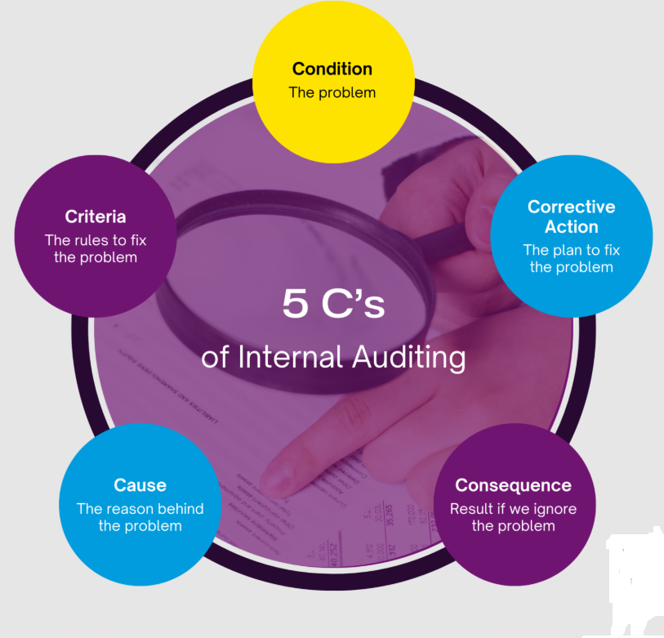
Issues related to audit and inspection of General Banking Operations
…in the case of Works
While raising issues in audit reporting we can follow 5 C’s:

Slide 6
Issues related to audit and inspection of General Banking Operation
…in the case of Works
1. Employess & Work Environment
Attendance Register : Enrollment, Marking Leave, Absence etc.
Office order : Job description, Job Rotation etc.
Employee’s Filing System: up-to-date documentation,leave record, joining, transfer.
Working Environment : internal and external( decoration, signboard, cleanliness, punctuality, customer service etc.
Security System: Volt, key register, Alarm system, CC camera, Guard/ ansar duty, secured cash section Gun license,fire extinguisher etc.

Slide 7
Issues related to audit and inspection of General Banking Operation
…in the case of Works
2. Cash and Volt limit:
Cash in hand : Receive-Payment ledger, Cash book, Scroll, Tocken , interbranch voucher entry, Late payment, evening banking, foreign currency , Bill receiving etc.
Prizebond: Examining Entry
Sonali Bank A/C: Balance confirmation,trasnsfer fund to HO
Torned and mutilated Note: As per BB circular, counter service, cash sorting etc.

Slide 8
Issues related to audit and inspection of General Banking Operation
…in the case of Works
2. Sundry Debtors : Justifying withdrawal though adjusted , unadjusted entry, balancing
3. Sundry Credotirs : Payment in due manner, detail description in each entry, balancing
4. Account Opening: NID verification, interview, proper KYC, Nominee, Minor AC, Risk Grading, TP, Source of Fund, Joint Account, Institutional Account etc.
5. Money Laundering: BAMALCO Nomination, Master circular of BFIU, CTR, STR, All files regarding AML, Independent Testing Procedure, Risk Grading File etc.

Slide 9
Issues related to audit and inspection of General Banking Operation
…in the case of Works
6. Clearing : Batch clearing, cheque Collection (outstation-Local), IBR-IBC , Endorsement etc
7. Security Stationery: Stationery stock in hand, cheque issue & register, Bearer cheque, Loose Cheque, Lost cheque, stop payment, PO issue, FDR issue, Leaf Balancing, Acknowledgement of FDR Receipt, Lost instrument File etc.
8. Consumption and Depreciation : Quarterly and Half yearly Accounting, Methods, Balancing
9. Sanchaypatra (if any): Suspense AC, Issue register etc

Slide 10
Issues related to audit and inspection of General Banking Operation
…in the case of Works
10. HO Reconciliation : whether sent timely with marking
11. Dormant/inoperative/ unclaimed A/C: Transactions (if any), deceased marking, KYC update etc
12. Deceased A/C Payment File: check the regularity
13. Monitoring Transaction: examine Payable GL head, Paid GL Head, Parking GL, Savings-current A/C, transfer amount without cheque, FDR Renewal etc.
14. Income-Expenditure: Examine Income GL head, expense GL Head, expenditure against Budget etc.

Slide 11
Issues related to audit and inspection of General Banking Operation
…in the case of Works
15. Preparation and Preservation of voucher:
Whether Checked and signed in due manner.
Joint signature (If necessary)
Is voucher register done entry daily basis?
Whether mandatory reports printed out and checked Daily: cheque issued report, Daily transaction reports, Inter-branch transaction Report, etc
Auto voucher preservation
16. IT Security :
Password sharing
Anti virus
Mail Checking

Slide 12
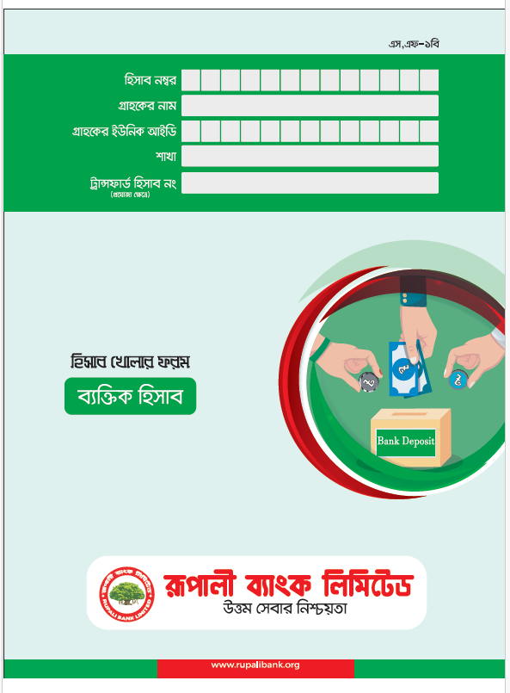
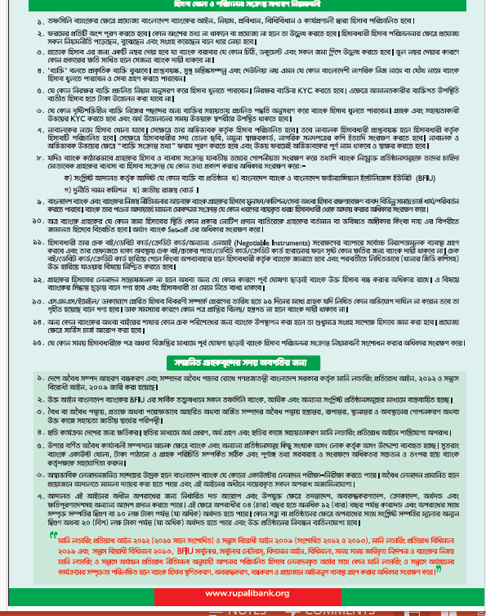
Issues related to audit and inspection of General Banking Operation
…in the case of Works

Slide 13
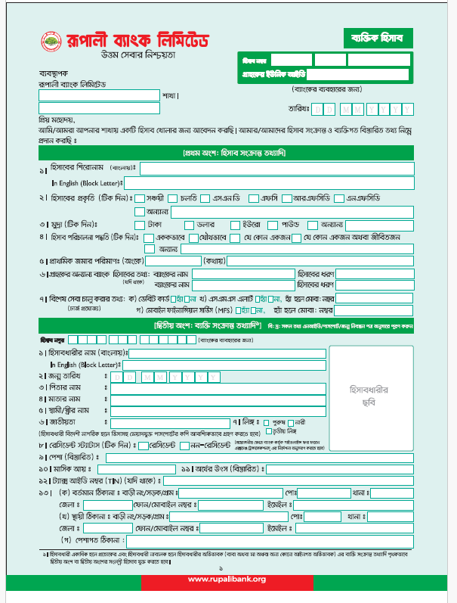
Issues related to audit and inspection of General Banking Operation
…in the case of Works

Slide 14
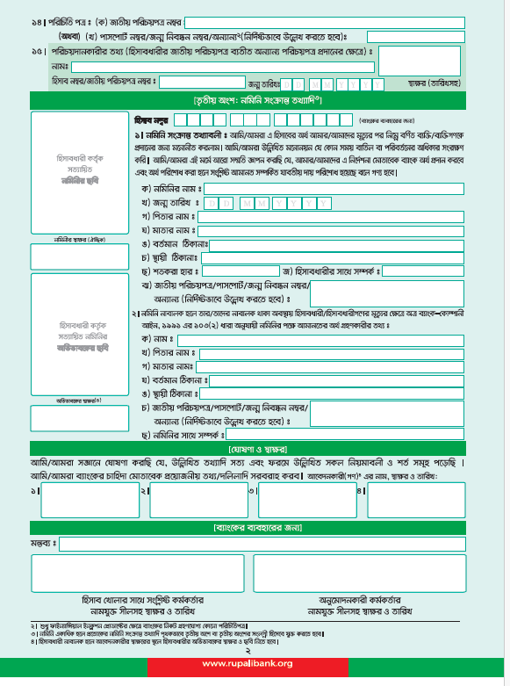
Issues related to audit and inspection of General Banking Operation
…in the case of Works

Slide 15
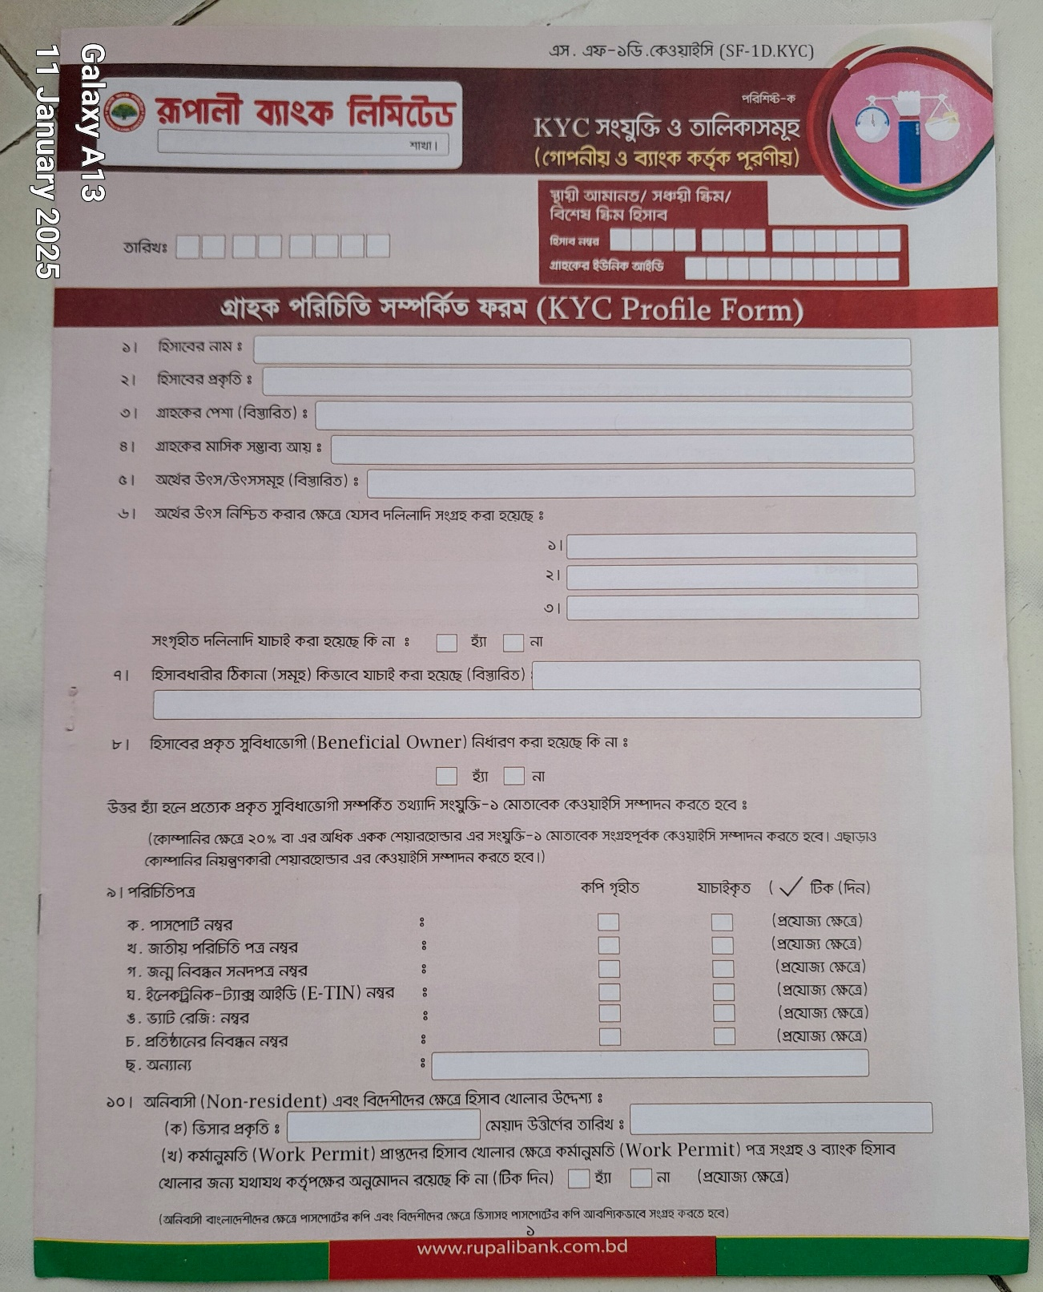
…in the case of Works

Slide 16
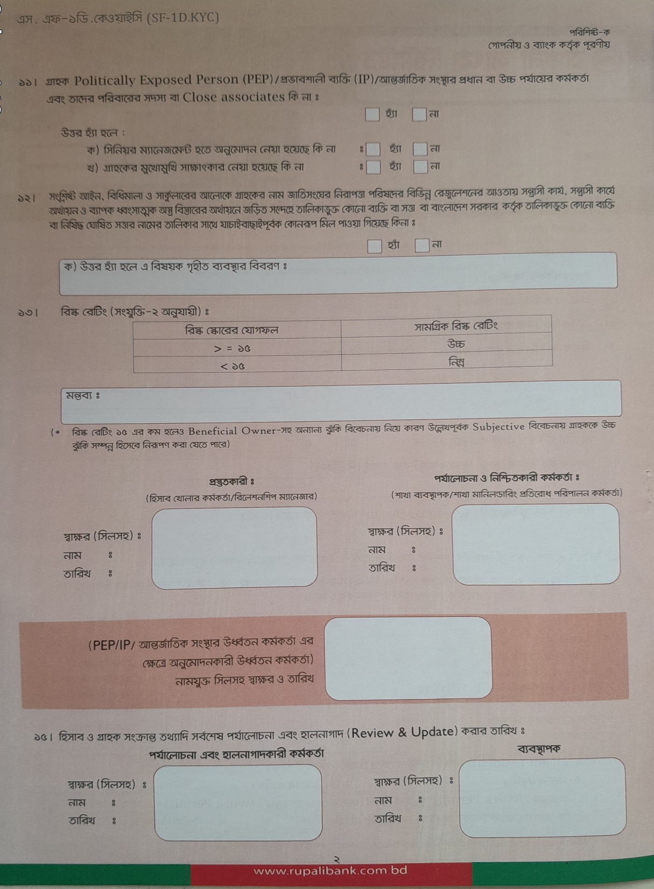
…in the case of Works

Slide 17
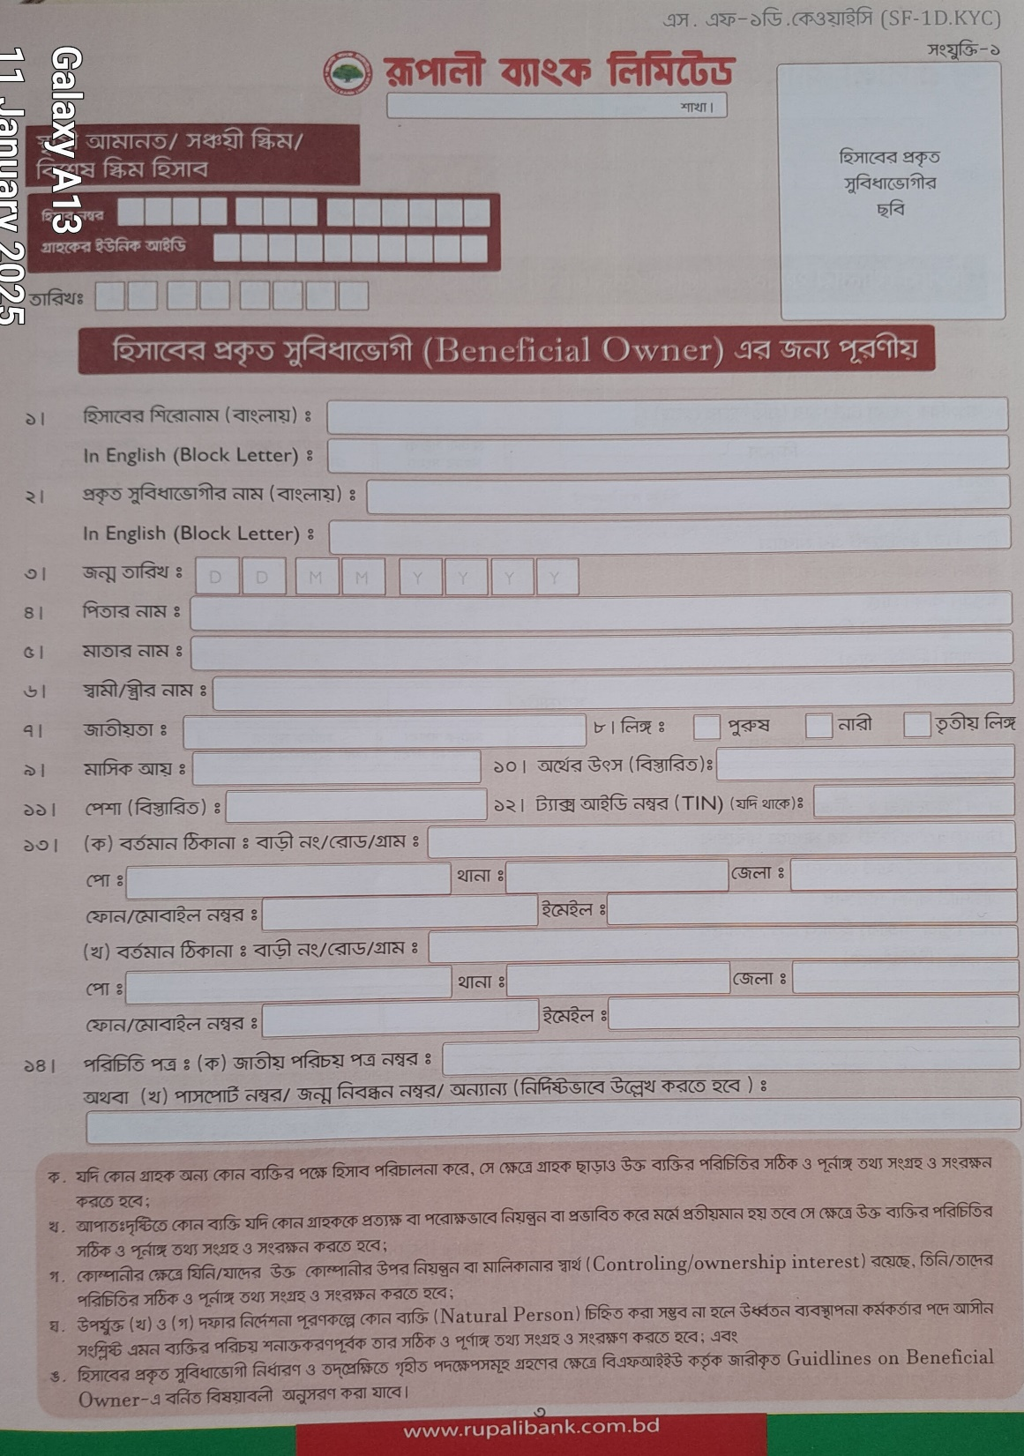
…in the case of Works

Slide 18
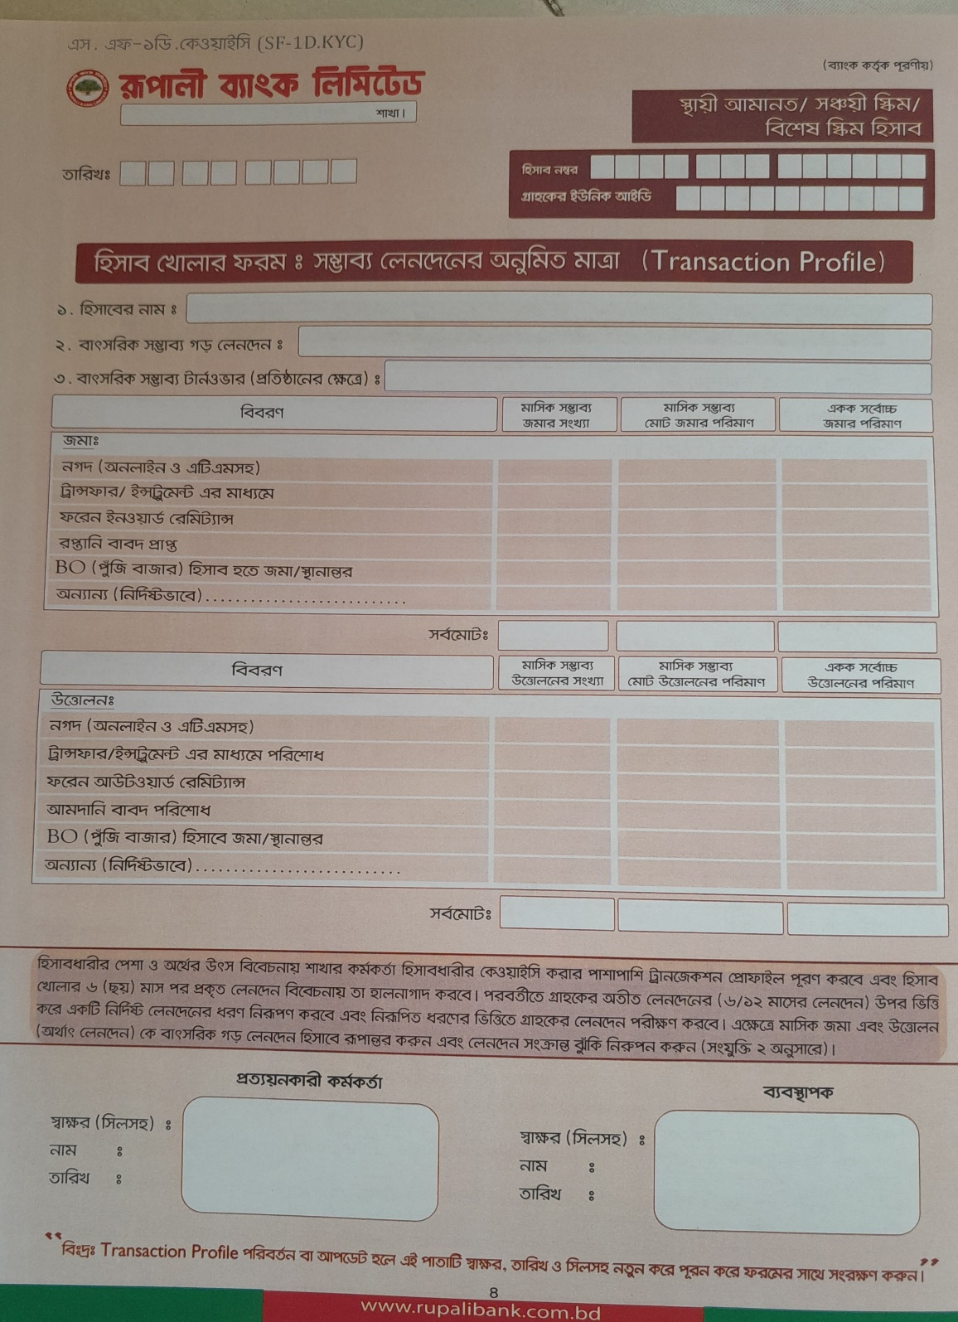
…in the case of Works

Slide 19
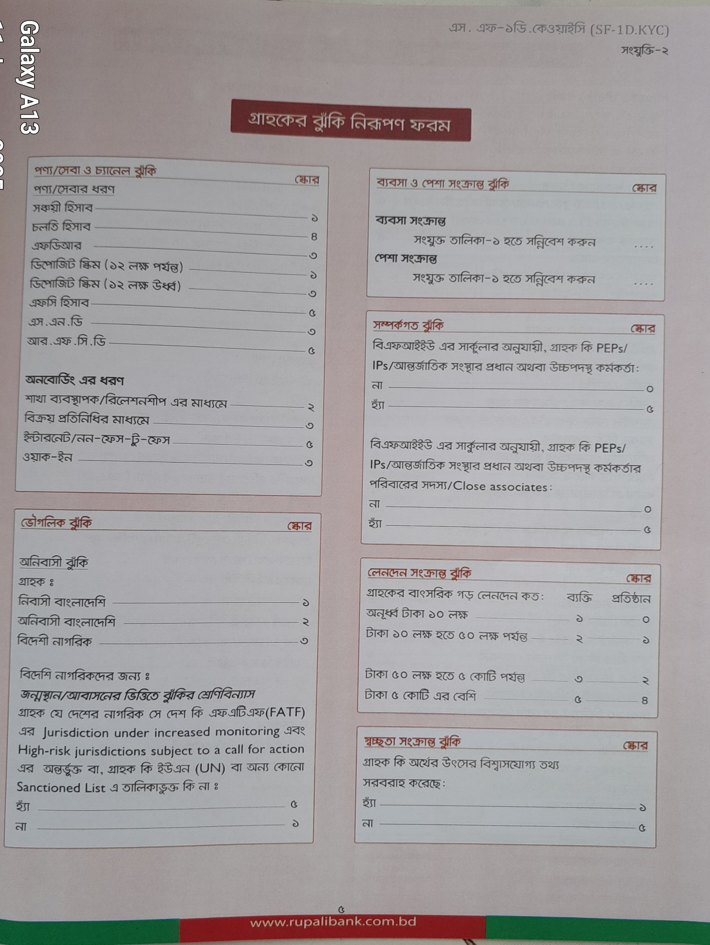
…in the case of Works

Slide 20
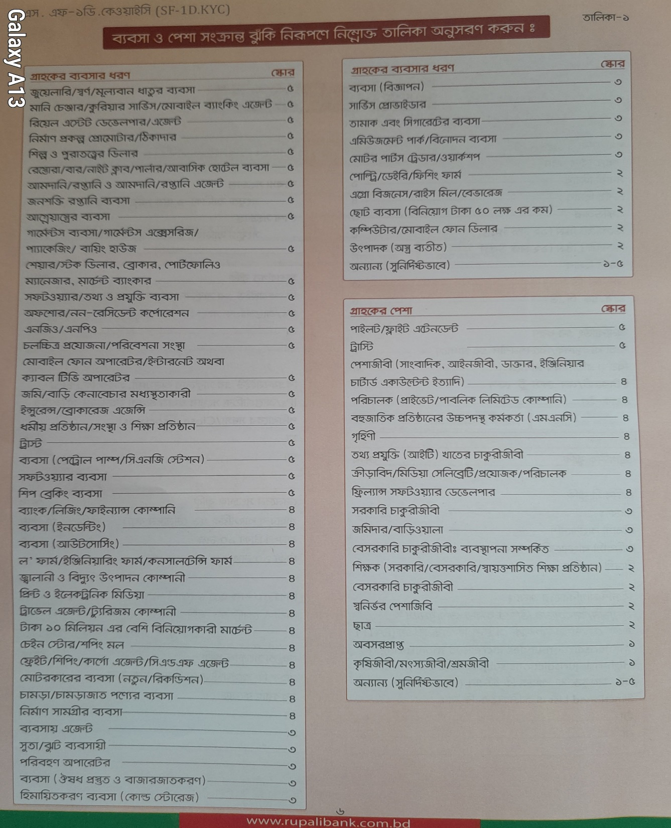
…in the case of Works

Slide 21
Question & Answer
Thank you all.

