Slide 1

WELCOME to
Effective Operations of Audit and Inspections with Risk Based Approach
Nisha Rani Datta
Assistant General Manager
Audit & Inspection Division-2
Head Office, Dhaka

Slide 2

Topics:
1. Auditing of Different type of Expenditures,
Approval, Budget limit,
2.Furniture-Fixtures: Purchasing process, Depreciation Voucher passing etc.
3.Printing and Security Stationery: Physical verification of stock, Balancing, Consumption voucher releasing etc.
4. Rent contract

Slide 3

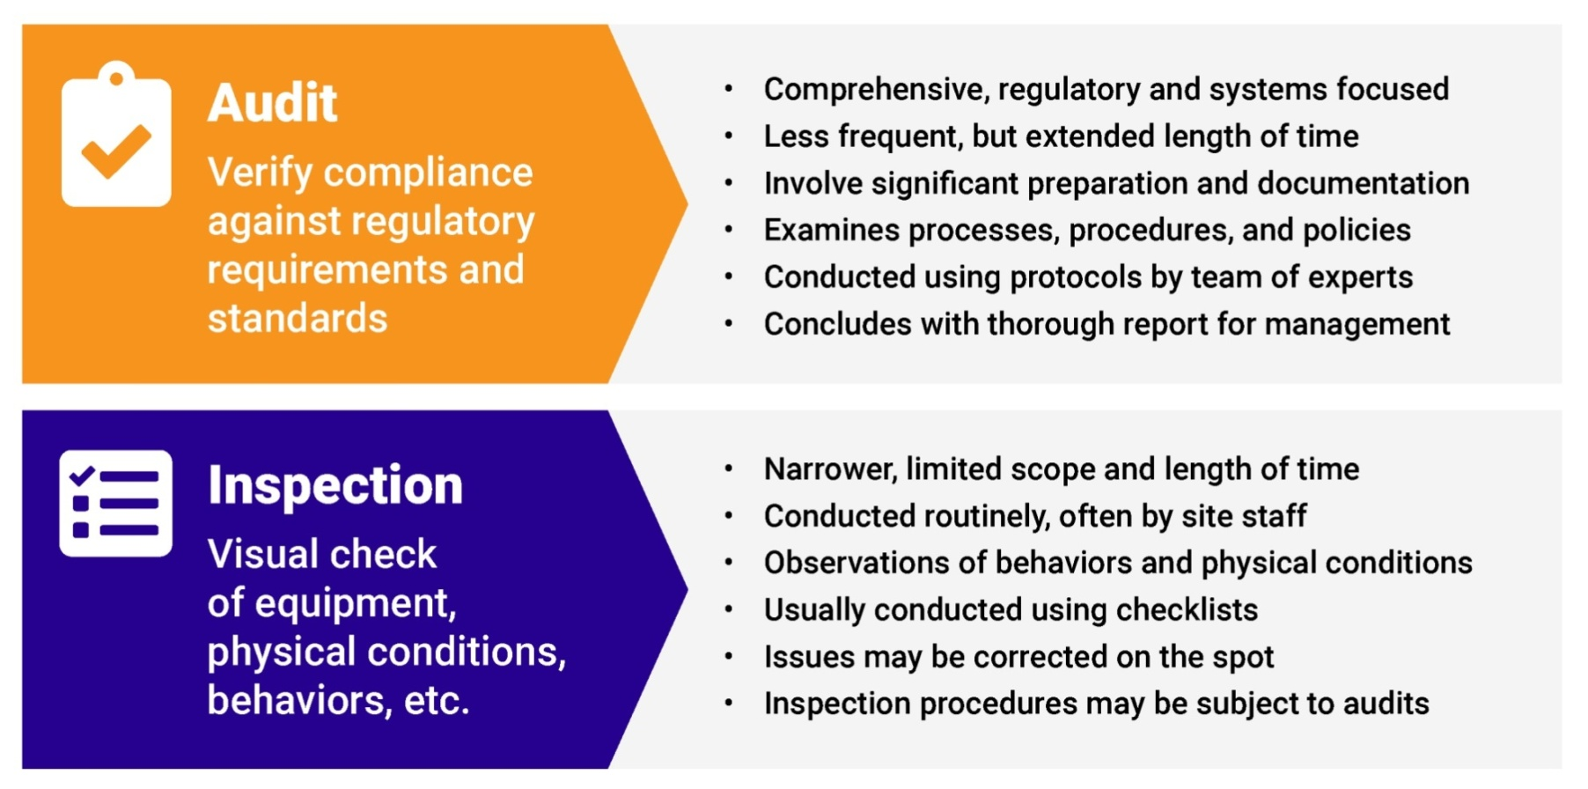
What is Audit and Inspection ?
Both Audit and Inspection comes from latin word ‘Audire ’ & ‘Inspectare’

Slide 4

Effectiveness of Audit & Inspection
Effective operations of Audit & Inspection depends on risk detection, mitigation & compliance. It ensures non repetitions of mistakes. It can be established by ensuring full compliance with rules, regulations and internal policies. It plays a vital role for establishing and exercising an effective control system within the organization.

Slide 5

What is Risk-Based Approach ?
Risk-based Internal Audit(RBIA) is an internal methodology which is primarily focused on the inherent risk involved in the activities or system and provide assurance that risk is being managed by the management within the defined risk appetite level. It is the risk management framework of the management and seeks at every stage to reinforce the responsibility of Management and Board of Directors for managing risk.
Risk based internal audit is conducted by internal audit department to help the risk management function of the bank by providing assurance about the risk mitigation.

Slide 6

Audit in Rupali Bank PLC.
As a part of ICC (Internal Control & Compliance) audit is conducted by Audit & Inspection Division-1 and Audit & Inspection Division-2.
ICC
Audit & Inspection
Compliance
Monitoring
Audit & Inspection-1
Audit & Inspection -2

Slide 7
Auditing of Different types of Expenditure – approval & budget limit
An expenditure is a payment of cash or credit for goods or services, often by a business, organization or corporation.
The purchase may be to obtain new assets, improve upon or repair assets, or reduce liability.
There are three types of expenditure audits
- Financial Audit
- Compliance Audit and
- Performance Audit

Slide 8
- Financial audits look at a company's financial statements to ensure they are accurate and up to date.
- Compliance audits check whether a company is in compliance with laws, regulations and standards.
- Performance audits check whether a company is achieving the objectives it set for itself.
Auditing of Different types of Expenditure – approval & budget limit

Slide 9
Auditing of Different types of Expenditure – approval & budget limit
1. The expenditure must be within the company's approved budget.
2. The expenditure must be properly documented.
3. The expenditure must be relevant to the company's objectives.
4. The expenditure must be legal.
5. The expenditure must be within the company's approved spending limit.
6. The expenditure must not have raised any red flags during previous audits.
7. The expenditure must be properly managed and monitored.

Slide 10

Furniture-Fixtures: Purchase Procedures, Depreciation Voucher passing
All Procurement procedures of Furniture-fixtures in our bank is done by Procurement Division, Head Office as per the requirements of all branch, zonal office, divisional office and all divisions of head office.
There are three methods used to procure furniture-fixtures.
Open tender Method(OTM)
Limited Tender Method(LTM)
Direct Purchase Method(DPM)/
Request for Quotation (RFQ)

Slide 11
Furniture-Fixtures: Purchase Procedures, Depreciation Voucher passing
Depreciation rate
Furniture-10% of book value (Declining method)
Mechanical Appliance-20% of book value (Declining method)
Computer Accessories- 20% of purchasing value (Straight line method)
Voucher passing
Depreciation should be calculated on half yearly basis but voucher should be passed annually to the respective accounts.

Slide 12
Printing and Security Stationery: Physical verification of stock, Balancing, Consumption voucher releasing etc.
Physical verification of printing and security stationary ensures that inventory is valued correctly, reducing the risk of tax-related issues. Improved decision-making, having an accurate inventory count allows organization to make informed decisions.
Printing and security stationary are supplied by our controlling office .
It should be checked and recorded (on register SB-56) and after getting challan the amount should be posted as asset on stationary stock in hand as follows:
Dr Stationary stock in hand a/c
Cr Head office a/c
The record on register should be balanced on month basis.
Consumption voucher should be released on quarter basis as follows:
Dr Stationary expense a/c
Cr Stationary stock in hand a/c

Slide 13
Rent Contract
Bank renders its services in own or rented space by establishing its branch, zonal office, divisional office etc. In case of opening a new branch(office) or shifting of existing branch(office) in rented space the following procedure is maintained:
1. Area selection
2. Location
3. Comparative study
4. Rent proposal to land owner
5. Request for approval of head office after getting acceptance of land owner
6. NOC of Bangladesh Bank and Ministry of finance is required
Contract between land owner and bank management

Slide 14
Thank You

