Slide 1
Welcome to the presentation on
Division
Operations
ICT
Inspection of CBS Transaction in Branch
Presented by:
Sohrab Hossain
Senior Principal Officer
Rupali Bank Limited
ICT Operations Division
Head Office, Dhaka

Slide 2
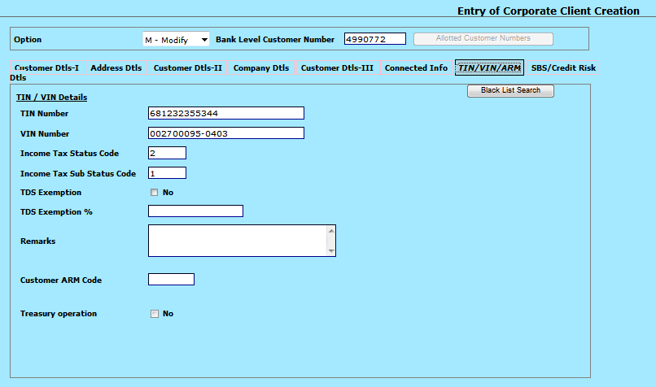
IT status/ Sub Status Code for Corporate Client
Division
Operations
ICT
Slide # 1 of 118

Slide 3
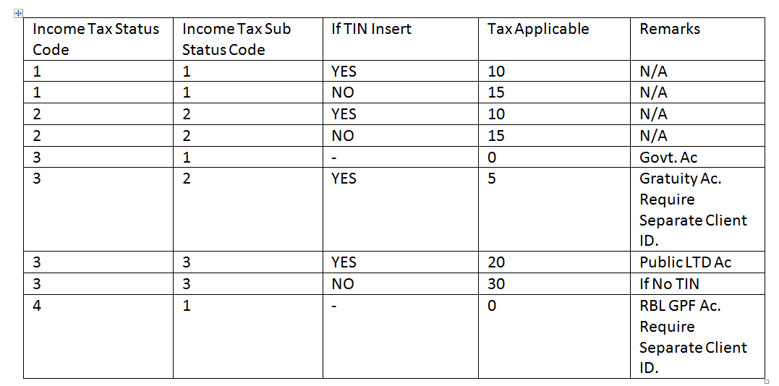
IT STATUS DETAILS FOR CLIENT CREATION IN CBS
Division
Operations
ICT
Slide # 2 of 118

Slide 4
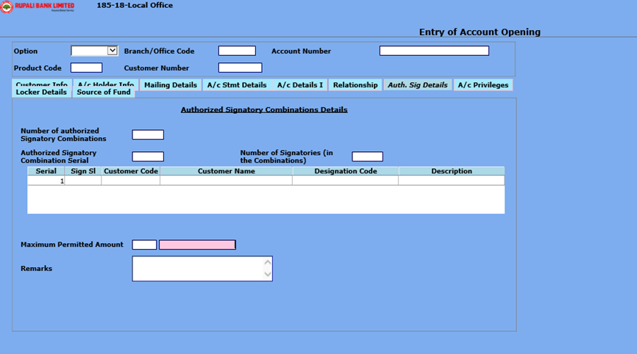
Special A/C Opening Information
Division
Operations
ICT
Slide # 3 of 118

Slide 5
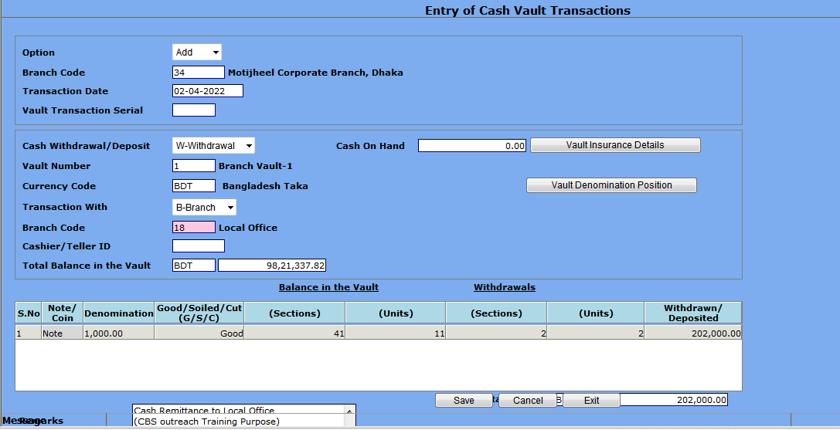
Cash Remittance by Vault Transaction
Division
Operations
ICT
Slide # 4 of 118

Slide 6
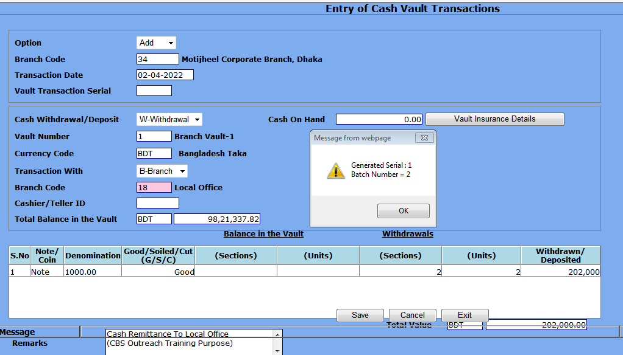
Cash Remittance by Vault Transaction
Division
Operations
ICT
Slide # 5 of 118

Slide 7
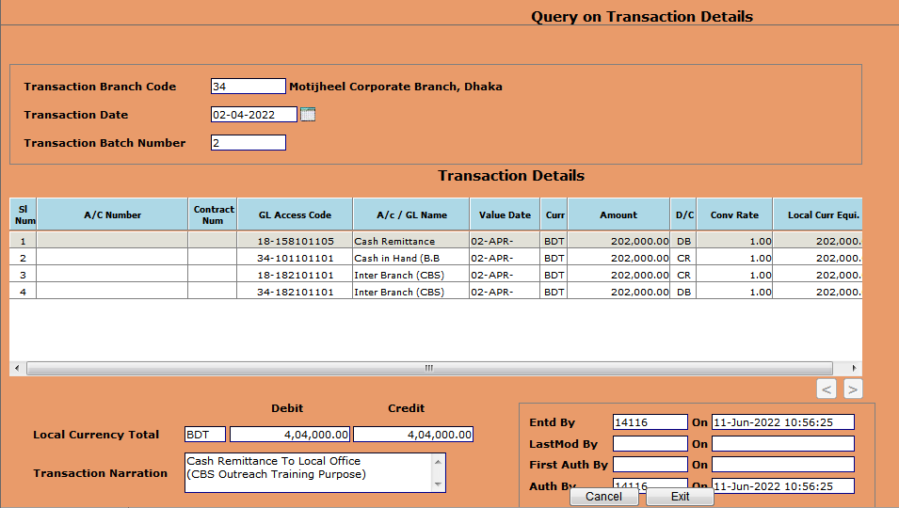
Cash Remittance by Vault Transaction
Division
Operations
ICT
Slide # 6 of 118

Slide 8
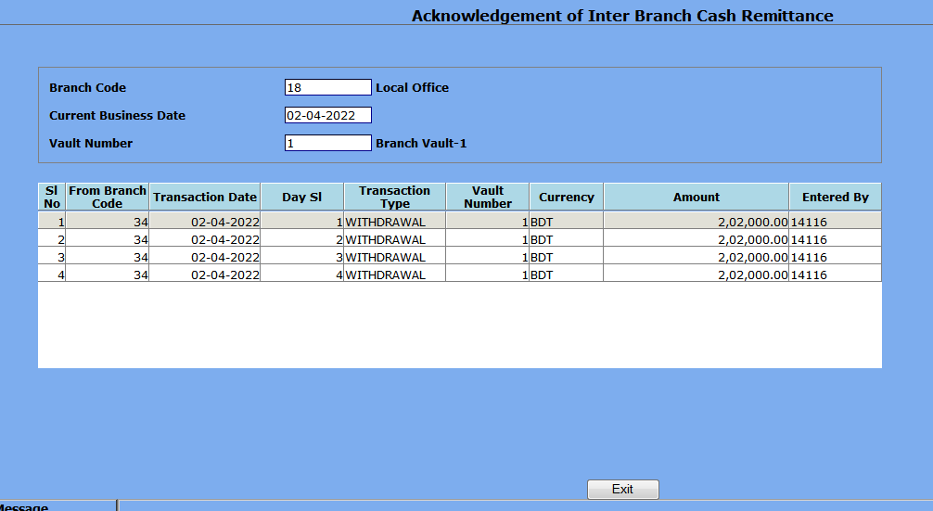
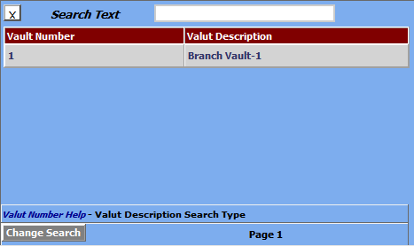
Acknowledgement of Cash Remittance by Receiver
Division
Operations
ICT
Slide # 7 of 118

Slide 9
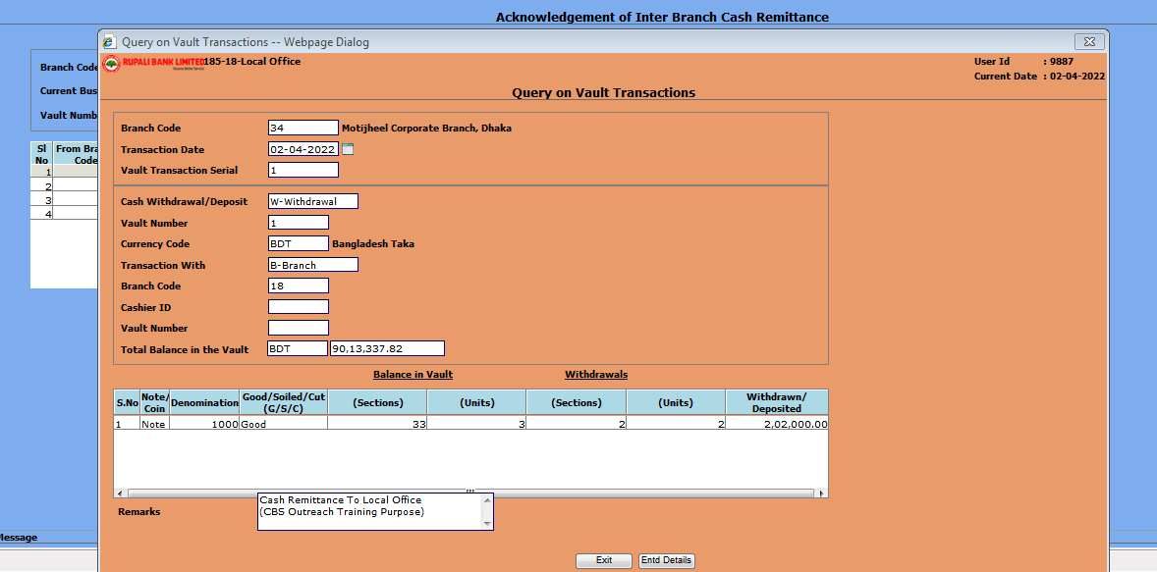
Acknowledgement of Cash Remittance by Receiver
Division
Operations
ICT
Slide # 8 of 118

Slide 10
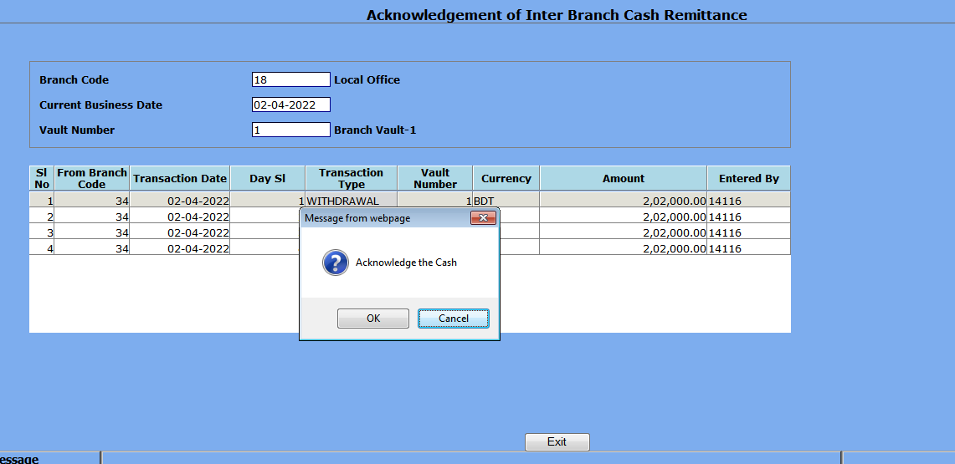

Acknowledgement of Cash Remittance by Receiver
Division
Operations
ICT
Slide # 9 of 118

Slide 11
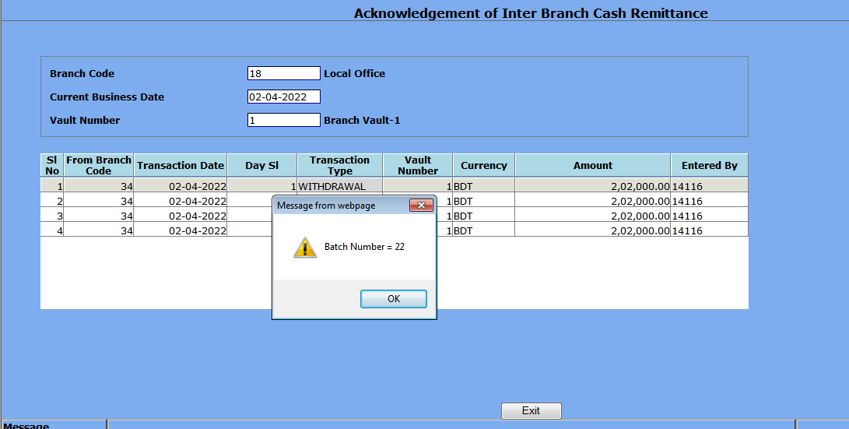
Acknowledgement of Cash Remittance by Receiver
Division
Operations
ICT
Slide # 10 of 118

Slide 12
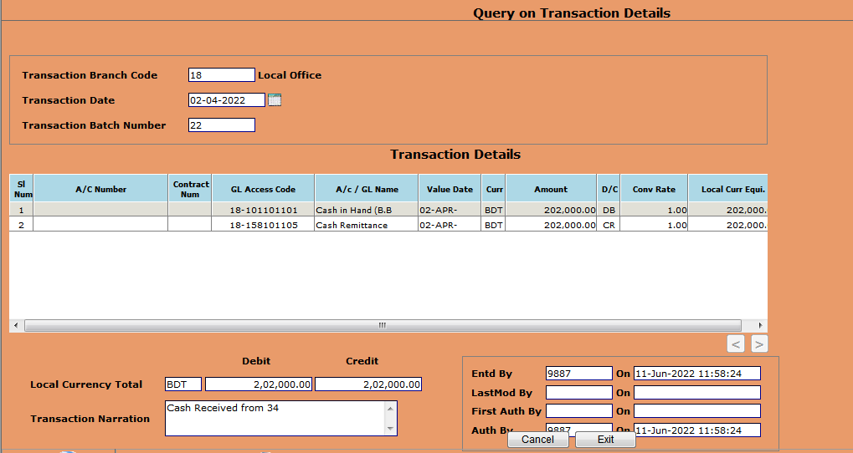
Transaction Query of Cash Remittance by Receiver
Division
Operations
ICT
Slide # 11 of 118

Slide 13
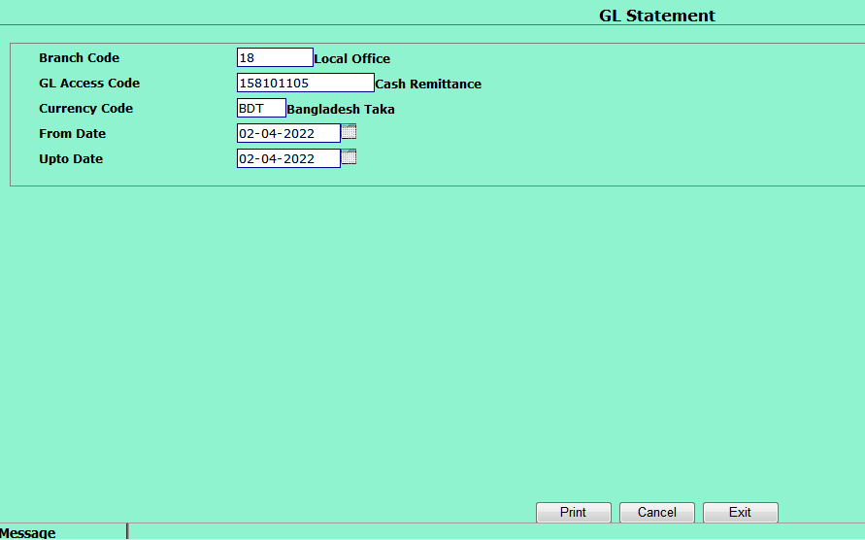
GL Statement of Cash Remittance by Receiver
Division
Operations
ICT
Slide # 12 of 118

Slide 14
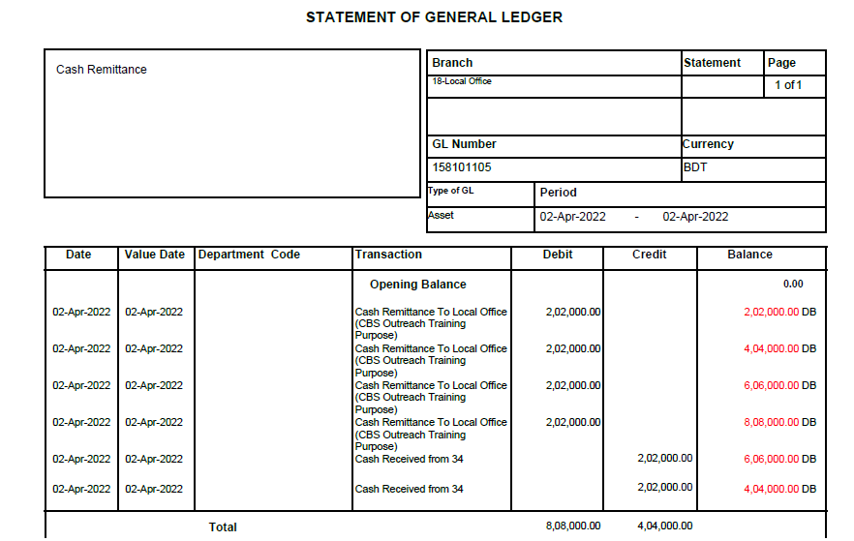
GL Statement of Cash Remittance by Receiver
Division
Operations
ICT
Slide # 13 of 118

Slide 15
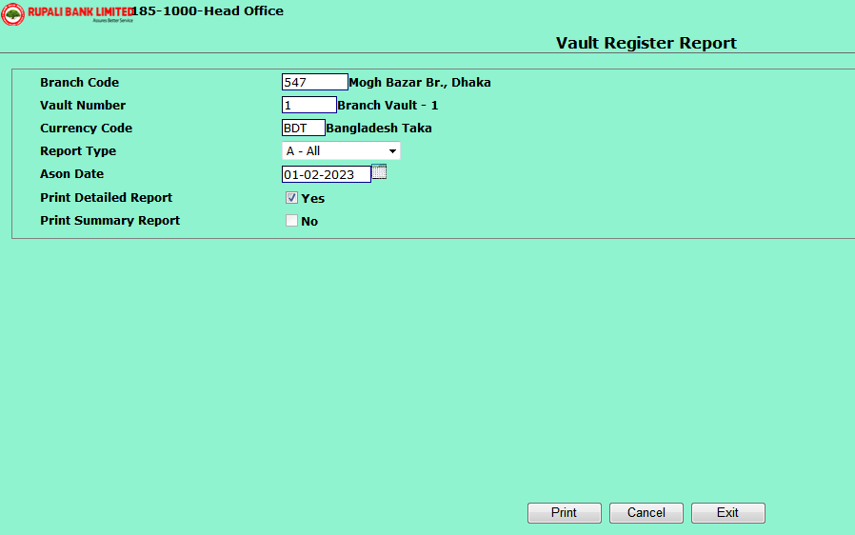
Division
Operations
ICT
Program for Daily Vault Register
Program ID-RVAULTREG
Slide # 14 of 118

Slide 16
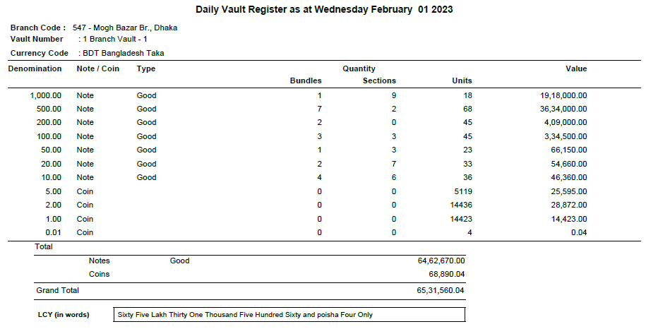
Division
Operations
ICT
Report for Daily Vault Register
Slide # 15 of 118

Slide 17
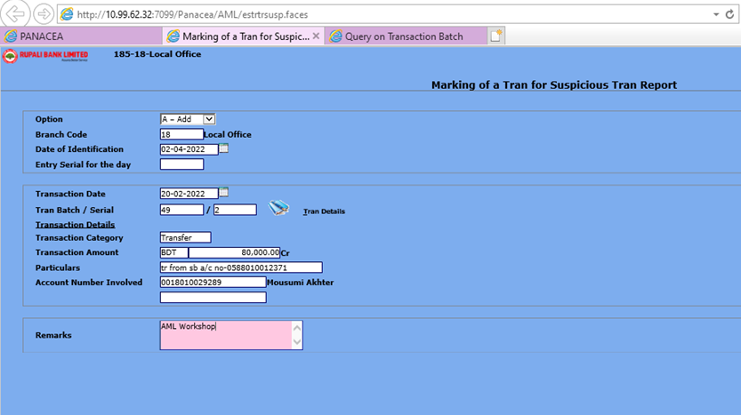
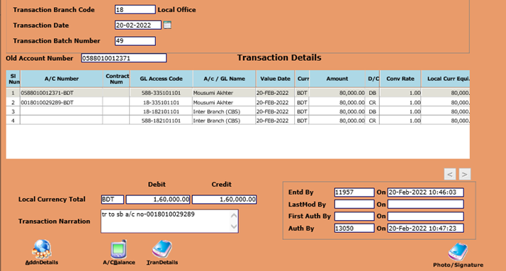
MARKING OF A TRANSACTION FOR STR IN CBS (ESTRTRSUSP)
Division
Operations
ICT
Slide # 16 of 118

Slide 18
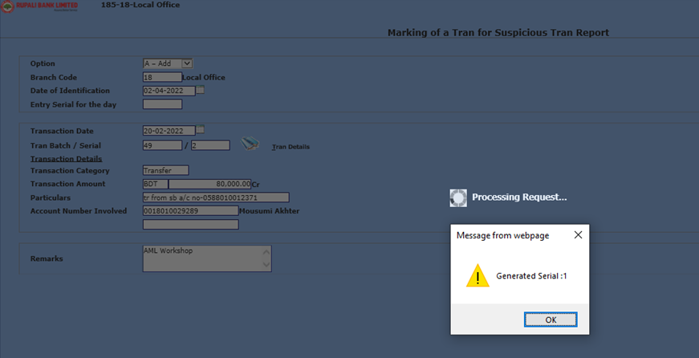
MARKING OF A TRANSACTION FOR STR IN CBS (ESTRTRSUSP)
Division
Operations
ICT
Slide # 17 of 118

Slide 19
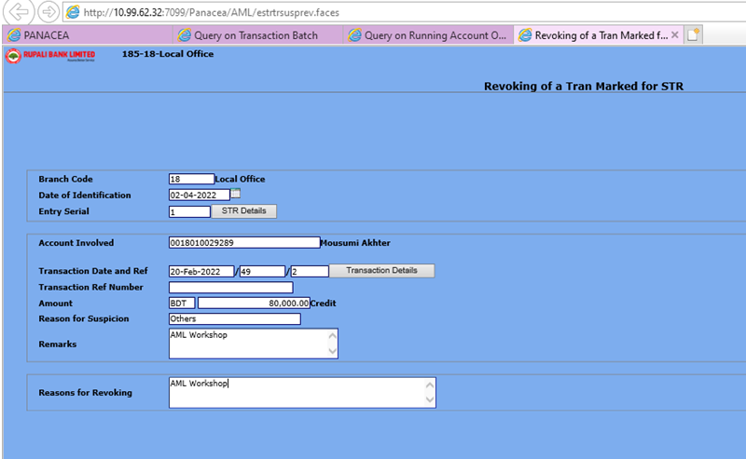
REVOKING OF A TRANSACTION MARKED FOR STR (ESTRTRSUSPREV)
Division
Operations
ICT
Slide # 18 of 118

Slide 20
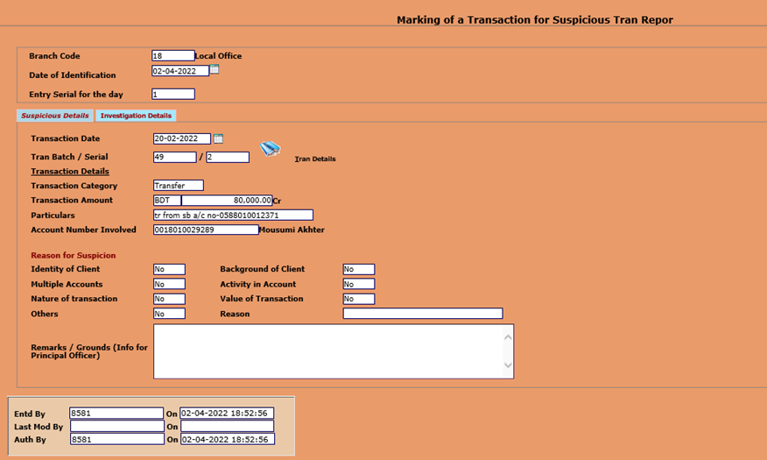
REVOKING OF A TRANSACTION MARKED FOR STR
(ESTRTRSUSPREV)
Division
Operations
ICT
Slide # 19 of 118

Slide 21
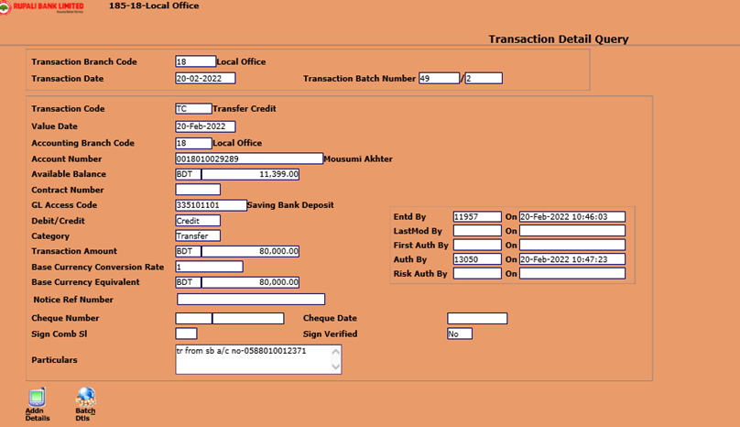
REVOKING OF A TRANSACTION MARKED FOR STR
(ESTRTRSUSPREV)
Division
Operations
ICT
Slide # 20 of 118

Slide 22
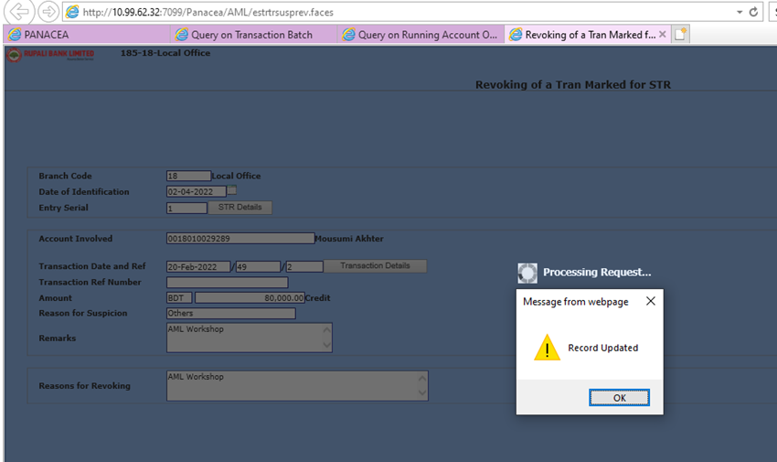
REVOKING OF A TRANSACTION MARKED FOR STR
(ESTRTRSUSPREV)
Division
Operations
ICT
Slide # 21 of 118

Slide 23
Some Inspection Tools in CBS
Division
Operations
ICT
1.Daily Cash Withdrawn Transactions
2.Daily Remittance Payment Transactions
3.Daily Cheque Collection Transaction through Settlement A/C or Parking GL- QGLVIEW
4.Daily RTGS outgoing Transactions
5.Daily Transactions in other Branches
6.Daily Sundry Debtor Nominal Transactions
7.Daily Exception Transaction
8.Deposit Matured but Not closed/Renewed
9.Daily SMS De-Registration Entry
10.Branch User Add/Modify or Activity Program Log
Slide # 22 of 118

Slide 24
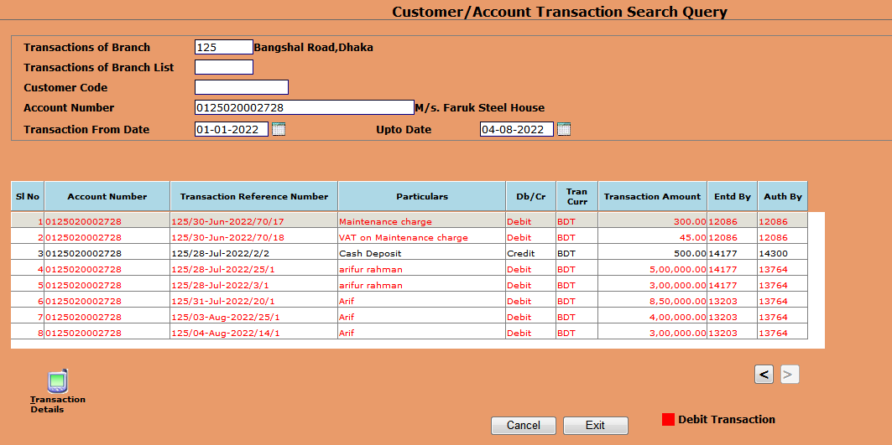
Customer/ Account Transaction
Division
Operations
ICT
QCUSTACTRSRCH
Slide # 23 of 118

Slide 25
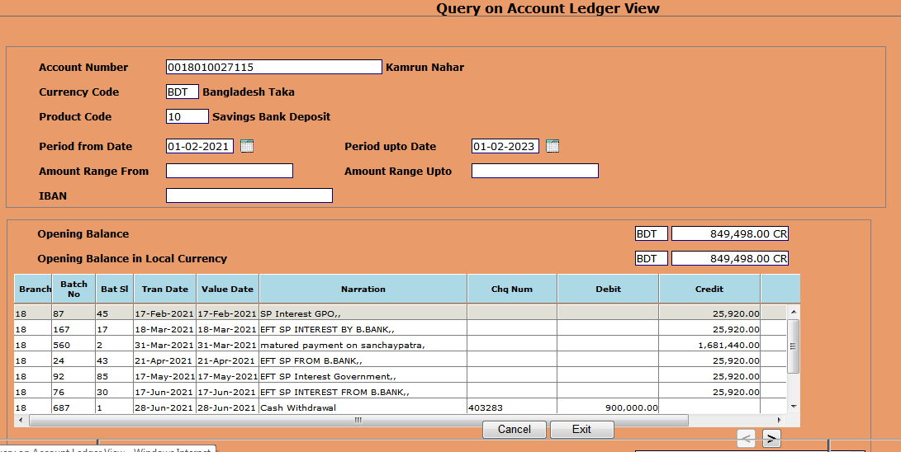

GL/Account Ledger Query
Division
Operations
ICT
QGLVIEW /QACLEDVIEW
Slide # 24 of 118

Slide 26
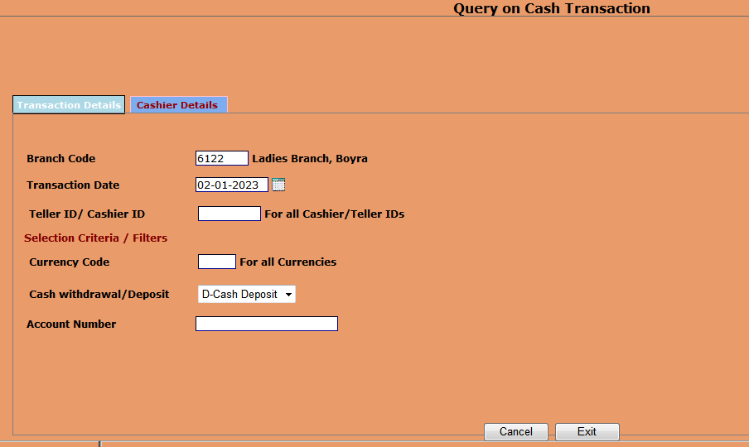
Cash Transaction
Division
Operations
ICT
QCASHSCROLL
Slide # 25 of 118

Slide 27
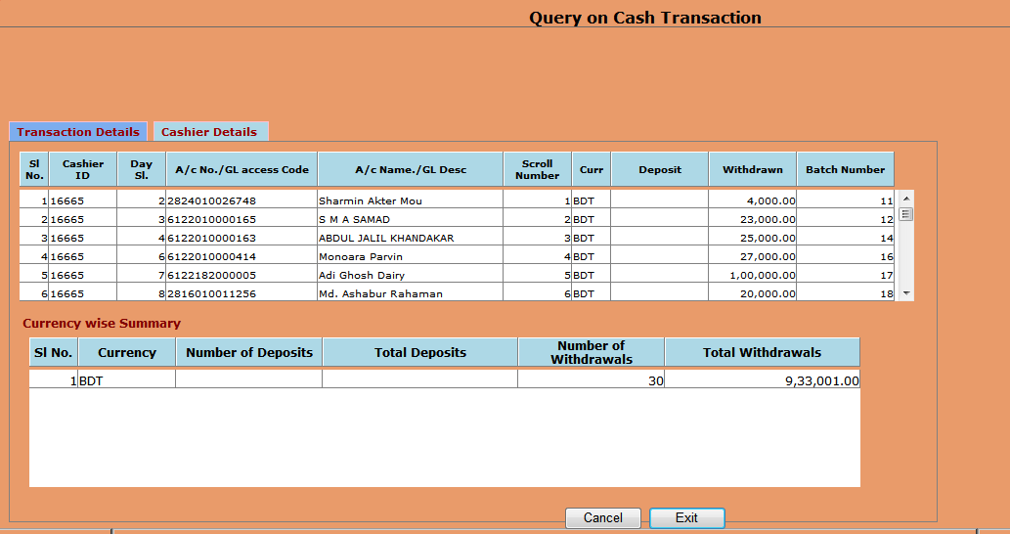
Cash Transaction
Division
Operations
ICT
Slide # 26 of 118

Slide 28
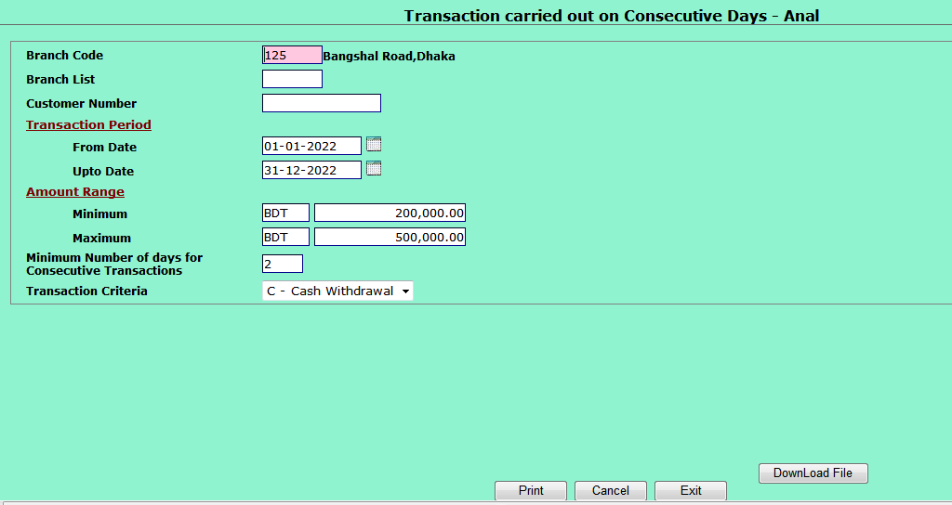
Transaction Analysis
Division
Operations
ICT
RTRANCONSDAYS
Slide # 27 of 118

Slide 29
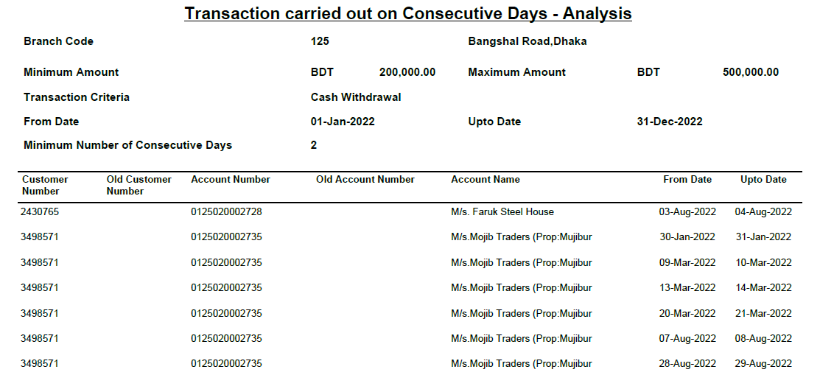
Transaction Analysis
Division
Operations
ICT
Slide # 28 of 118

Slide 30
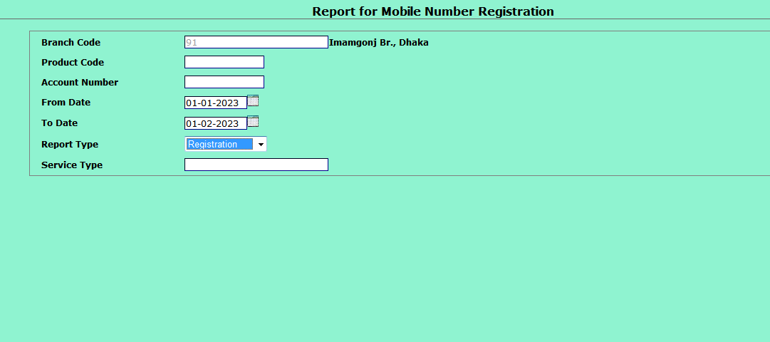
Division
Operations
ICT
Program for Mobile Registration
Slide # 29 of 118

Slide 31
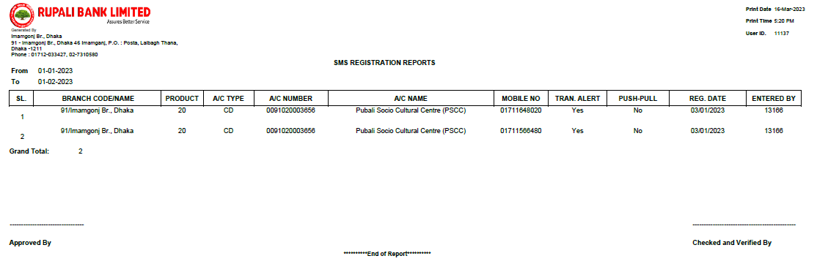
Division
Operations
ICT
Report for Mobile Registration
Slide # 30 of 118

Slide 32
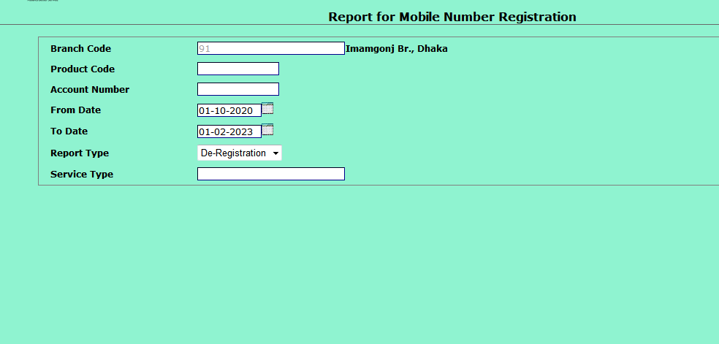
Division
Operations
ICT
Program for Mobile De-Registration
Slide # 31 of 118

Slide 33
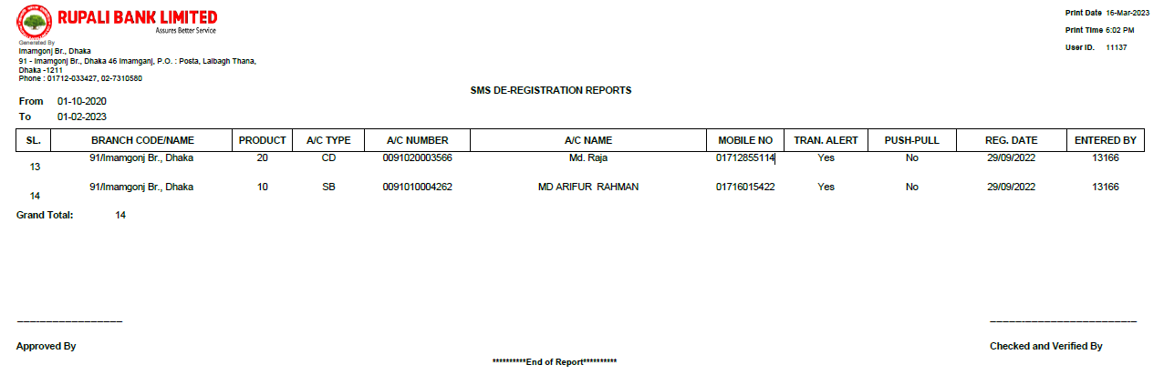
Division
Operations
ICT
Report for Mobile De-Registration
Slide # 32 of 118

Slide 34
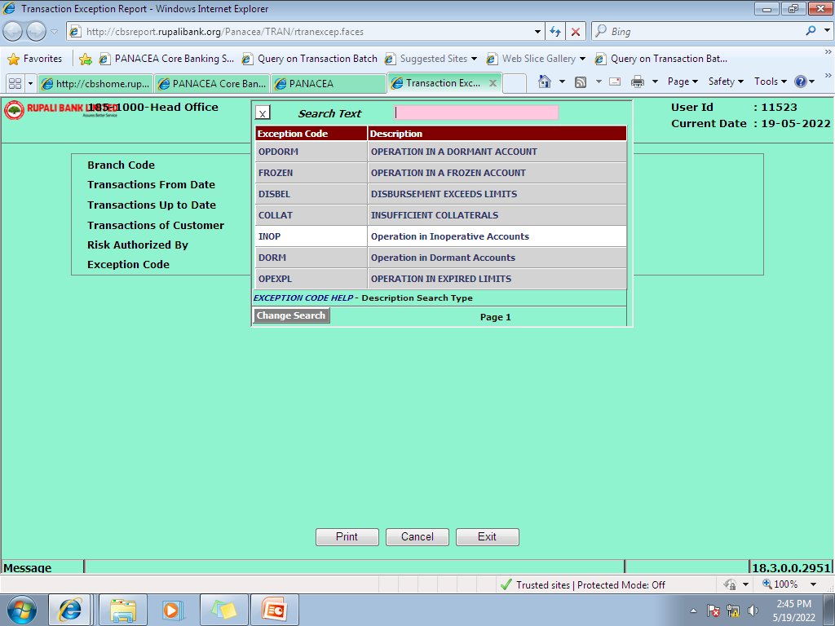
Division
Operations
ICT
Program for Exception Transaction
Slide # 33 of 118

Slide 35
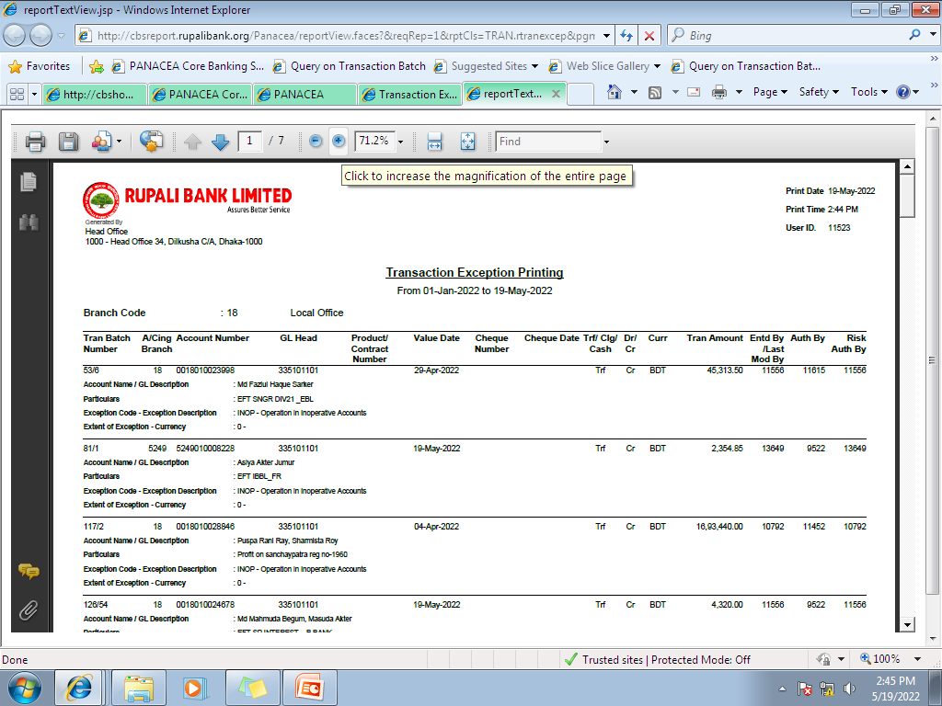
Division
Operations
ICT
Report for Exception Transaction
Slide # 34 of 118

Slide 36
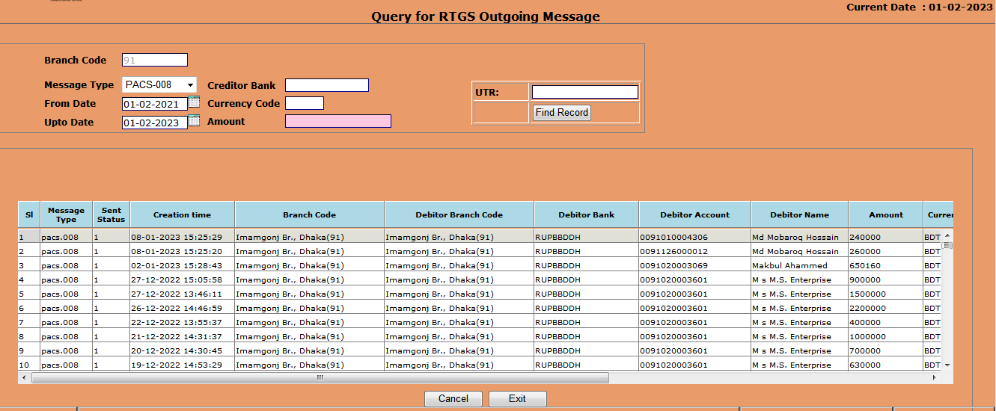
Division
Operations
ICT
Query for RTGS Outgoing
Slide # 35 out of 118

Slide 37
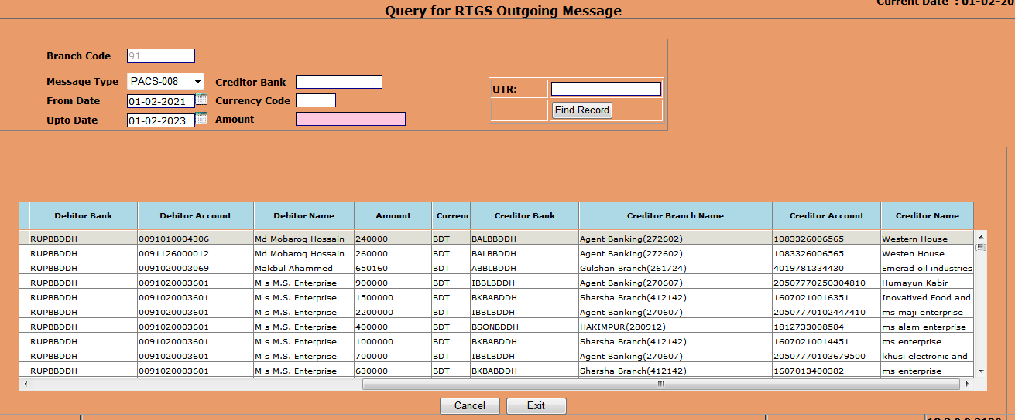
Division
Operations
ICT
Query for RTGS Outgoing
Slide # 36 out of 118

Slide 38
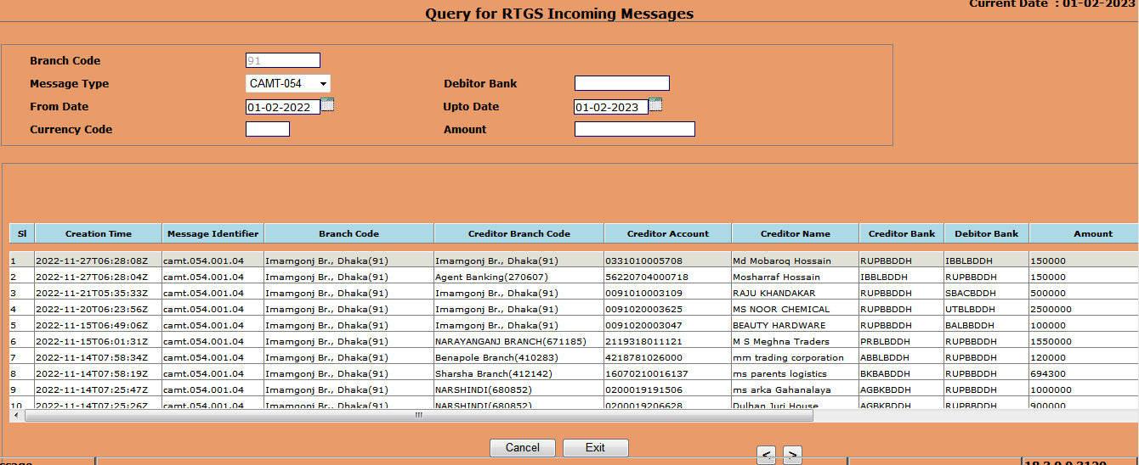
Division
Operations
ICT
Query for RTGS Incoming
Slide # 37 out of 118

Slide 39
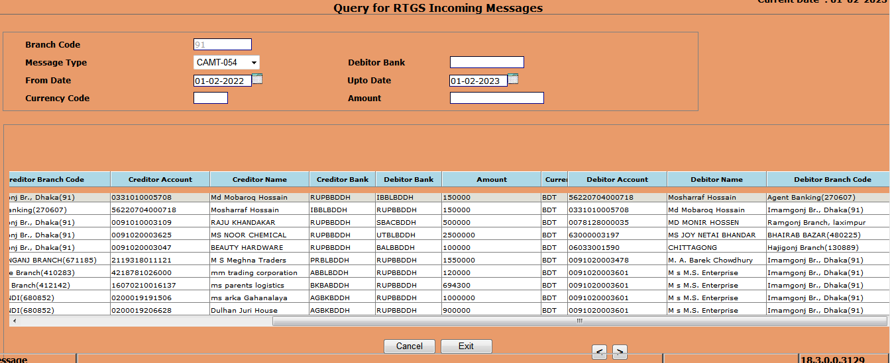
Division
Operations
ICT
Query for RTGS Incoming
Slide # 38 out of 118

Slide 40
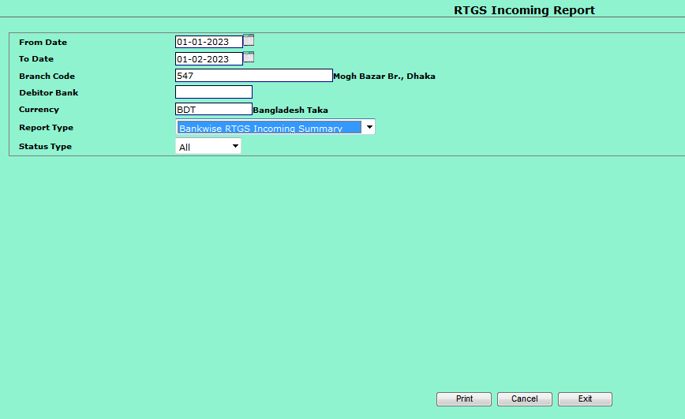
Division
Operations
ICT
Program for RTGS Incoming- Bank Wise
Slide # 39 out of 118

Slide 41
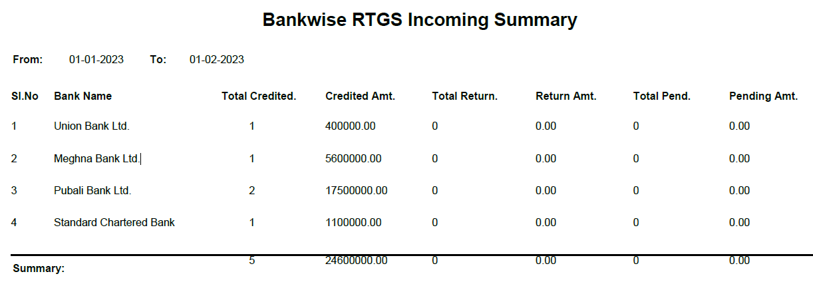
Division
Operations
ICT
Report for RTGS Incoming- Bank Wise
Slide # 40 out of 118

Slide 42
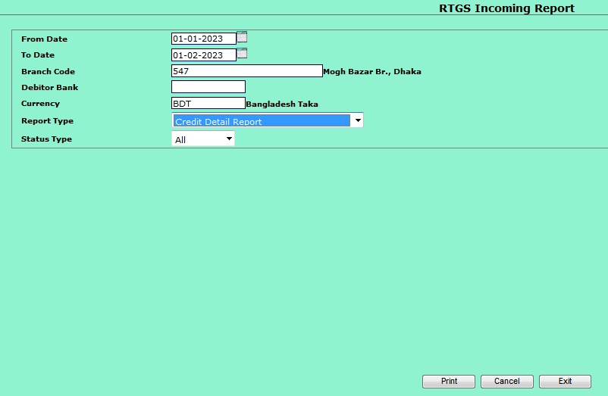
Division
Operations
ICT
Program for RTGS Incoming-Detail
Slide # 41 out of 118

Slide 43
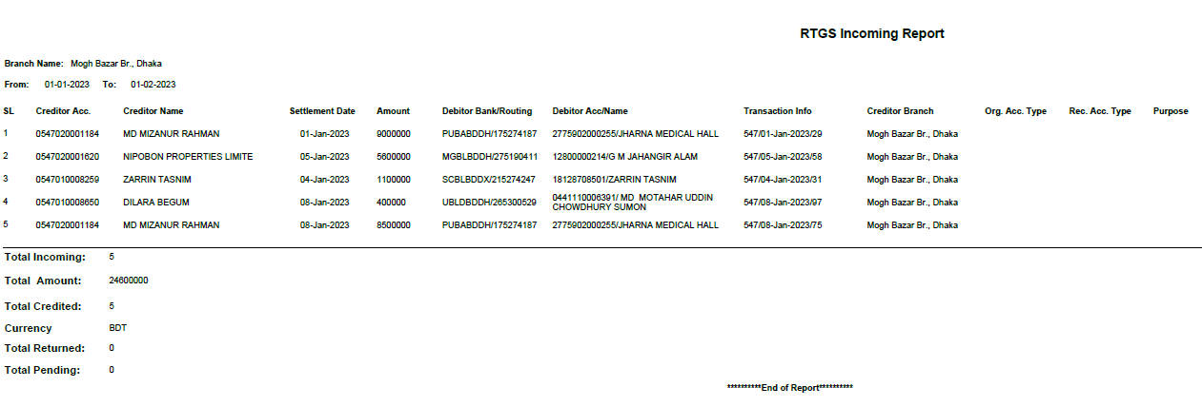
Division
Operations
ICT
Report for RTGS Incoming-Detail
Slide # 42 out of 118

Slide 44
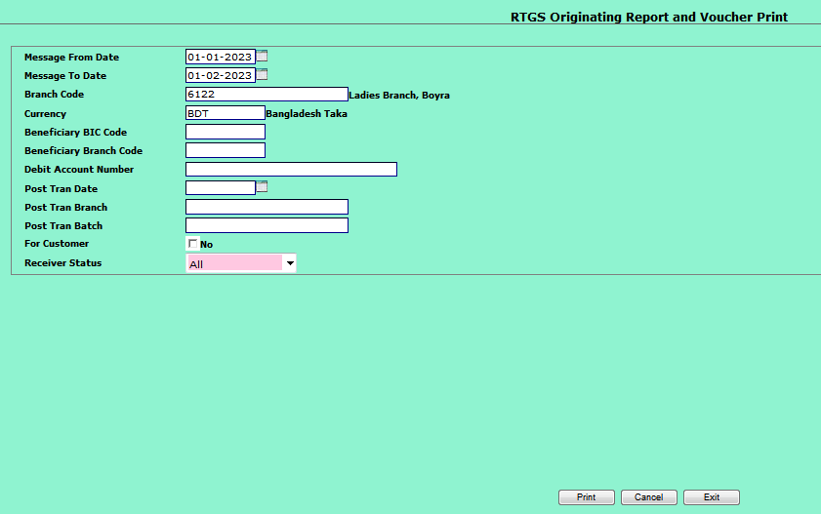
Division
Operations
ICT
Program for RTGS Outgoing- Detail
Slide # 43 out of 118

Slide 45
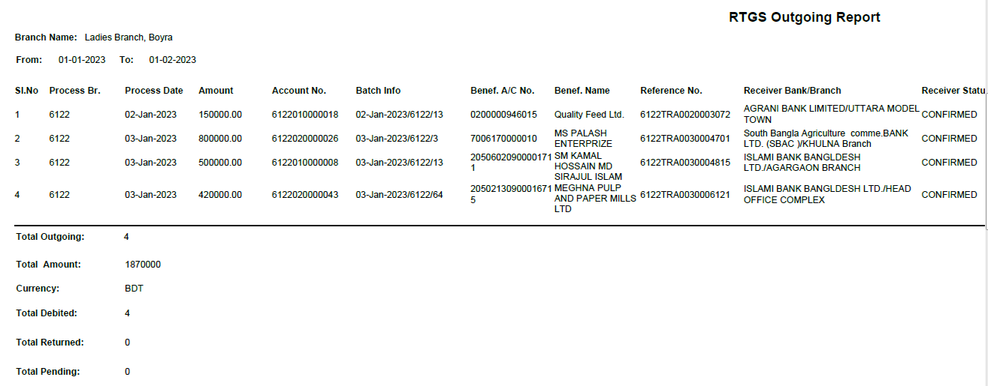
Division
Operations
ICT
Report for RTGS Outgoing- Detail
Slide # 44 out of 118

Slide 46
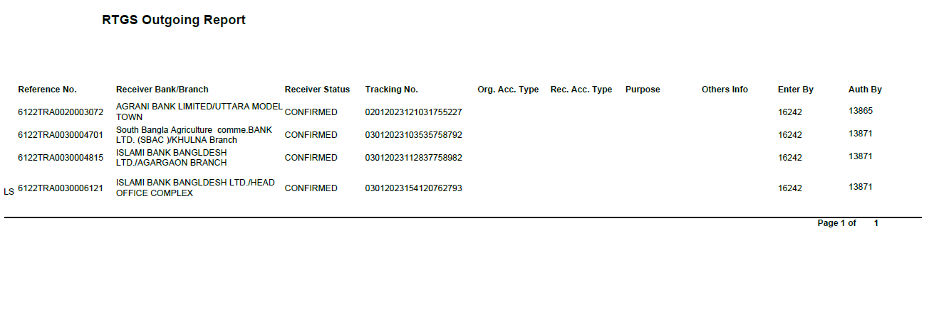
Division
Operations
ICT
Report for RTGS Outgoing -Detail
Slide # 45 out of 118

Slide 47
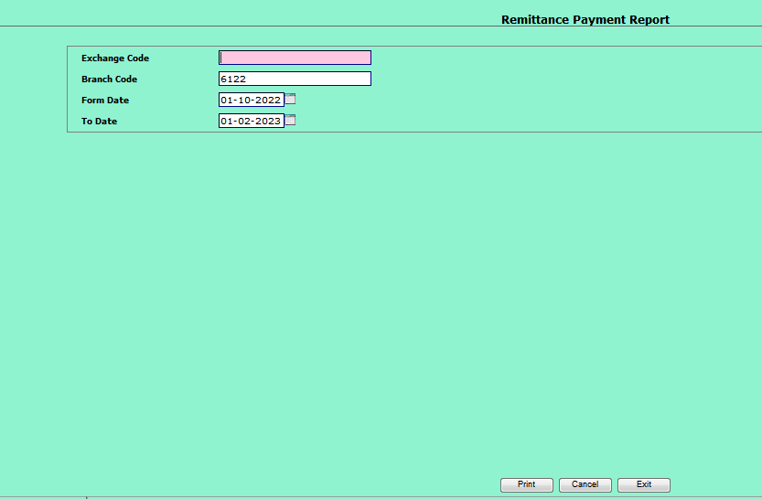
Division
Operations
ICT
Program for Remittance paid
Slide # 46 out of 118

Slide 48
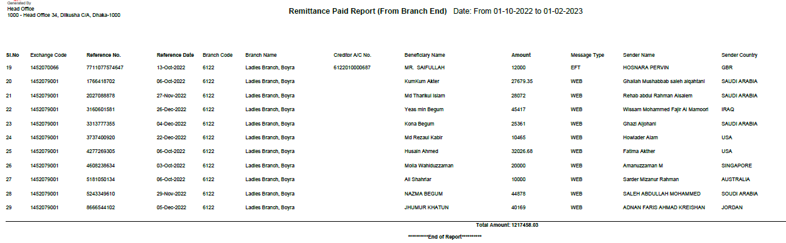
Division
Operations
ICT
Report for Remittance paid
Slide # 47 out of 118

Slide 49
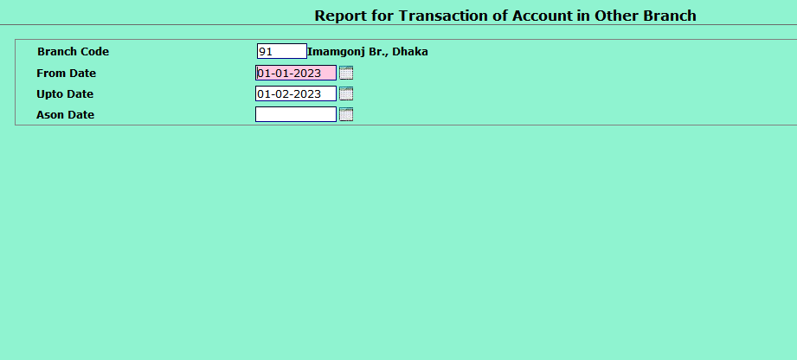
Division
Operations
ICT
Program for Transaction in Other Branch
Slide # 48 out of 118

Slide 50
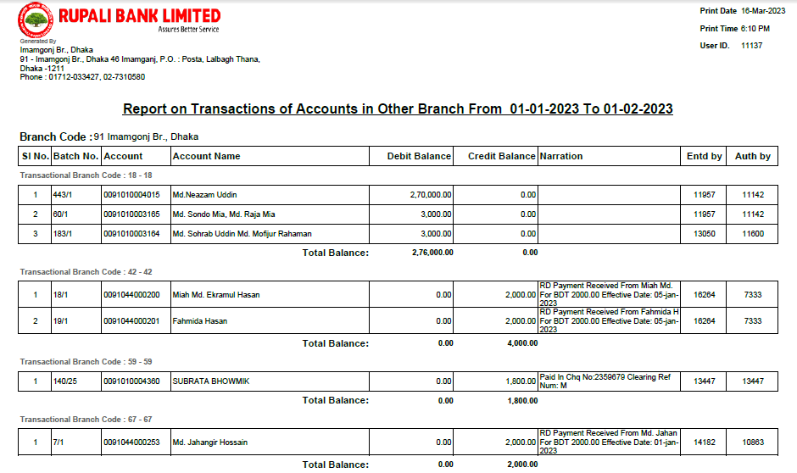
Division
Operations
ICT
Report for Transaction in Other Branch
Slide # 49 out of 118

Slide 51

Division
Operations
ICT
Program of Deposit Matured & not Closed
Slide # 50 out of 118

Slide 52

Division
Operations
ICT
Report of Deposit Matured & not Closed
Slide # 51 out of 118

Slide 53

Loan A/C opening Term (govt. employee house loan )
Division
Operations
ICT
A1

Slide 54

Limit line Creation (govt. employee house loan)
Division
Operations
ICT
A1

Slide 55

Loan A/C opening Term (Project Loan )
Division
Operations
ICT
A1

Slide 56

Loan A/C opening Term (Project Loan )
Division
Operations
ICT
A1

Slide 57

Loan A/C opening Term (Project Loan )
Division
Operations
ICT
A1

Slide 58

Loan A/C opening Term (Project Loan )
Division
Operations
ICT
A1

Slide 59

Loan A/C opening Term (Project Loan )
Division
Operations
ICT
A1

Slide 60

Loan A/C opening Term (Project Loan )
Division
Operations
ICT
A1

Slide 61

Loan A/C opening Term (Project Loan )
Division
Operations
ICT
A1

Slide 62
Reporting Matrix of different Categorized Loan
Division
Operations
ICT
CL-1
CL-2
CL-3
CL-4
CL-1 is the summary of classification status for different loan categories along with staff loan & off balance sheet exposure.
Continuous Loan (I.SMEF II.CF III.Loan to BHs/MBs/SDs IV. Others)
Demand Loan (I.SMEF II.CF III.Loan to BHs/MBs/SDs IV. Others)
  Fixed Term Loan (I.SMEF II.CF III.HF IV. LP
  V.Loan to BHs/MBs/SDs VI. Others)
CL-5
  STA & Micro Credit (I.STAC II.MC)
  NB:Classified SHBL (If any) & As rescheduled loan is term loan so both will report in CL-4

Slide 63
Basis of Loan Classification
Division
Operations
ICT
There are two bases:
(A)Objective Criteria
(B)Qualitative Judgment

Slide 64
Past Due/Over Due Loan
Division
Operations
ICT
Past due/ Over due
1) Continuous loan if not repaid /renewed within the fixed expiry date for repayment or after the demand by the bank will be treated as past due/ overdue from the following day of the expiry date.
3) Installment(S) or part of Installment(S) of a Fixed Term Loan is not repaid within the fixed expiry date the amount of unpaid installment(S) will be treated as past due/ overdue after 6months of the expiry date .
4) STA & MC is not repaid within the fixed expiry date will be treated as past due/ overdue after 6 months of the expiry date.
2) Demand loan if not repaid within the fixed expiry date for repayment or after the demand by the bank will be treated as past due/ overdue from the following day of the expiry date.

Slide 65
Rules of classification Under Objective Criteria
Division
Operations
ICT
Classification Status/ Length of Overdue
Type of Loan | SMA | SS | DF | BL
Other than Loan under CMSME : Continuous , Demand - If past due/ overdue for & Term Loan – If defaulted installments are equals payables for | 2 months or more but less than 3 months | 3 months or more but less than 9 months | 9 months or more but less than 12 months | equal to or more than 12 months
Under CMSME : Continuous , Demand - If past due/ overdue for & Term Loan – If defaulted installments are equals payables for | 2 months or more but less than 6 months | equal to or more than 6 months or more but less than 18months | equal to or more than 18 months or more but less than 30 months | equal to or more than 30 months
STAC & MC -If past due/ overdue for | - | equal to or more than 12 months but less than 36 months | equal to or more than 36 months but less than 60 months | equal to or more than 60 months

Slide 66


Comparative Discussion regarding CL in Tabular form
Division
Operations
ICT
NB →The criteria for OD/Past Due & SMA of any CMSME will be same as illustrated in BRPD 3/2019 & 14/2012
NB →The criteria for OD/Past Due & SMA of any CMSME will be same as illustrated in BRPD 3/2019 & 14/2012

Slide 67
Defaulted Loan
Division
Operations
ICT
Loans have to be treated as defaulted loan as per Section 5 (GaGa) of The Banking Company Act, 1991. “defaulter borrower” means loan which remains overdue for 06 (six) months.
DF/BL status along with a portion of the SS Status (which remains overdue for 06 (six) months) of all Continuous, Demand & Term loan
SS/DF/BL status of all STAC & MC
Will be reported as defaulted loan
Note that- all defaulted loan are classified but all classified loan are not defaulted loan.
Notes:
CL Start from 12 months of over due. So before that STA & MC remains UC. That’s why it will not treated as defaulted from 6 months of overdue.

Slide 68
Maintenance of provision
Division
Operations
ICT
Particulars |  | Short Term Agri. Credit | Consumer Financing |  |  | SMEF | Loans to BHs/ MBs/ SDs | All Other Credit | Types of Provision
 |  |  | Other than HF,LP | HF | LP
UC | Standard | 1% | 5% | 1% | 2% | 0.25% | *1% | 1% | General Provision
 | SMA | -- | 5% | 1% | 2% | 0.25% | *1% | 1%
CL | SS | 5% | 20% | 20% | 20% | 5% | 20% | 20% | Specific provision
 | DF | 5% | 50% | 50% | 50% | 20% | 50% | 50%
 | B L | 100% | 100% | 100% | 100% | 100% | 100% | 100%
HF-Housing Finance, LP- Loans for Professionals to set up business under Consumer Financing Scheme , BHs-loans to Brokerage House, MB- Merchant Banks, SD- Stock Dealers
NOTE THAT- @1% on the off-balance sheet exposures. -Provision will be on the total exposure and amount of cash margin or value of eligible collateral will not be deducted while computing Off balance sheet exposure. * as per BRPD letter -3, 02-02-2023

Slide 69
Division
Operations
ICT
Base for Provision –Case (A)
For loan given against eligible collaterals of the following types: 1. Deposit with the same bank under lien against the investment 2. Government bond/savings certificate under lien 3. Guarantee given by Government or Bangladesh Bank :-
Base for Provision = Outstanding Balance – (Interest Suspense + Value of eligible Securities)

Slide 70
Division
Operations
ICT
Base for Provision –Case (B)
For loan given against all other Eligible collaterals :-
I. Base for Provision = Outstanding Balance – (Interest Suspense + Value of eligible Securities)
II.15% of the outstanding balance, Whichever is higher.
Provision should be minimum 15% or higher as per guideline.

Slide 71

Loan module in CBS (auto recovery a/c)
Division
Operations
ICT
A1

Slide 72

Limit Line Creation (IDCP)
Division
Operations
ICT
A1
Notes:
Idcp Exp date s/b construction end date

Slide 73

Limit Line Creation (IDCP)
Division
Operations
ICT
A1
Notes:
Idcp Exp date s/b construction end date

Slide 74

Account Assign to Limit Line (IDCP)
Division
Operations
ICT
A1

Slide 75

Loan A/C opening Term (IDCP)
Division
Operations
ICT
A1

Slide 76

Loan A/C opening Term (IDCP)
Division
Operations
ICT
A1

Slide 77

Limit Line Creation (IDCP)
Division
Operations
ICT
A1
Notes:
Idcp Exp date s/b construction end date

Slide 78

Limit Line Creation (IDCP)
Division
Operations
ICT
A1
Notes:
Idcp Exp date s/b construction end date

Slide 79

Limit Line Creation (IDCP)
Division
Operations
ICT
A1
Notes:
Idcp Exp date s/b construction end date

Slide 80

Loan A/C opening Term (IDCP)
Division
Operations
ICT
A1

Slide 81

NPA Continuous Loan Rescheduling
Division
Operations
ICT
B1

Slide 82

Rephasement of Term Loan Entry
Division
Operations
ICT
A2

Slide 83

Rephasement of Term Loan Entry
Division
Operations
ICT
A2

Slide 84

Rephasement of Term Loan Entry
Division
Operations
ICT
A2

Slide 85

Rephasement of Term Loan Entry
Division
Operations
ICT
A2

Slide 86

Rephasement of Term Loan Entry
Division
Operations
ICT
A2

Slide 87

Rephasement of Term Loan Entry
Division
Operations
ICT
A2

Slide 88

Rephasement of Term Loan Entry
Division
Operations
ICT
A2

Slide 89

OD against Deposit account opening.
Division
Operations
ICT
A3

Slide 90

OD against Deposit account opening.
Division
Operations
ICT
A3

Slide 91


OD against Deposit account opening.
Division
Operations
ICT
A3

Slide 92

OD against Deposit account opening.
Division
Operations
ICT
A3

Slide 93

OD against Deposit account opening.
Division
Operations
ICT
A3

Slide 94

OD against Deposit account opening.
Division
Operations
ICT
A3

Slide 95

Drawing Power Change.
Division
Operations
ICT
A4

Slide 96

Drawing Power Change.
Division
Operations
ICT
A4

Slide 97

Manual loan a/c interest rate maintenance
Division
Operations
ICT
A5

Slide 98

Manual loan a/c interest rate maintenance
Division
Operations
ICT
A5

Slide 99

Security module
Division
Operations
ICT
Slide # 98 out of 118

Slide 100

Division
Operations
ICT
Loan Accrual Query
Slide # 99 out of 118

Slide 101

Division
Operations
ICT
Program for New Advance Summary
Slide # 100 out of 118

Slide 102

Division
Operations
ICT
Report for New Advance Summary
Slide # 101 out of 118

Slide 103

Division
Operations
ICT
Program for Asset Code Wise Loan Summery
Slide # 102 out of 118

Slide 104

Division
Operations
ICT
Report for Asset Code Wise Loan Summery
Slide # 103 out of 118

Slide 105

Division
Operations
ICT
Program for Rate Wise Loan Summery
Slide # 104 out of 118

Slide 106

Division
Operations
ICT
Report for Rate Wise Loan Summery
Slide # 105 out of 118

Slide 107

Division
Operations
ICT
Report for Rate Wise Loan Summery
Slide # 106 out of 118

Slide 108

Division
Operations
ICT
Program for Limit due for Renewal
Slide # 107 out of 118

Slide 109

Division
Operations
ICT
Report for Limit due for Renewal
Slide # 108 out of 118

Slide 110

Division
Operations
ICT
Program for Income Debit Transactions
Slide # 109 out of 118

Slide 111

Division
Operations
ICT
Report for Income Debit Transactions
Slide # 110 out of 118

Slide 112

Division
Operations
ICT
Query of a customer loan limit
Slide # 111 out of 118

Slide 113

Division
Operations
ICT
Query of a customer loan limit
Slide # 112 out of 118

Slide 114

Division
Operations
ICT
Program for Loan Rate History
Slide # 113 out of 118

Slide 115

Division
Operations
ICT
Report for Loan Rate History
Slide # 114 out of 118

Slide 116

Division
Operations
ICT
Program for Loan Sanctioned
Slide # 115 out of 118

Slide 117

Division
Operations
ICT
Report for Loan Sanctioned
Slide # 116 out of 118

Slide 118

Division
Operations
ICT
Program for Limit Expired
Slide # 117 out of 118

Slide 119

Division
Operations
ICT
Report for Limit Expired
Slide # 118 out of 118

Slide 120
THANK YOU ALL
Division
Operations
ICT

