Slide 1
Probable security threats in cbs, internet banking and online banking

Slide 2
Myself
G. M. Faruk Ahmed
CISSP, CISA, CBDP, CDCP, CEH, ITAF
B.Sc in CSE (IU), M.Sc in SE, CEMBA, DAIBB
Professional Details:
IS Security Analyst & IT Auditor
Senior Principal Officer (Senior Programmer),
Rupali Bank Limited.
From Feb, 2012 – Till now
Project: CBS, DC, DR, ICT Security Policy, BCP
linkedin.com/in/gmfaruk/
Software Engineer
LEADS Corporation Limited
From Dec, 2008 to Feb, 2012
Project: Core Banking Solution
Youtube.com/learnsplace
http://sersc.org/journals/index.php/IJDRBC/article/view/633

Slide 3
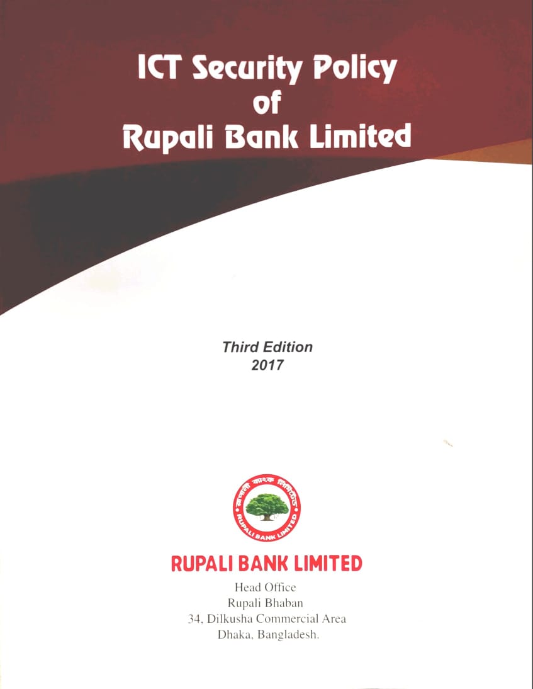
Agenda
Office of State Finance
Overview ICT Security Policy
Policy, Procedure, & Guideline
Tech. Architecture of Rupali Bank Ltd.
ICT Security Policy of Rupali Bank Ltd.
Vulnerability, Threat, & Risk
Present Security Control Measure
Branch Activities & Responsibilities

Slide 4
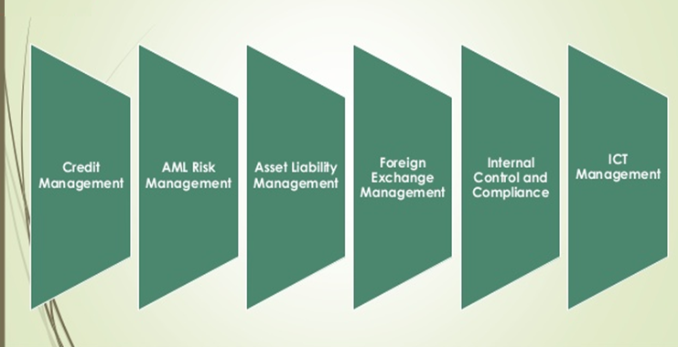
ICT Risk Management
Core Risks of a Bank

Slide 5
ICT Risk Management
RBL ICT Risk Management
ICT risk is the business risk associated with the use, ownership, operation, involvement, influence and adoption of ICT within RBL
ICT Risk consists of ICT related events and conditions that could potentially impact the business.

Slide 6
ICT Risk Management
Risk Management Functions
The risk management function should be consistent with ICT security policies and provide support for investigation of any ICT related frauds and incidents.
Identifying, measuring, monitoring, and controlling ICT risks.
Implementing an ICT organizational structure suitable to support the business activities of the institution.

Slide 7
ICT Risk Management
Risk Management Functions (Cont.)
Maintaining current documentation of the systems in place and developing a satisfactory understanding of how each of these systems supports the associated business processes.
Ensuring outsourcing to third-parties are consistent with strategic plans and appropriately managed.

Slide 8
ICT Risk Management
Categorization of banks/branches/units depending on ICT Operation
Three tiers depending on ICT setup and operational environment/procedures as:
Tier‐1: Centralized ICT Operation through Data Center (DC) including Disaster Recovery Site (DRS) to which all other offices, branches and booths are connected through WAN with 24x7 hours attended operation.

Slide 9
ICT Risk Management
Categorization of banks/branches/units depending on ICT Operation (Cont.)
Tier‐2: Head Office, Zonal Office, Branch or booth having Server to which all or a part of the computers of that locations are connected through LAN.
Tier‐3: Head Office, Zonal Office, Branch or booth having standalone computer(s).

Slide 10
ICT Risk Management
ICT Security Management
ICT Security Policy
Every bank having Information systems must have an ‘ICT Security Policy’ which must be fully complied with this ICT Security Guideline and be approved by the board of the bank.
Training and Awareness
Bank shall ensure that all relevant personnel are getting proper training, education, updates and awareness of the ICT security activities as relevant with their job function.

Slide 11
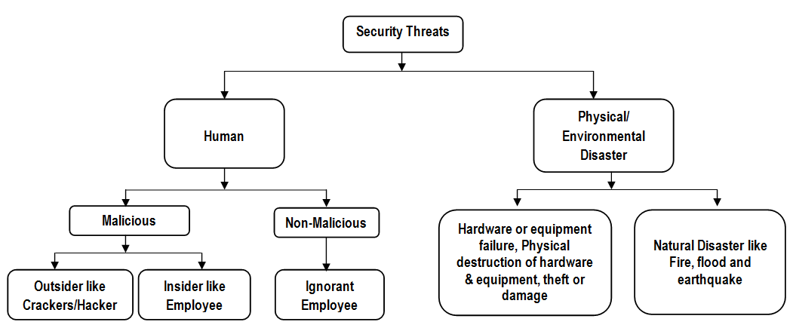
ICT Risk Management
Source of information Security Threats

Slide 12
ICT Risk Management
Source of information Security Threats
Types of Threats | Example | Prevention Strategy
Insiders Threats/ Attacks | An employee or worker with malicious intent to steal sensitive organization’s information, commit fraud or cause damage to systems or information. | Information Technology Use Policy - Staff & Other Authorized Users
Malware/ Software Attacks | Malicious software such as Virus, Worms, Trojan Horse, Macros, Denial-of-service, password Sniffing etc. | User awareness program Ensure baseline security of OS, Hardware, Software and Related component.
Physical attacks | Hardware or equipment failures, Physical destruction of hardware and equipments, theft or damage. | Approved Business Continuity Plan
Environmental attacks | Natural Disaster like Fire, flood and earthquake. | Approved Business Continuity Plan
Social Engineering | Phishing, Vishing and Cross-site scripting. | Internet and Data usages policy
Unauthorized Access | The attempted or successful access of information or systems without permission or rights to do so. | Information Technology Use Policy - Staff & Other Authorized Users
Email Attacks | Email spoofing, spamming and bombing and Sending malicious codes through email. | Email Policy. Use of Signature

Slide 13
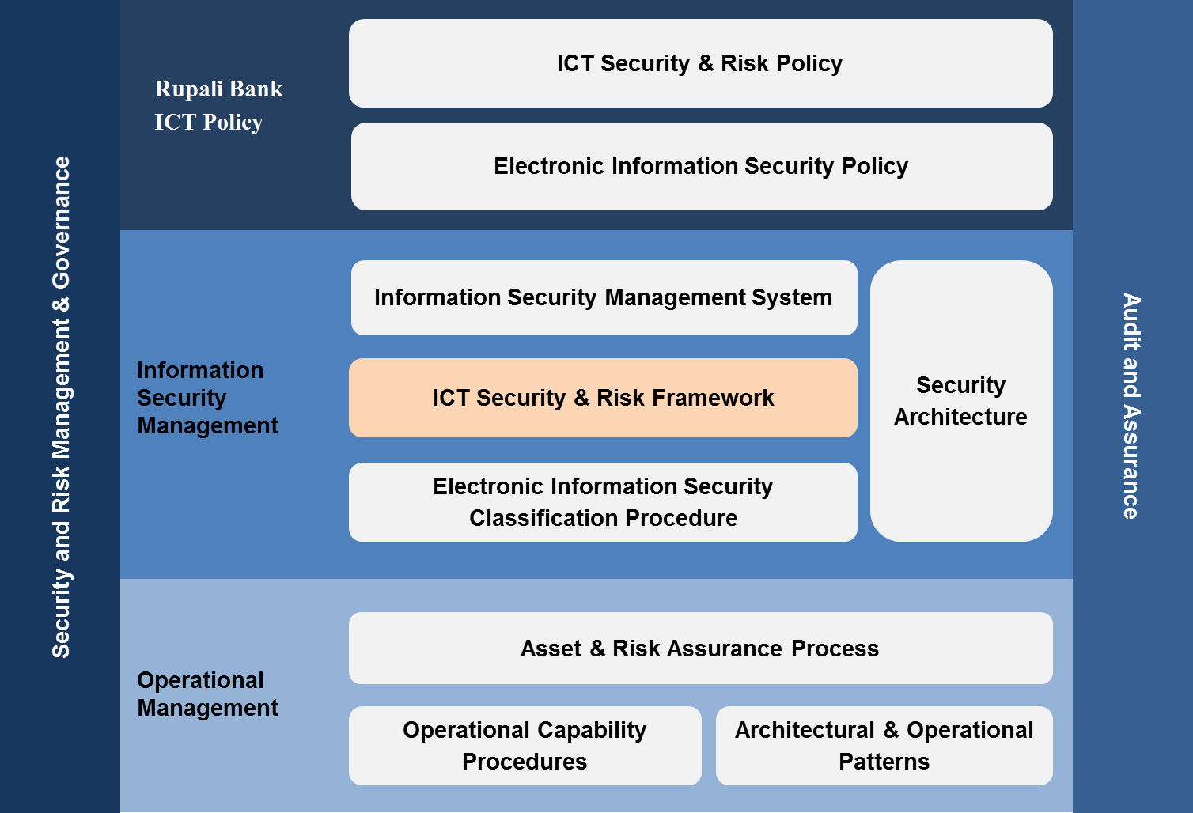
ICT Risk Management
ICT security and risk controls

Slide 14
ICT Risk Management
ICT security and risk controls
ICT Operation Management
Change Management
Asset Management
Request Management
Physical Security for Tier‐1
Data Center Access
Environmental Security
Fire Prevention

Slide 15
ICT Risk Management
ICT security and risk controls (Cont.)
Physical Security for Tier‐2
Server Room Access
Environmental Security
Fire Protection
Physical Security for Tier‐3
Computer Room Access
Environmental Security
Fire Protection

Slide 16
ICT Risk Management
Physical Security for Desktop and Laptop Computers Information Security Standard
Access Control for Information Systems
User ID Maintenance
Password Control
Input Control
Network Security
Data Encryption
Virus Protection
Internet and e‐mail

Slide 17
ICT Risk Management
Physical Security for Desktop and Laptop Computers Information Security Standard
Transactions through Alternative Channels
Services through Mobile
Internet Banking
Payment Cards
Software Development and Acquisition
In‐house Software
Outsourced Software
Vendor Selection
Software Documentation

Slide 18
ICT Risk Management
Physical Security for Desktop and Laptop Computers Information Security Standard
Business Continuity and Disaster Recovery Plan
Business Continuity Plan (BCP)
Disaster Recovery Plan (DRP)
Backup and Restore Plan (BRP)
Service Provider Management
Service Level Agreement (SLA)
Outsourcing
Cross‐border System Support

Slide 19
