Slide 1

Irregular Account Maintain
Md. Shahidur Rahman
Assistant General Manager
Rupali Bank Training Academy

Slide 2
What is Irregular Account ?
The Bank Account not operate Regularly.
Kinds of irregular Account
1. Dormant/ Inoperative Accounts
2.Unclaimed Account
3.Deceased Account
4.Suspenec Account
Notes:
01715488555

Slide 3
What is Irregular Account ?
When a constituent does not conduct his account properly.
Cheque have to be returned frequently for insufficient fund.
Drawing large amount of cheque but maintain a normal balance in his account.
Request
  Warning
    Maintaining Public Relation
      Finally close the Account
Notes:
01715488555

Slide 4
Dormant Account which has not been operated by the customer for a long period.
L.R Chowdhury
What is dormant Account ?

Slide 5

When a Account Became Dormant ?
A dormant account is an account that has had no financial activity for a long period of time, except for the posting of interest.

Slide 6
Dormant
Which Account will be Dormant
Savings Account, Current Account and any kind of Cheque bearing Account can be Dormant.
It is variable for Country and Types of Deposit.

Slide 7
Dormant Account
Current Account will be after 12 (Twelve ) Months
Savings Account will be after 24 (Twenty four)
Legacy Accounts to whom KYC is not completed are also considered as Dormant Account.

Slide 8
D.A Maintain Procedure
Cheque is Presented
  Manager will Personally deal and no action should be taken without his consent.
    No incidental charges will be charged.
    After satisfaction and proper inquiry this account should be converted into a regular account.
    Interest on Dormant/Inoperative Savings Bank Account will be credited as usual.

Slide 9
Restrictions of Dormant Accounts
No issue of a fresh cheque book
No new debit card
No access to internet banking
Once it becomes dormant, you can expect following additional restrictions:
No withdrawal of money from an ATM or a bank branch or through phone banking
No debit card renewal
No modification of Signatures
Not able to change address or email id or contact number
No addition or deletion of a joint holder

Slide 10
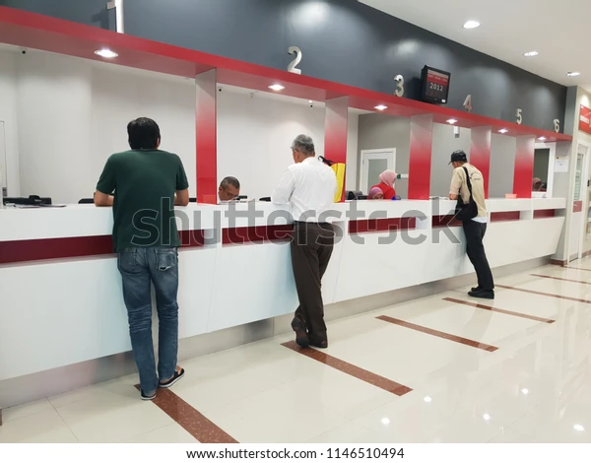
Prevent Account from Becoming Dormant?
The Easiest way to prevent account from becoming dormant is to make a small transaction regularly.

Slide 11

Dormant Account Reactivation
Communication
Application
Submit Update KYC
Make a Single transaction
Photo, I.D Card if needed.

Slide 12
Unclaimed Account
Five Years Current and Savings accounts ‘Dormant/inoperative
Three Years
  Overdue Fixed Deposits
  Demand Drafts
  T.T Payable
  M.T Payable
  Sundry Deposits
  Pay Orders and
  Call Deposits

Slide 13
Unclaimed Account
Any Instrument present for Payment all activities should be done under the supervision of manager
Account Opening Form and Signature card should be segregated from Dormant account.
As all unclaimed account shall be treated as Current accounts, therefore no interest shall be paid to it.
Bank will have to submit the unclaimed fund and assets to the Central Bank
Two years later the BB will transfer those to Government Account.

Slide 14
Fund Submission Process
To Be send a registered letter with Acknowledgement Receipt
To be given three months to reply the letter
If not any reply submit the fund and assets to BB in April of every calendar year.
After transferring the fund and assets, Bank will have to publish advertisements in at least two newspapers once every three month for a year.
If any claim comes bank will have to submit the client application
Along with other Documents to BB.
After 12 (twelve) years no claim is Acceptable.

Slide 15
Unclaimed Account Timeline
For Fixed Deposit: Expiry date to 10 (Ten) years
For other Deposit : Last transaction or Last account statement received Date to 10 (Ten) years.
For Assets : Last visiting Date to 10 (Ten) years

Slide 16
Standing Instructions
A standing order (or a standing instruction) is an instruction a bank account holder ("the payer") gives to their bank to pay a set amount at regular intervals to another's ("the payee's") account. The instruction is sometimes known as a banker's order.

Slide 17
Types of Standing Instructions
Standing Payment Order
Standing Collection Order
Account Sweep (Sweep in and Sweep out )
Variable Payment
Range Balancing Sweep

Slide 18
Types of Standing Instructions
According to Guidelines on Core Banking Solution (CBS)
1.9.1 Automatic Sweep/Standing Instruction Facilities
I. System shall be able to transfer of fund from one to many, many to one, many to many and one to one based on clients instruction(maintaining minimum Balance/Fixed Amount)or tenure-wise.
ii. Sweep transactions may be both push and pull (i.e. sweep-in and sweep-out)
iii. Frequency of sweep / SI shall be daily/weekly/fortnightly/ monthly/set date or in transaction event based.

Slide 19
Disposal of Deceased Account
Deceased Account is Two Types according to Nominee
1. With Nominee
2. Without Nominee

Slide 20
Payment to Nominee
Essentials are as Bellow
Application
Death Certificate (Local /Foreign applicable)
NID/SMART CARD/Passport/Driving License/Birth Certificate
Identification Certificate from Two valuable clients/ Bank officer/Public Representative on behalf of Nomination and introduction of Nominee.
Passport size colored Photo duly Signed by Nominee

Slide 21
Payment to Nominee
Cont---
Essentials are as Bellow
Indemnity Bond with two witness
Unused Cheque Book , Debit Card, Deposit Receipt(FDR)
Approval From Higher Authority if Beyond of Manger’s Business Delegation
Clearance of Loans And Advance.
Payment By Bank Account or Pay order

Slide 22
Deceased Account without Nominee
Application of the successor
Death Certificate
Succession Ceftificare
NID/Smart Card/Passport/Driving License/Birth Certificate(Attested by Public Representative) Coloured attested photo with name(Attested by Public Representative)
Unused Cheque Book, Debit Card , Deposit Receipt(FDR) etc
Indemnity bond in non Judicial stamp with two witness by the Successor.

Slide 23
Deceased Account without Nominee
Indemnity Bond from a Valued Customer
Clearance for Loan and Advance
Receiving Successor Bank account
Legal opinion From Panel Layer(IF needed)
Approval from Higer Authority(If needed)
Letter of Administrator (If needed)

Slide 24
Suspense Account
Advance Rent
Demand Draft Paid without Advice
Interest Receivable
Accrued Income
Sundry Debtor
Foreign Draft Paid without Advice
Pension Paid to Retired Person
Protested Bills

Slide 25
Sundry Deposit Account
Hajj Deposit
L/C Margin
Guarantee issue Margin
Income Tax
Key Deposit
Staff Security Deposit
Interest Payable in Different Deposit Account

Slide 26
Sundry Deposit Account
Excise Duty Payable account
Source Tax
Sundry Creditor
Interest Suspense on Bad and Doubtful Account
Foreign Bills Receivable
Vat on L/C commission
Vat

Slide 27


