Slide 1
An Overview of
NIKASH – BEFTN & New BACPS Software
MD. FARDAUSUR RAHAMAN
Senior Principal Officer
BACH Program, Rupali Bank Ltd.
Local Office, Dhaka.

Slide 2

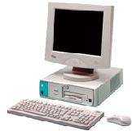

Why BACH / NIKASH-BEFTN
A modern Payment System; Essential for Economic Growth and Development of a Country.
m-payments
EFT
e-payments (EFT)
IVR
ATMs & POS
Cards
Barter
Cash
Cheque

Slide 3

BACH Overview
BACH Programme launched in banking sector in 2010.
# BACPS (Bangladesh Automated Cheque Processing System)
launched from 7th October 2010.
# BEFTN (Bangladesh Electric Fund Transfer Network)
launched from 28th Feb. 2011.
# Bangladesh Bank Upgraded above BACH software which is known as BACH-II Starts from 24.10.2019.
# Rupali Bank providing BACH service for it’s customer with 221 Truncation Point & 586 branch.

Slide 4
Bangladesh Automated Clearing House (BACH)
BACH
BACPS
Bangladesh Automated Cheque Processing System
NIKASH-BEFTN
Bangladesh Electronic Fund Transfer Network
High Value/Same Day
Regular Value
Credit Entry
Debit Entry

Slide 5
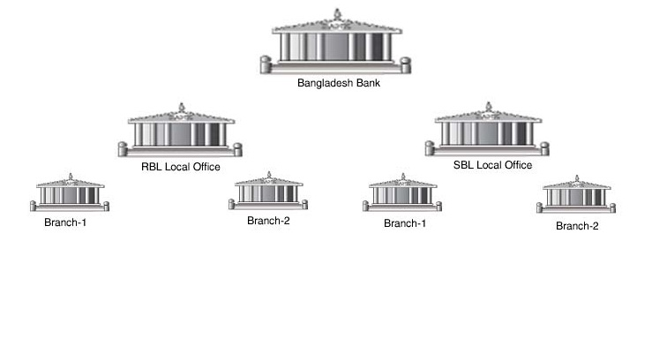
BACH Transactions Flow:-

Slide 6
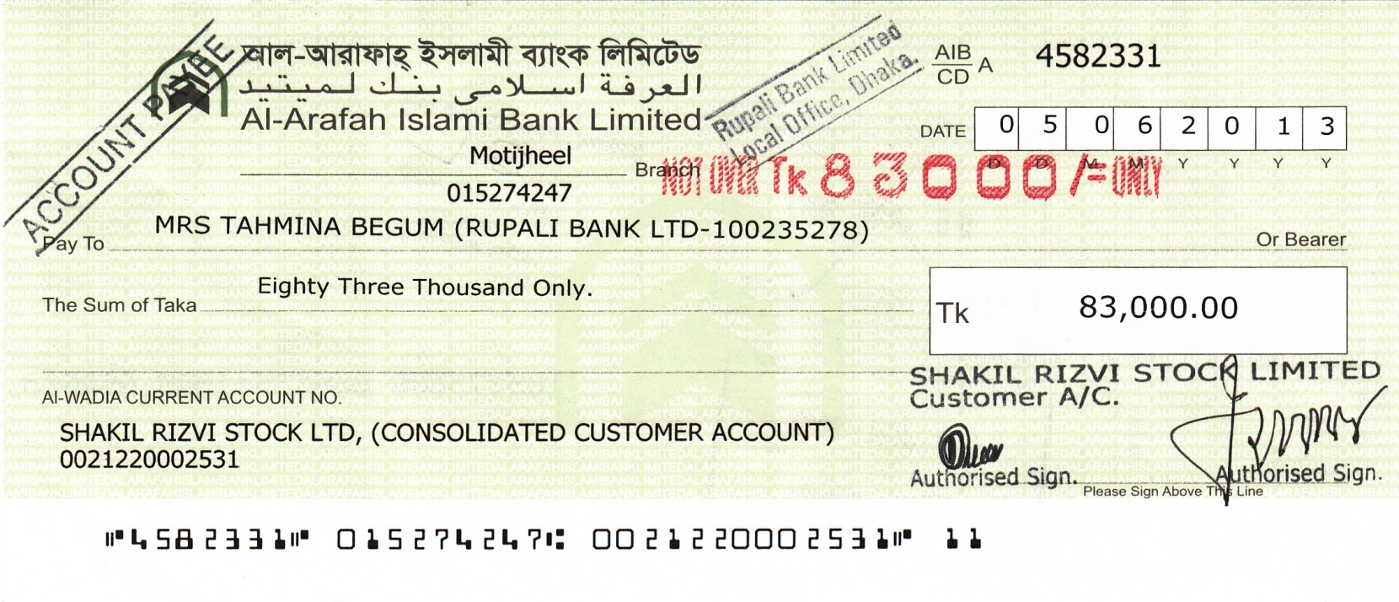
MICR Cheques:
The new cheques contain Magnetic Ink Character Recognition (MICR) line which has been formulated to provide information on Cheque Number (7 digits), Routing Number (9 digits), Account Number (13 digits) and Transaction Code (2 digits). These information on MICR line will be read electronically by machines and transmitted with the corresponding images using prescribed software and hardware electronically. Following is the composition of MICR line of the new cheques – Routing Number, an essential component of the MICR line, is newly formulated numeric code for easy identification of bank-branch of a cheque’s origin. Transaction Code is a numeric code to identify different types of payments.
Cheque No(7 digits), | Routing Number(9 digits), | Account Number(13 digits) | Transaction Code(2 digits). | Amount
4582331 | 015274247 | 0021220002531 | 11 | 83000.00

Slide 7
Routing Number:-Routing Number is 9 digits number allocated by Bangladesh Bank for each branch of every bank .
1st 3(three) Digits in Routing Number
assigned as Bank Code:
Name of Banks | Routing Number
Sonali Bank | 200
Janata Bank | 135
Agrani Bank | 010
Rupali Bank | 185
Next 2(Two) digits used in Routing Number
as District Code:
Name of Banks | Routing Number
Dhaka | 26,27
Chittagong | 15
Sylhet | 91
Barisal | 06
Next 3(Three) digits used in Routing Number is Branch Code & last digit a check digit generated by computer . Some Example of routing number of different branches.
Name of Branches | Routing Number
RBL Local Office, Dhaka | 185273886
ABL, Bandar Bazr, Sylhet, | 010610193
SBL, Uttara Model town, Dhaka | 200264604
JBL, Barisal Corporate | 135060344

Slide 8
CHEQUE PHYSICAL SECURITY STANDARDS…
Watermark
Microprint
Magnetic Ink
Erasable Inks (for Cheque Background)
Invisible UV Fluorescent
Chemical Sensitivity

Slide 9
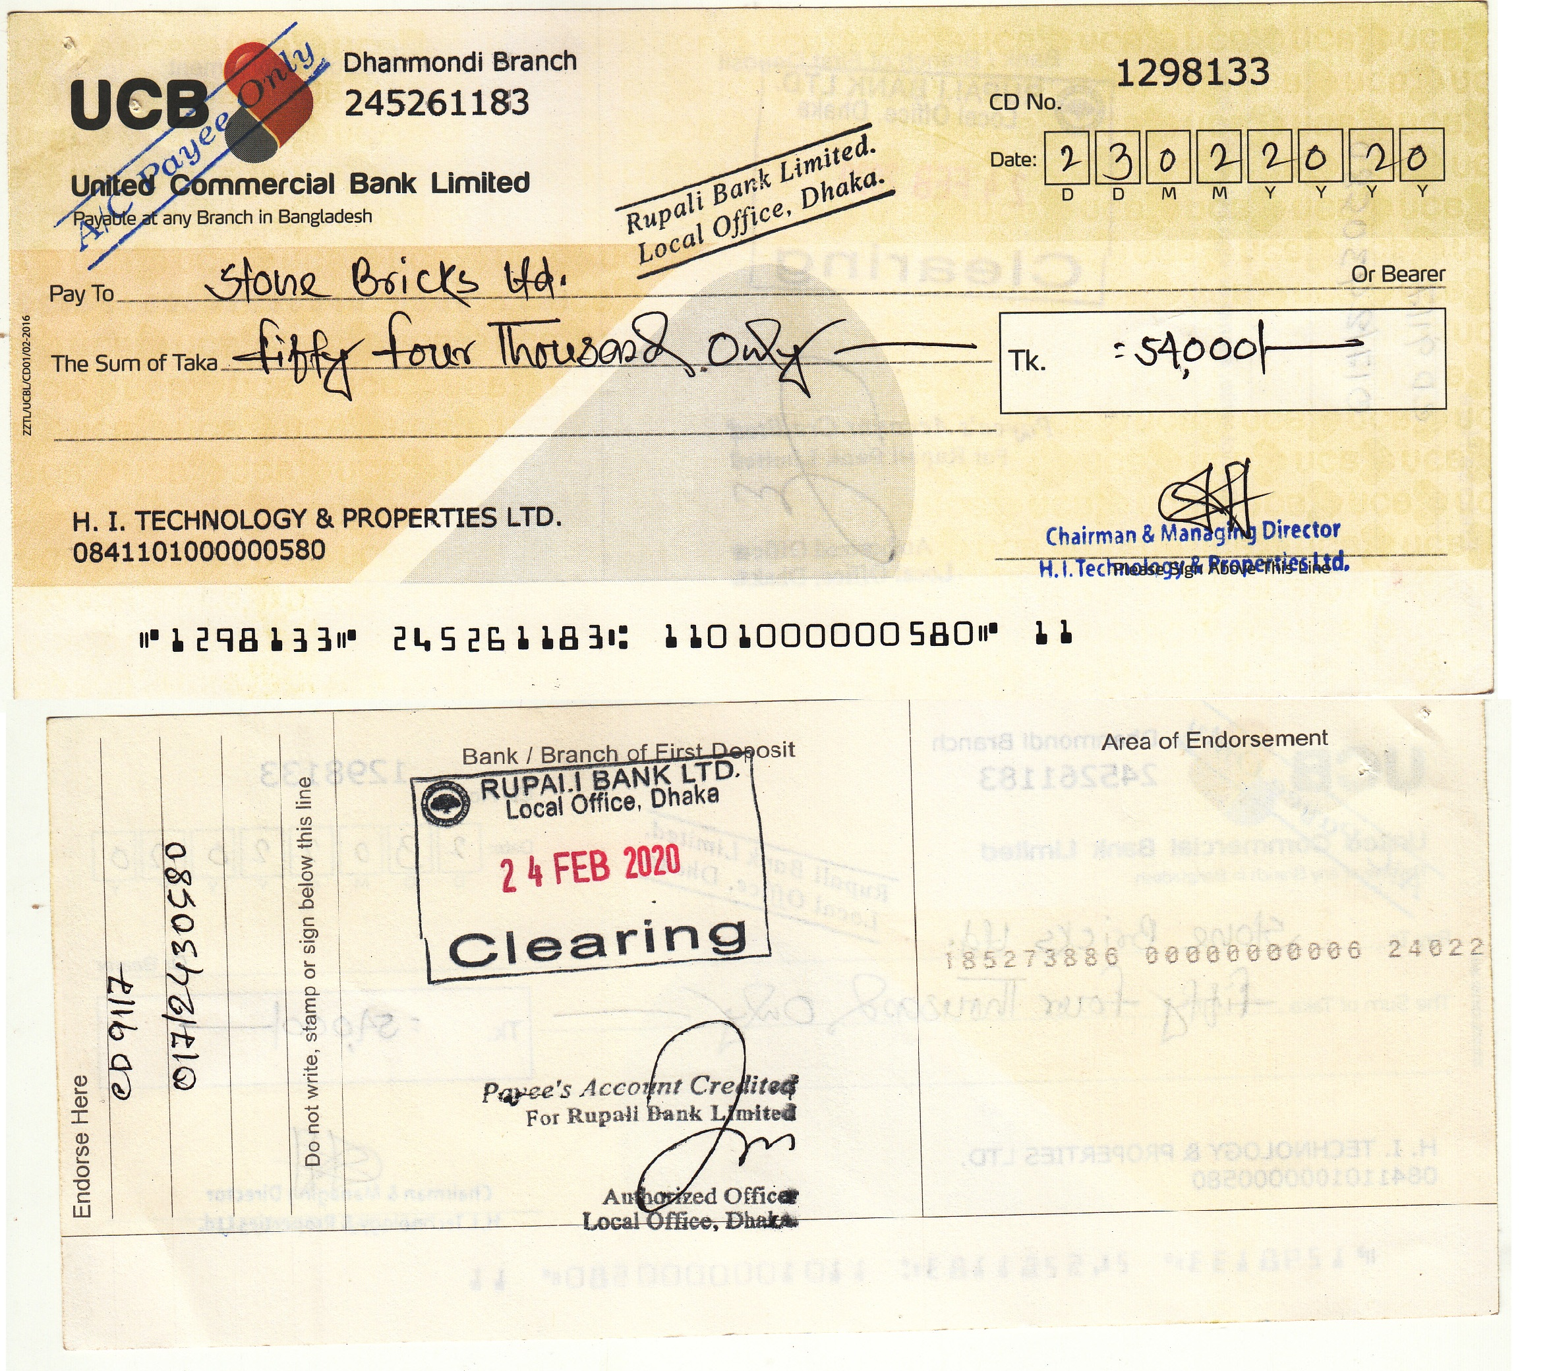

Slide 10


BACPS
Bangladesh Automated Cheque Processing System
Scanman
Br. Level/TP
Maker
Br. Level
checker
Br. Level
other bank
Admin
PBM (BB) Settlement/Report
Admin
Rbl Admin

Slide 11
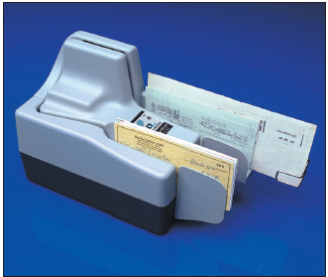
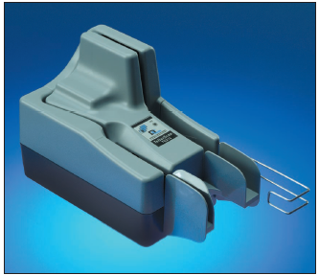
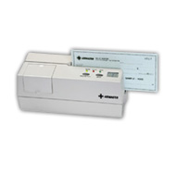
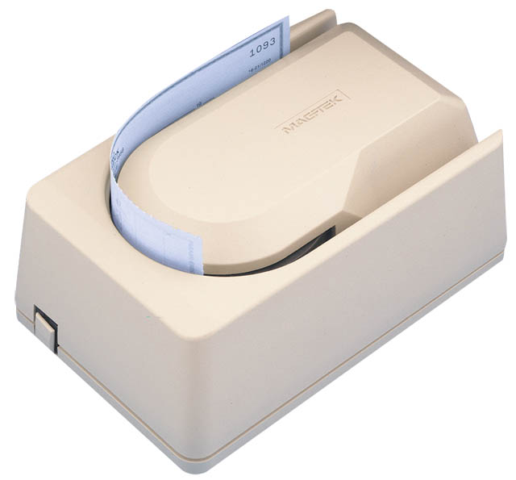
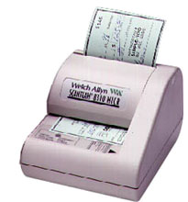
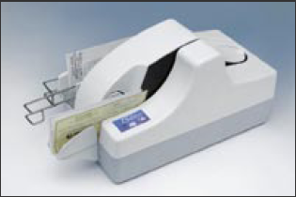
MICR Reader:

Slide 12
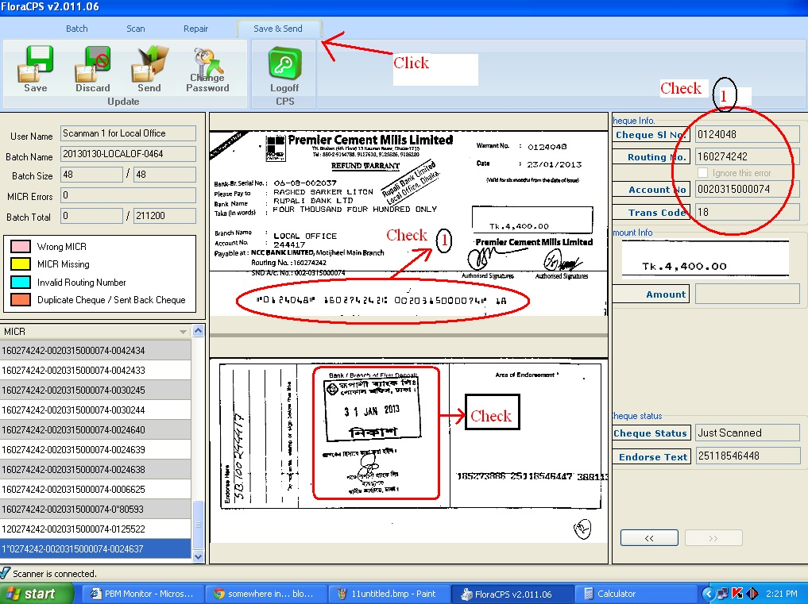

Slide 13
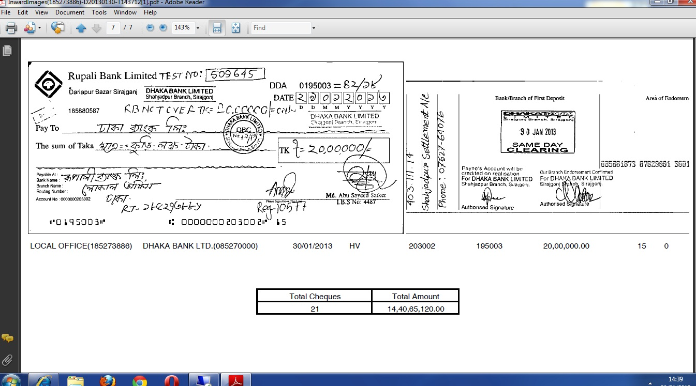
Image & Data at Paying Bank

Slide 14
Presenting Banks Responsibilities
By presenting an approved BACPS-Eligible item for payment to the Bangladesh Bank, the participating Bank:
agrees to comply with the applicable BACPS rules and agrees that those rules govern the relationship among all of the participants.
certifies that the front and back images of the BACPS-Eligible item is a copy of the original negotiable instrument;
It shall be duty of the presenting bank to verify prima facie genuineness of the cheque that can be verified with due diligence and ordinary care. The presenting bank shall be responsible for detecting the following:
  genuineness of the of the cheque leaf
  material alteration of the payee name, amount or date.
In such cases where grunginess can not be verified or material alteration is detected; the presenting bank should not submit such cheque(s) to BACPS
aggress within seven calendar days to make the original negotiable instruments available for inspection during normal business hours, if requested by the paying bank
Upon realization of the proceeds the bank shall pass the same to their customer account on the date of settlement subject to completion of the return session or internal rules of the bank
If requested by the participating bank, failure to present the original negotiable instrument will result in non-payment of the instrument. The original instrument will remain with the paying bank after the instrument has been available by the presenting bank;
Authorizes the Bangladesh Bank holding the Bank’s settlement account to credit the amount for cheques presented to the Bank’s settlement account on the settlement date and
Agrees to indemnify the Bangladesh Bank processing or setting for the item for any loss or expense( including attorney fees and expenses of the litigation) incurred by the Bangladesh Bank as a result of presenting Bank’s negligence or non compliance with any of the clauses of the BACPS Operating Rules and Procedures with respect to the presented item.

Slide 15
Paying Banks Responsibilities
Transmission of Posting Files
Digital signature Validation
Payment Processing
Retuned Cheques in Time
Request for Paper
Internal Control
Reconciliation of Clearing Difference

Slide 16
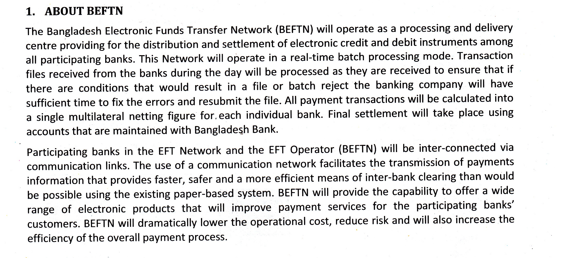
Bangladesh Electronic Funds Transfer Network (BEFTN)
Electronic credit and Debit instructions…

Slide 17
Bangladesh Electronic Fund Transfer Network (BEFTN)
BEFTN
BEFTN Inward/Outward Credit
BEFTN Inward/Outward Debit

Slide 18
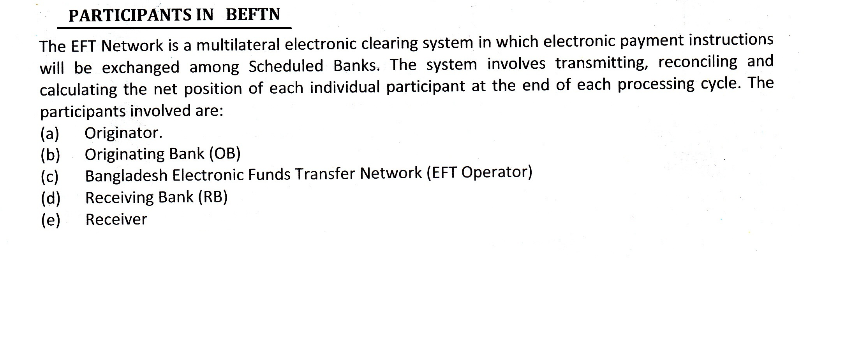

Slide 19
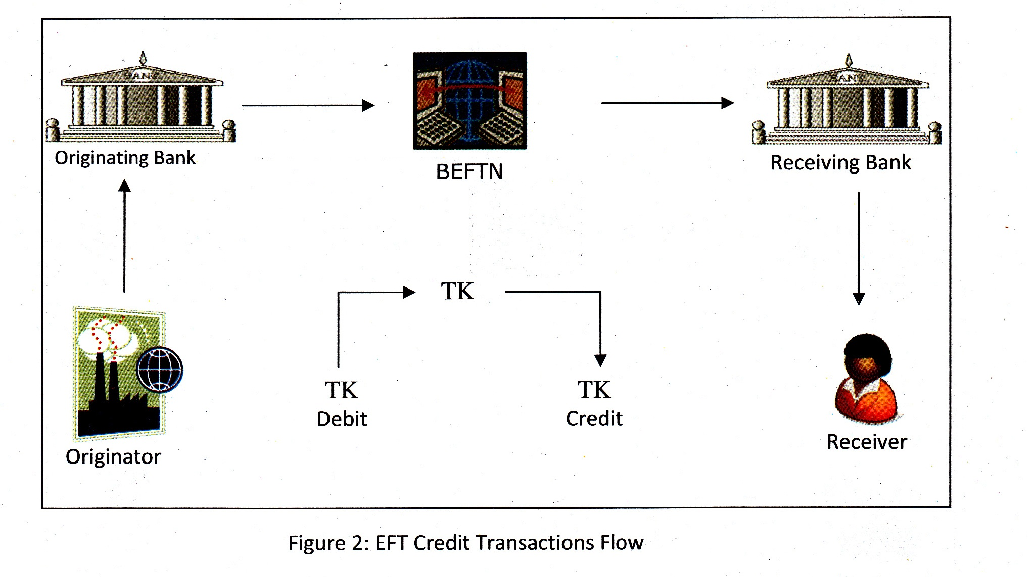
EFT Credit Transactions Flow..

Slide 20
BEFTN Transactions Flow:-
Ex Co
KSA
Beneficiary
NRB

Slide 21
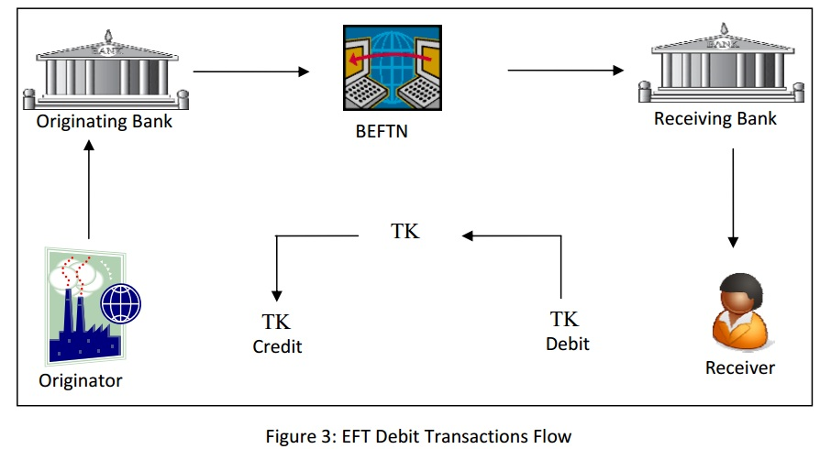
EFT Debit Transactions Flow..

Slide 22
Some examples of credit entries are: | Some examples of EFT debit entries are:
•Inward Foreign remittances •Domestic remittances •Payroll private and government •Dividends/Interest/Refunds of IPO •Business to business payments (B2B) •Government tax payments •Government vendor payments •Customer‐initiated transactions | •Utility bill collection •Equal Monthly Installments (EMI) collection •Government tax collection •Government license fees collection •Insurance premium collection •Mortgage payments collection •Club/Association subscriptions collection

Slide 23

BEftn
Bangladesh Electric Fund Transfer Network
Maker
File Create/upload
checker
File Authorize
other bank
Admin
PBM (BB) Settlement/Report
Admin
Rbl Admin

Slide 24
New NIKASH BEFTN Software
Bangladesh Bank is going to inaugurate NIKASH BEFTN app as replacement of BACPS & BEFTN (28th August2023).
Rupali Bank also replacing BACPS & BEFTN app Developed by CBS Vendor M/S Sonali Intellect integrated with NIKASH BEFTN of Bangladesh Bank.
As a result Branch User will Experience of some new way to originate, return of BACH Instrument & posting to CBS.

Slide 25
What’s New in NIKASH BEFTN
Session :
Existing BACH has only 02 (two) Session, but in
New NIKASH BEFTN app will have 04 (four) Session.
Outward File Originate :
Outward Files originated by Flora BACH app in Existing system but in New NIKASH BEFTN Outward Files will be originated by CBS software .
Outward File Posting :
Outward Files posted manually in CBS app in Existing system but in New NIKASH BEFTN Outward Files will be Posted by CBS software .

Slide 26
What’s New in NIKASH BEFTN
Inward File Receiving :
Inward Files received by Flora BACH app in Existing system, but in new NIKASH BEFTN app inward files received by CBS app.
Inward File Posting :
Inward Files posted in CBS Manually, but in in new NIKASH BEFTN app inward files will be posted automatically by CBS app.
Posting Gateway :
Using Existing Flora BACH app All vouchers are posted Manually.
New NIKASH BEFTN app will post All vouches automatically.

Slide 27
What’s New in NIKASH BEFTN
Outward Operation:
Using Existing app Branch will first post in CBS Manually, then submit/upload files in BEFTN app. But in new NIKASH BEFTN app files will be posted automatically by CBS app.
Inward Operation:
Inward Files first Downloaded from existing Flora BEFTN app Manually, but in in new NIKASH BEFTN inward files will be posted automatically by CBS app.
Handling Return:
Branch has to confirm A/C details from CBS Manually, but in new NIKASH BEFTN app CBS will confirm about A/C & posted automatically by CBS app.

Slide 28
Differences between Existing FLora BEFTN with new NIKASH BEFTN
Scanman, Maker, Checker :
All above process done by Truncation Point Branch only.
Scanman process done by TP but Maker & Checker process done by respective Branches.
Settlement :
Settlements are done with TP Branch by Local Office(BACH).
By new NIKASH BEFTN settlements will be done with all respective branches by Local Office(BACH).
Dependency :
Non TP Branch depends on TP Branch for Clearing process & Net settlement. by Local Office(BACH).
Non TP Branch depends on TP Branch for Scan man process only.

Slide 29
Differences between Existing FLora BEFTN with new NIKASH BEFTN
Clearing Collection Account:
In Existing Flora BEFTN TP Branch & Not TP Branch has to use Clearing Collection Account for settlement with each other & at the year end excise duty imposed on that Account.
But in new BIKASH BEFTN settlement of 586 Branch will be directly done by Local Office (BACH) with respective Branches.
Outward process :
Outward File process by Flora BEFTN & posted to CBS manually in existing system. But in new BIKASH BEFTN all outward file processed & posted to CBS will be automatically.

Slide 30
Differences between Existing FLora BEFTN with new NIKASH BEFTN
Inward process :
Inward BACPS /BEFTN Files download from existing Flora BEFTN app. & posted to CBS manually .
But in new BIKASH BEFTN all process will be done by CBS app.
Reports /Settlement :
Branch has to depend on Flora BEFTN & CBS for Report & Settlement in existing system.
But in new BIKASH BEFTN all Report & Settlement will be automatically by CBS.
Time Consumsion:
Using existing Flora BEFTN app user have work in two system (Flora BEFTN & CBS ), so extra time required.
But in new BIKASH BEFTN all process will be done by CBS app.

Slide 31
Legal Framework
The EFT process operates from beginning to end through a series of legal agreements. Before any transaction is initiated via EFT network, the originator and OB execute an agreement to use BEFTN to originate payments. Among other things, the agreement should bind the originating company or individual to the BEFTN Rules, define the parameters of the relationship between the two parties, and identify processing requirements for the specific application(s), and establish liability and accountability for procedures related to certain application(s).
Other laws/regulations that have a direct bearing on EFT operation are listed as under:
• Bangladesh Bank Order, 1972 (Amended 2003)
• The Banks Companies Act, 1991
• Money Laundering Prevention Act, 2009
• Information and Communication Technology Act, 2006.
• The Bankruptcy Act, 1997
• The Foreign Exchange Guidelines, Volume 1 & 2.
• Foreign Exchange Regulation Act, 1947.
• The Bangladesh Telecommunication Act, 2001.

Slide 32
Thank You

