Slide 1

All About Bank Cheques
Presented By
Sharmin Rahman
Principal Officer
Rupali Bank Training Academy

Slide 2
What is a Cheque?
Negotiable Instrument Act, 1881 (Section-06)
A “cheque” is a bill of exchange drawn on a specified banker and not expressed to be payable otherwise than on demand.

Slide 3
Features of Cheques
It must It must be in writing.
contain an express order to pay.
The order to pay must be definite and unconditional.
It must be signed by the drawer.
The sum contained in the order must be certain sum.
The order must be to pay money only.
Three parties (drawer, drawee and payee) must be certain.
It is always drawn upon a specified banker.
It is always payable on demand
. Cheque must mention exact amount to be paid
. Cheque has 3 parties : Drawer, Drawee & Payee
Drawer : A drawer is a person, who draws a cheque.
Drawee : A drawee is a bank on whom a cheque is drawn.
Payee : A payee is a person in whose favour a cheque is drawn.

Slide 4
Things to check before payment
When a customer hands you a check, look to make sure the following information is on it:
Payer name and address.
Payee name (i.e., you or your business)
The amount being paid, written out.
Bank information (e.g., name, logo, website, address)
Note about the purpose of the payment.
The bank routing number.
Check number.
Date.

Slide 5
Precautions
Check that the cheque is within the validity period printed on the cheque book;
Observe the pre-printed mentions on the cheque;
Write only in the spaces that are to be filled in, without going outside these spaces;
Check that the account has sufficient funds available to pay the cheque;

Slide 6
We Need Printed Form for Cheque
■Fulfill all Conditions for Writing a Cheque
■Easiest Way for Record Keeping
Parties of Cheque
Drawer → Account Holder
Drawee → Bank Branch
Payee- → Beneficiary

Slide 7
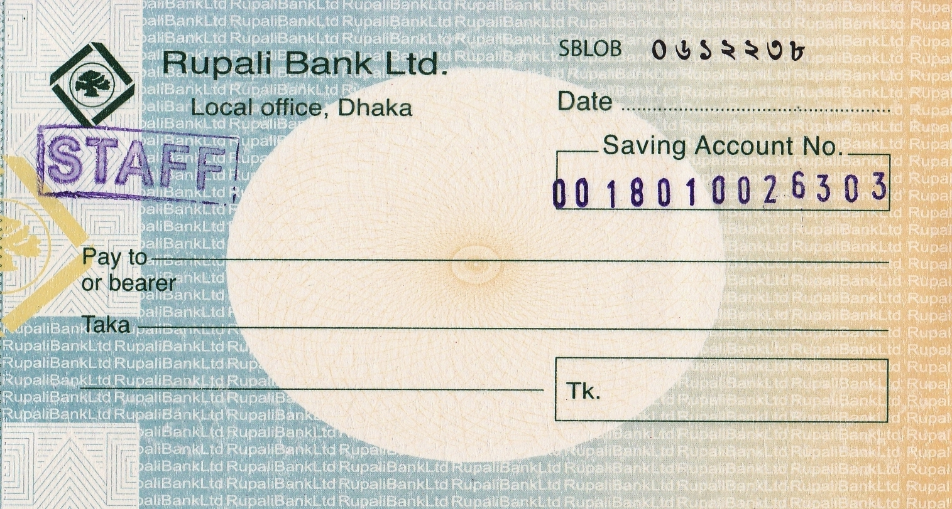

Slide 8
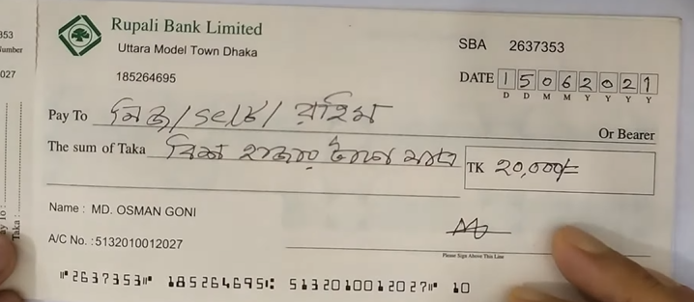

Slide 9
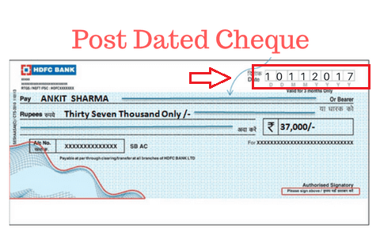
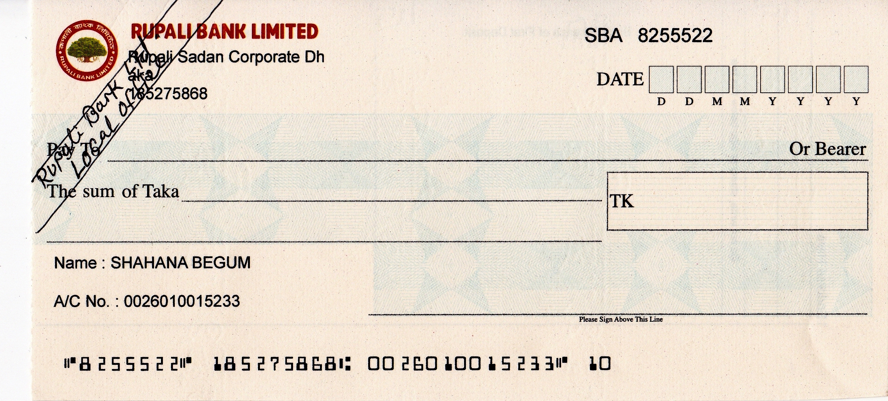

Slide 10
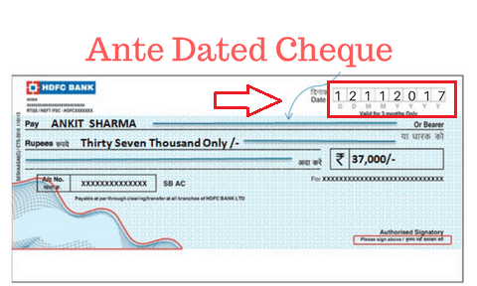

Slide 11
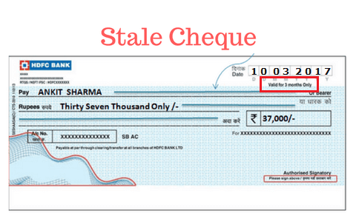

Slide 12
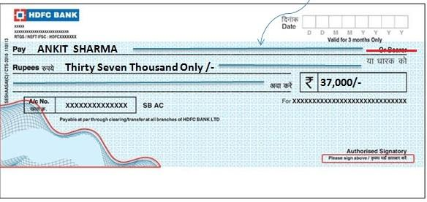
Undated Cheque

Slide 13
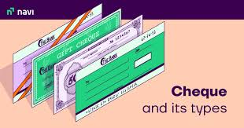
Types of Cheques

Slide 14
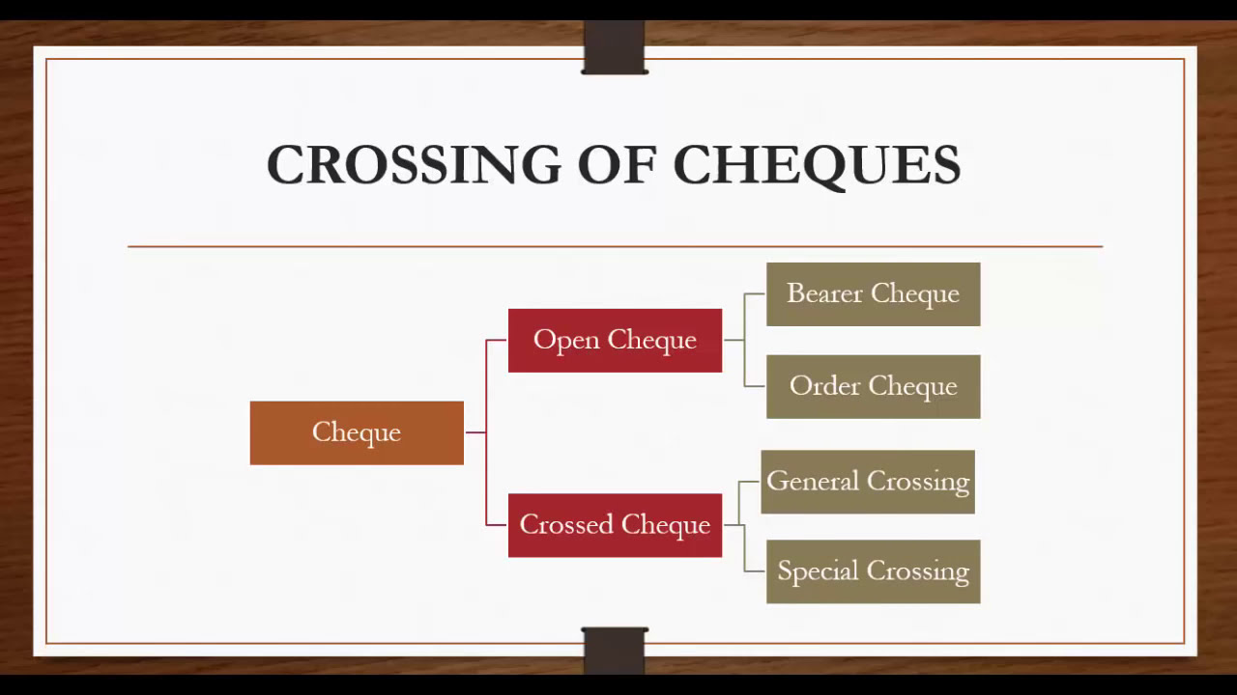

Slide 15
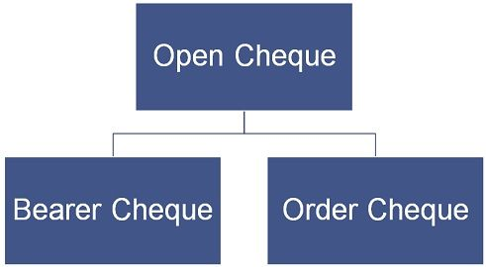

Slide 16
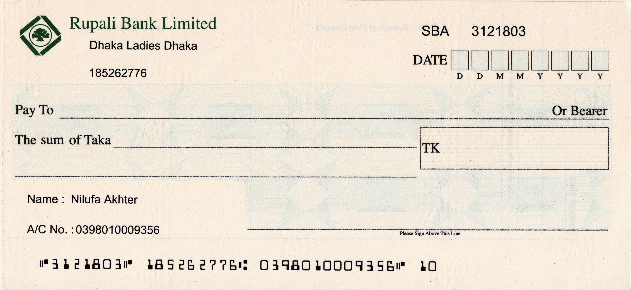
Open Cheque

Slide 17
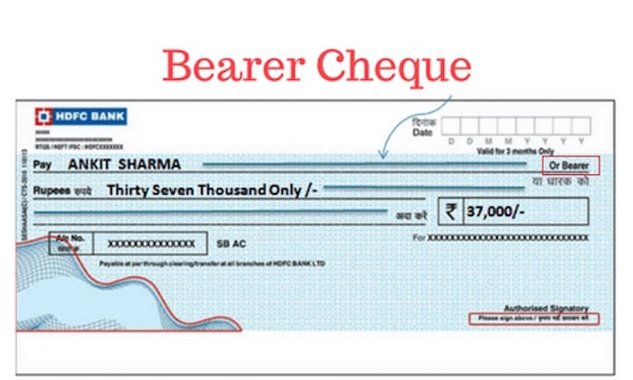

Slide 18
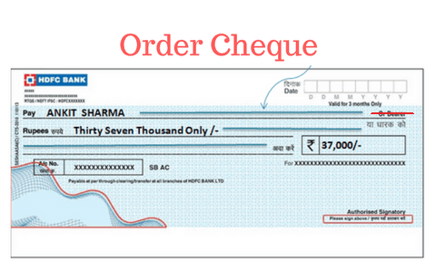

Slide 19
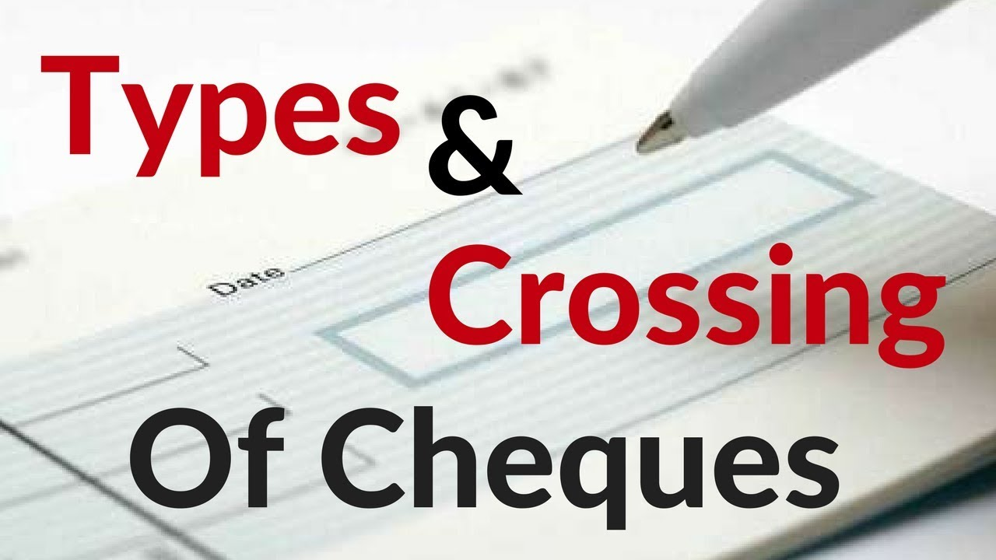

Slide 20
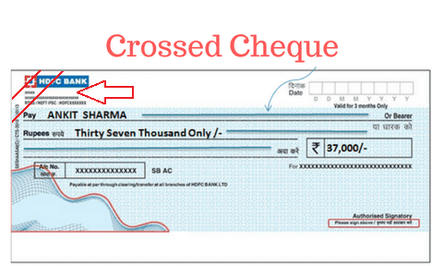

Slide 21
General Crossing

Slide 22
Special Crossing

Slide 23
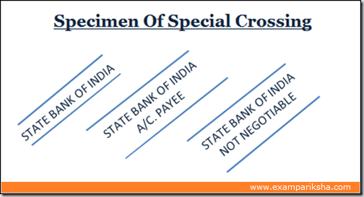

Slide 24
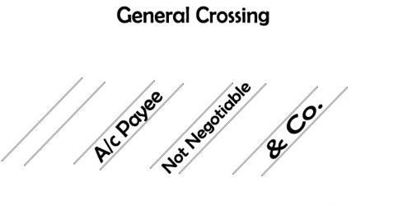

Slide 25
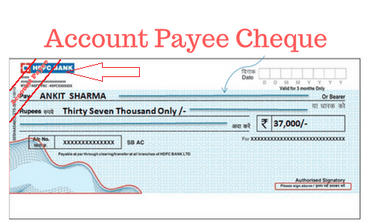

Slide 26
Reasons Why Cheque Dishonoured Or Bounced
Dishonoured cheques that a bank on which is drawn declines to pay (“honour”). There are a number of reasons:
Insufficient Funds
Material Alterations
Irregular Signature
Post-dated cheque
State cheque
‘Stop payment instructions’.
Frozen account
Account closed etc.

Slide 27
Dishonour of Cheque Laws in Bangladesh
According to Section 138 of the Negotiable Instruments Act, 1881 (“NI Act”), if a person draws a cheque on a bank account he or she maintained for the payment of any amount of money to another person and the bank returns the cheque as unpaid because the account balance is either insufficient to honour the cheque or the amount written on the cheque exceeds the amount agreed to be paid from that account by an agreement made with the bank, then such person shall be deemed to have committed an offence.

Slide 28
Recipient must first meet the requirements listed below in order to file the lawsuit:
*Presenting the cheque before the bank
*Obtaining the Dishonour Slip (within 30days)
*Legal Notice:
Legal Notice:
After receiving the bank’s Dishonour Slip, the recipient of the cheque must send a legal notice by registered mail to the drawer of the cheque demanding payment within 30 days of receiving such notice. The NI Act allows the Recipient of the Cheque to launch a criminal case against the drawer of the Cheque if the drawer fails to pay the Recipient within 30 days of receiving such notice.

Slide 29
For the purpose of filing a lawsuit under the NI Act, the Recipient of the Cheque or the Complainant must possess the following documents:
The Cheque
Dishonour Slip
Copy of the Legal Notice
Postal Receipt of the Legal Notice
Acknowledgment Due of the Legal Notice
Penalties
The penalty for this offence is one (1) year of imprisonment or/and a fine up to three times the amount of the cheque. It is also important to note that separate cases must be filed for each dishonoured cheque.

Slide 30
Positive Pay Instruction
Usually, a Positive Pay Instruction contains; Customer Account number and name. Name of the person or institution to whom the cheque was paid. Name of the bank through whom the cheque will be placed on Bangladesh Automated Clearing House (BACH). The amount which is mentioned on the cheque.

Slide 31

1 Lakh & Above
5 Lakh & Above

Slide 32
Commerical paper
Promissory note
Demand Draft
Cheque
Quiz
Q 1) What is an order to a bank to pay a stated sum from the drawer's account, written on a specially printed form ?
a) Commerical paper b) Promissory note c) Demand Draft d) Cheque
Q 2) What is the name of the cheque which is payable to a person who so ever having it ?
a) Blank cheque b) Bearer cheque c) Stale cheque d) order cheque
Q 3) What is the name of the cheque which is more than 6 months old ?
a) Multilated cheque b) Open cheque c) Stale cheque d) crossed cheque
Q 4) What is name of the cheque which bears date later than date of issue ?
a) Stale cheque b) Ante-dated cheque c) Post-dated cheque d) Order cheque
Q 5) What is known as alteration of date ,name of payee , sum payable on cheque ?
a) Cheque alteration b) Material alteration c) Instrument alteration d) Negotiable alteration

Slide 33
Q 6) Which of the following is needed to prevent the cheque to fall into the hands of wrong or unauthorized patners ?
a)A/c payee only cheques b) General crossing cheques c) Special crossing cheques
d) All the above
Q 7) Which of the follwing is not special circumstance where bank can withheld payments ?
a)Insane customers b)Rich customers c)countermanding d) insolvent drawers
Q 8) Which of the following is not a party of cheque ?
a) Drawer b) Drawee c)Payee d)Writer

Slide 34


