Slide 1
Assessment of Credit worthiness of borrower/ Borrower Selection Process
Md. Nizam Uddin
Deputy General Manager
& Head of Branch
O. R. Nizam Road Corporate Branch
Chittagong
E-mail: nizamshahriar@gmail.com

Slide 2
Assessment of Credit worthiness of borrower
Definition
Creditworthiness measures how deserving a loan applicant is to get a loan sanctioned in his favor.

Slide 3
Assessment of Credit worthiness of borrower
Definition
Credit Worthiness reflects a person’s, company’s, or entity’s ability to pay back a debt.

Slide 4
Assessment of Credit worthiness of borrower
Definition
In other words, how likely they are to repay a loan by meeting their financial obligations.

Slide 6
Assessment of Credit worthiness of borrower
To measure the credit worthiness of borrower the following factors may be considered:
5 Cs 5 Ps 5 Ms 5 Rs
Character Person Man Reliability
Capacity Purpose management Responsibility
Capital Product Money Resources
Condition Place Materials Respectability
Collateral Profit Market Returns

Slide 7
Assessment of Credit worthiness of borrower
To measure the credit worthiness of borrower 3cs are considered as main factors.
Character
Capacity
Capital

Slide 8
Assessment of Credit worthiness of borrower
Character
Implies personal qualities like i) Honesty ii) Integrity iii) Promptness iv) Business reputation, etc .
A man of good character will be very prompt in setting his account.
Study of his past transactions with the banks.

Slide 9
Assessment of Credit worthiness of borrower
Capacity
Depends upon technical/Managerial experience.
Effects the repayment schedule.
Ability, competence and the personal experience of the entrepreneur reflects the nature of his business transactions.

Slide 10
Assessment of Credit worthiness of borrower
Capital
Adequate funds.
Worthwhile funds to the business.

Slide 11
Assessment of Credit worthiness of borrower
Credit worthiness assessment Chart
CHARACTER + CAPACITY + CAPITAL = SAFE CREDIT .
CHARACTER + CAPACITY + INSUFFICIANT CAPITAL = FAIR CREDIT RISK.
CHARACTER + CAPACITY - CAPITAL = LIMITED SUCCESS .
CHARACTER + IMPAIRED CAPACITY + CAPITAL = DOUBTFULL CREDIT RISK.
CAPACITY + CAPITAL - CHARACTER = DANGEROUS RISK .
CHARACTER + CAPITAL - CAPACITY = INFERIOR CREDIT RISK.
CAPACITY - CAPITAL - CHARACTER = FRADULENT ONE .

Slide 13
Borrower Selection Process
Borrower selection is the basic and most essential part of credit investigation. Every prudent banker investigates loan proposals to confirm Safety, Liquidity, and Profitability of their concern. Among safety; liquidity and profitability, one should not be sacrificed for another.
Commercial Bank will carefully analyze and consider common 7 factors before sanctioning loans to its customers.
1) Liquidity.
2) Profitability.
3) Safety and Security.
4) Purpose.
5) Sources of Repayment.
6) Diversification of Risk.
7) Social Responsibility.
Though it is near to impossible to declare that a specific borrower will never default because there are lots of grounds exist to default a loan, but banker can curtail the risk by selecting a good borrower.

Slide 16
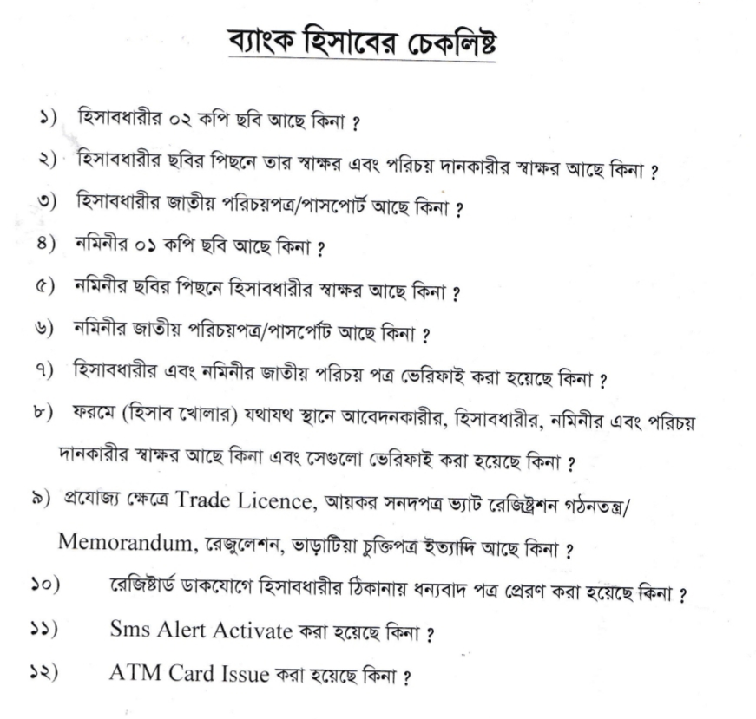

Slide 18
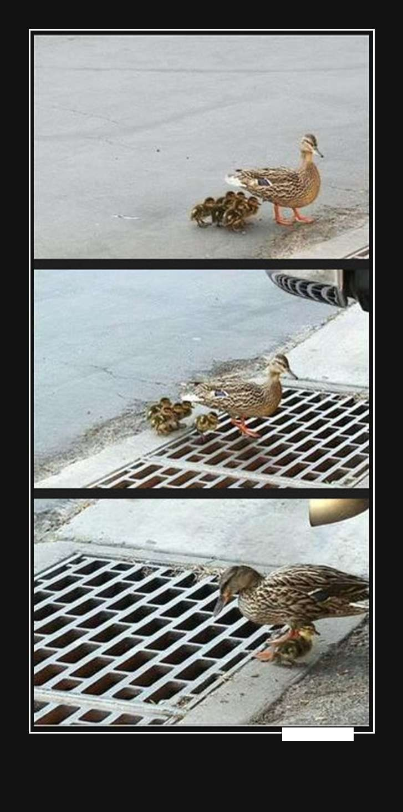
ভাবিয়া করিও কাজ, করিয়া ভাবিও না

Slide 19
nizamshahriar@gmail.com
Thank you so much !!!

