Slide 1
Audit Observations & its settlement process
Facilitator:
Md. Shah Alam
Joint Secretary, FID
Cell: 01552 311540.

Slide 2
Objectives of the Session:
In this session we will discuss:
  Audit and Audit Process
  Audit Observation Settlement process
  Role of the Ministry & Responsible Party
  Reforms in Audit Process [AMMS 2.0]
  Conclusion

Slide 3
Acts Related to Bank :
  The Bank Companies Act, 1991/2023, (Act XIV of 1991)
  The Companies Act, 1994/2020, (Act XVIII of 1994)
  The Negotiable Instrument Act, 1881
  The Bankers’ Books Evidence Act, 1891/2021
  The Money Laundering Prevention Act, 2012
  The Foreign Exchange Regulation Act, 1947/2015
  The Financial Reporting Act, 2015
  And many more…

Slide 4
Audit and Inspection in SOCB:
Internal Audit
External Audit
Internal Audit and Control [section- 15(ga) of the Bank Companies Act 1991]
CA Firm audit [section 210 of the Companies Act,1994 and sec 39 of Bank company Act 1991.
Central Bank Inspection
CAG’s audit [Article 128 of Constitution]
Corporate Governance Code Compliance Certificate [BSEC requirement]

Slide 5
Difference Between CAG’s Audit & CA Firm’s Audit
 | CAG’S Audit | CA Firm’s Audit
Mandate | Constitution | Companies Act
Audit Type | Compliance | Compliance [ISA, IFRS, GAAP]. Gives Audit Opinion:- unqualified, qualified, disclaimer, adverse.
Audit Report | Placed before Parliament | Placed before AGM

Slide 6
Definition of Audit
Audit is an independent examination of books of accounts, other documents, stores, assets etc relating to receipts and expenditure of the Government, statutory public authorities and public enterprises with a view to ensure that
  rules and orders framed by competent authority in regard to financial matters have been followed;
  sums due have been properly assessed, realized and brought to accounts;
  all expenditure & disbursements are authorized, vouched and correctly classified;
  assets have been properly utilized and safeguarded;
  public resources have been used economically, efficiently and effectively; and
  the accounts truly represent the fact.

Slide 7
Audit Authority
Supreme Audit Institution (SAI), established by the Constitution of the country.
CAG in Bangladesh [Art 127 to 132]
  Art 127: There shall be a Comptroller and Auditor General (CAG) of Bangladesh who shall be appointed by the President.
NAO (National Audit Office) in UK
GAO (Government Accountability Office) in USA
Board of Audit of Japan

Slide 8
CAG’s Mandate
CAG derives its power -
Article 128 (1) of the constitution of Bangladesh.
The Comptroller & Auditor General (Additional Functions) Act 1974
Article 128 (4) CAG’s Independence.

Slide 9
Scope of Audit according to Art.128(1) of the Constitution
The public accounts of the Republic and of all courts of law and all authorities and officers of the Government shall be audited and reported on by the Auditor General and for that purpose he or any person authorised by him in that behalf shall have access to all records, books, vouchers, documents, cash, stamps, securities, stores or other government property in the possession of any person in the service of the republic.

Slide 10
Offices under CAG, Bangladesh
17 Audit Directorates under the direct administrative control of CAG.
To perform two fold functions:
  To fulfil the constitutional obligation of CAG,
  To meet the requirements of Parliament

Slide 11
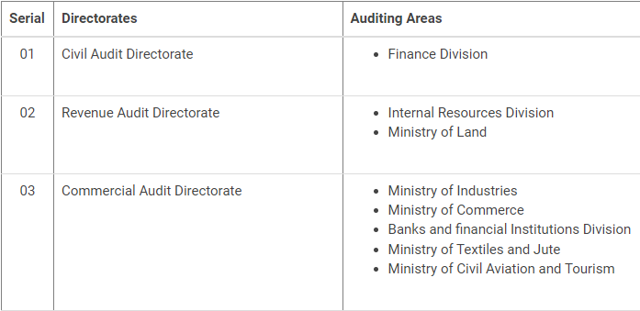
Offices under CAG, Bangladesh

Slide 12
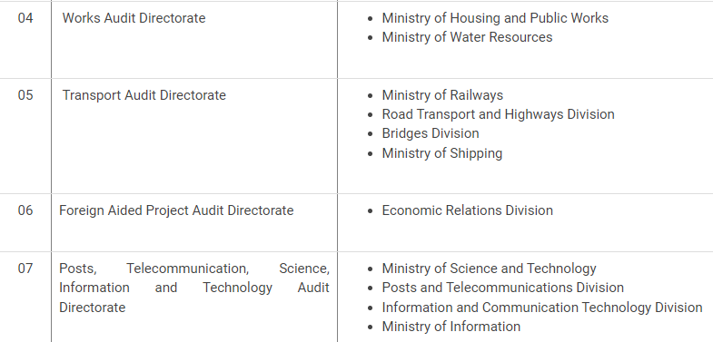
Offices under CAG, Bangladesh

Slide 13
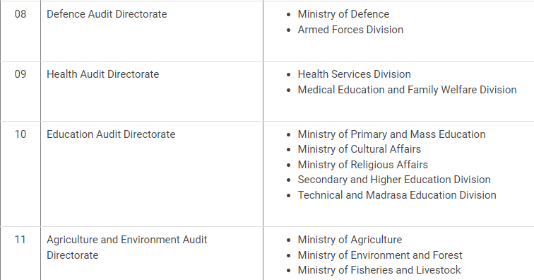
Offices under CAG, Bangladesh

Slide 14
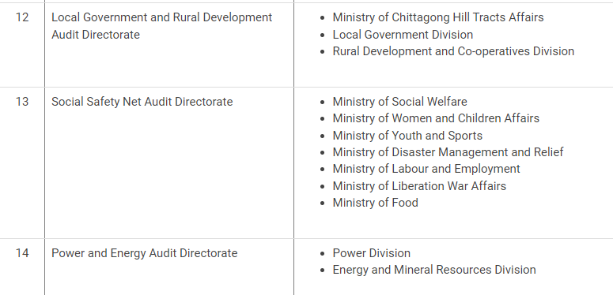
Offices under CAG, Bangladesh

Slide 15
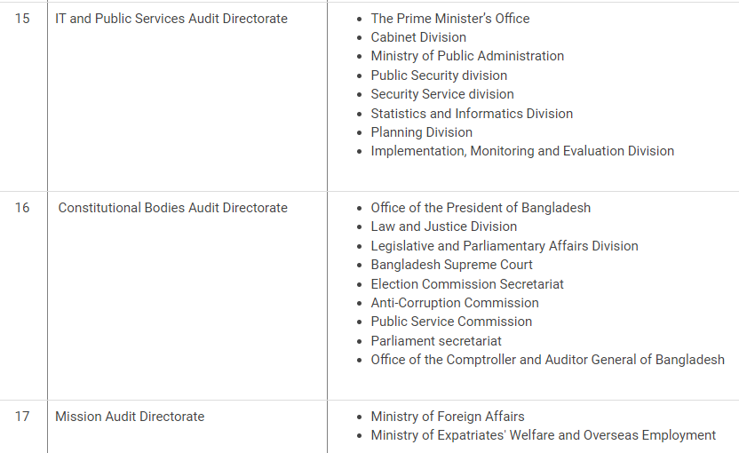
Offices under CAG, Bangladesh

Slide 16
Types of Audit
Audit can be classified into four basic types:
  Regularity or Compliance audit
  Financial Statement audit
  Forensic Audit
  Performance or Value for Money audit.

Slide 17
Regularity or Compliance audit:
The examination of receipts and expenditure to determine whether the entity incurs the expenditure with specific applicable laws, regulations, procedures, etc.[criteria] that apply to it.

Slide 18
Financial Statement Audit
To ensure that-
The financial statements are accurate, complete and are consistent with primary records.
The financial statements are prepared in accordance with accepted accounting standards.
Sufficient disclosures are presented about various elements.

Slide 19
Forensic Auditing
It is a special type of compliance audit.
It involves an investigative examination of pre-identified cases brought to the attention of the auditor to determine the validity of allegations of fraud and other wrongdoing.

Slide 20
Performance or Value for Money Audit:
Performance Audit involves an independent assessment of whether the entity/ project/ programs are operating in accordance with the principles of economy (spending less- minimizing cost of resources of a given quality), efficiency (spending well- minimizing use of resources for a given output) and effectiveness (spending wisely- achieving business objectives in full) in the utilization of its resources.

Slide 21
Audit Procedures
Audit planning
Overview of auditee organization
Data collection
Risk and materiality analysis
Audit programming
Review of reports: previous Audit and Inspection Report (AIR), records etc.
Discussion with head of the auditee organization
Preparation and issue of AIR

Slide 22
What is Audit Finding/Observation:
The gap between ‘ what should be’ (audit criteria) and ‘ what is ’ (audit evidence) is audit finding.

Slide 23
Audit memo
It is the immediate result of the audit work that contains all the audit findings.
After completion of audit, audit memos are sent to the Audit Directorate to identify SFI (serious financial irregularities) and non-SFI paras.

Slide 24
Audit Inspection Report (AIR)
Audit Inspection Report is the most important and basic document of audit. In this report SFIs and non-SFIs are identified and sent to the Head of the Department and to the respective ministry.

Slide 25
Action on AIR
AIR
Non-SFI
Direct correspondence with Audit
SFI-Correspondence with Audit through Ministry
Draft para / Audit Report

Slide 26
Time Frame for Preparation of Audit Report:
Issue of SFI to the Ministry –ask for reply within 35 days
In case of non-compliance, reminder for reply within 14 days
DO letter to PAO/Secretary and ask for reply within 28 days.
Preparation of DP (draft audit report) and send to CAG office for approval within 14 days.

Slide 27
Time Frame for Preparation of Special Audit report:
Issue of SFI to the Ministry –ask for reply within 28 days
In case of non-compliance reminder for reply within 10 days
Write DO letter to PAO and ask for reply within 14 days.
Preparation of DP and send to CAG office for approval within 07 days.

Slide 28
Audit Report Should be
    Clear
    Concise
    Constructive and courteous
    Relevant
    Accurate/Reliable
    Objective (Dispassionate)

Slide 29
Submission of Audit Report:
Hon’ble PM is apprised of the Audit Reports by the CAG as per the Rules of Business.
Audit Reports are submitted to the Hon’ble President who causes them to be laid before the Parliament. [Art 132 of Constitution]

Slide 30
Relationship with Parliament:
PAC (Art- 76(1) | To scrutinize, Appropriation Accounts and the ‘Annual’ Finance Account of the Government. To scrutinize CAG’s Audit Reports to give recommendations and follow up actions. (15 member)
P UC (10 member) | To examine the reports and accounts of the public undertakings and to check that affairs of the public undertaking are being managed in accordance with sound business principles & prudent commercial practices.
P EC (10 member) | The functions of the PEC are to report what economic improvements in organization, efficiency or administrative reform, consistent with the policy underlying the estimate may be affected to suggest alternative policies in order to bring about efficiency and economy in administration.

Slide 31
How audit observations are settled
There are several ways to settle audit observations:
    Spot reply
    Exit meeting
    Broadsheet reply
    Bi-lateral meeting [non-SFI]
    Tri-partite meeting [SFI]
    Public Accounts Committee(Parliament)

Slide 32
How audit observations are settled
Spot reply: reply given during the time of audit
    Audit observations are raised during field audit. Authority can furnish reply with relevant evidence at the time of field audit. If the reply is satisfactory the audit observation is settled at the spot.
    do not pass on any audit observation for future reply or for somebody else to reply in future.
    defend your office with all relevant documents and arguments, otherwise accept the observation and act accordingly.

Slide 33
How audit observations are settled
Exit meeting:
    A seen and discussion meeting is supposed to be held with the head of audited entity at the last day of the audit. At that meeting after discussion and presentation of evidence, audit observations may be dropped.

Slide 34
How audit observations are settled
Broadsheet (BS) reply:
After issuance of the AIR, the responsible party can send written reply with evidence to Audit. The reply of SFIs must be sent to Audit through concerned ministry. HQ examines the reply and comments on it. The reply of non-SFI shall be sent directly to the Audit Directorate.
Ministry recommends for settlement of SFI para if the reply and evidence are found satisfactory.
Audit observations are dropped if Audit Directorate is satisfied with the BS reply.

Slide 35
How audit observations are settled
Bi-lateral/Tri-partite meeting:
Bi- lateral meeting can take place between the Audit Directorate and the Auditee Organization/Responsible Party to discuss non SFI paras & try to settle.
Tri-partite meeting is chaired by representative from the concerned Ministry. Audit Directorate and Responsible Party discuss the SFI paras. The role of Ministry is like an arbitrator.
Paras are recommended for settlement if the reply and evidence furnished are found appropriate.

Slide 36
How audit observations are settled
Public Accounts Committee (PAC) meeting:
    Audit observations included in the CAG’s audit report are discussed in the PAC of the Parliament. After detailed discussion PAC gives its recommendation. PAC is formed as per art-76(1) of Constitution and is a 15 member committee.

Slide 37
Audit Evidence
Information that supports the auditor's opinion, conclusion or judgement.
Auditors should obtain sufficient, relevant and reliable evidence to support their judgement & conclusions expressed in the report.
Sufficient: information that is quantitatively sufficient.
Relevant: information that is pertinent to the audit objectives.
Reliable: information that is consistent with the facts, i.e. it is valid.

Slide 38
REFORM IN AUDIT PROCESS
AMMS 2.0 (Audit Management and Monitoring System)
Reconciliation of audit observations
Online audit reply platform.
Both auditor and responsible parties/auditee can monitor the progress of reply.
https://cag.org.bd/

Slide 39
Follow up of Audit observation
Follow up is done by-
Audit Directorate – whether recommendations of previous audit and PAC have been followed.
Auditee organization/Responsible party- will follow the audit & PAC recommendations .
Ministry- will follow up the settlement of Advance Para, and recommendations of PAC.

Slide 40
Role of Ministry in audit disposal
Examine the reply and evidence on SFI Para sent by auditee/responsible party. If satisfied, send recommendation to the Audit Directorate for disposal.
Play a pivotal role in tripartite meeting
Follow up PAC recommendations.

Slide 41
FIXING LIABILITY/RESPONSIBILITY
Fixing liability of an irregularity is the management job.
Audit doesn’t fix liability, instead it identify the irregularity (if any) only.

Slide 42
Why audit observation arises:
Non compliance of
    Rules, regulations, agreements and other orders issued by Govt.
    Lack of transparency in procurement.
    Lack of proper documentation in transactions.
    Unnecessary or irregular expenditure or loss of income
    lack of action on matters previously reported by the auditor

Slide 43
Continued ……
Lack of Internal controls (SOAP MAPS)
[Internal Control Manual, MoF, 2005]- to form Audit Committee & internal audit in each ministry.
(i) Segregation of duty, (ii) Organizational structure, (iii) Authorization & approval,(iv) Physical safeguard, (v) Monitoring, (vi) Accounting, (vii) Personnel management, (viii) Supervision.
2 types: Preventive controls- prevent errors, omissions, losses and Detective controls- detect such problems after the event.

Slide 44
Continued ……
Poor Monitoring
    Delay in preparation & submission of records
    Incomplete information from field offices
    Non reconciliation of accounts
    Long outstanding advances

Slide 45
Preventive Measures……..
  Compliance to financial rules and regulations.
  Proper documentation of related supporting papers and government orders.
  Establish Internal Control System and ensure
      Supervision (oversee the person at any job)
      Inspection and
      Monitoring (overseeing + advising) by the authority.
  Establish Internal Audit

Slide 46
Preventive Measures (contd…..)
Build up skilled manpower
      Arrange in house training
      Regular/special training
Maintain a working relationship with audit party by supplying documents as per requisition.
Think of audit as a watchdog and an aide to management not an opponent.

Slide 47
THANK YOU ALL

