Slide 1
An overview of Digital Payment Systems in Banking Operation
Jayanta Kumar Bhowmick
Additional Director (ICT)
PSD, Bangladesh Bank

Slide 2
Payment Ecosystem in Bangladesh
Automated Cheque Processing
Electronic Fund Transfer
Real-Time Gross Settlement
Interoperable ATM, POS and QR Transactions
Instant Internet Banking Fund Transfer
Mobile Financial Services
Bilateral Arrangements with Banks for different payment products of MFS Wallets
Billers and Merchants Integrations with Banks and MFS
E-Commerce, Online Merchant Payments and Bill Payments
MFS Interoperability

Slide 3
Payment Ecosystem in Bangladesh
Payment ecosystem is fairly equipped to serve the nation effectively and efficiently.
COVID-19 pandemic was an automatic stress testing for our payment platforms amongst all clutches.
Digital exchange of financial data can become the building block for emerging service models, removing inefficiencies in the system and opening new product possibilities.
So, it brings in front the new horizon of Open Banking landscape to transform the financial systems and may lead to product innovation and better facilitation of financial services.

Slide 4
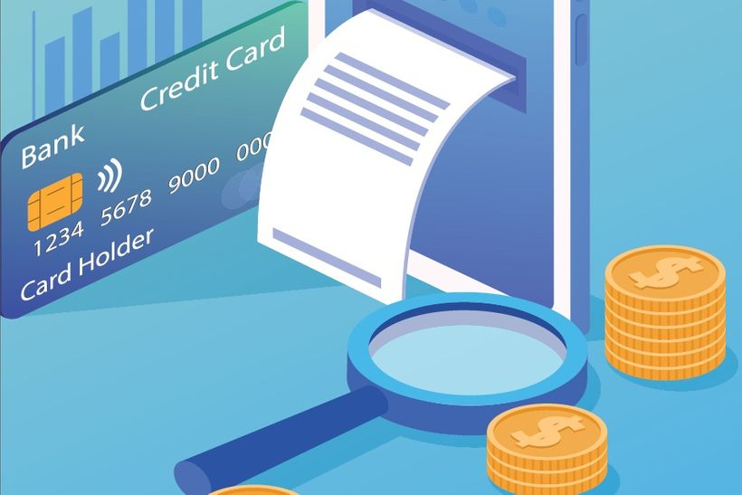
Payment Cards
Payment cards are part of a payment system issued by financial institutions, such as a bank, to a customer that enables its owner (the cardholder) to access the funds in the customer's designated bank accounts, or through a credit account and make payments by electronic account transfer and access automated teller machines (ATMs).

Slide 5
Types of Payment Cards
There are few types of payment cards, the most common being credit cards, debit cards, charge cards, stored-value cards, prepaid cards, gift cards and ATM cards.
Credit cards:
allow the cardholder to spend up to a specified credit limit
offer the account holder an interest-free period
require the account holder to repay at least the minimum amount each month, but charge interest on the unpaid balance
incur no interest if the bill is paid in full by the specified date

Slide 6
Types of Payment Cards (Cont’d)
Debit cards:
are issued in conjunction with a bank or building society current account
limit the cardholder to the funds available in that account plus any overdraft, if available
Charge cards:
may require the account holder to pay an annual fee
allow the cardholder a period of credit, but - to avoid additional fees - this must be paid off in full each month

Slide 7
Types of Payment Cards (Cont’d)
Pre-paid cards:
can be provided pre-loaded – e.g. for staff to pay expenses
enable businesses to manage and monitor spending
are available in different currencies, so can be used as an alternative to business travel cards
usually incur various fees and charges
Business travel cards:
operate in the same way as other business credit or charge cards
can offer a convenient way for staff to pay for business travelling expenses
often offer additional benefits, such as travel insurance or currency facilities

Slide 8
Card Technologies
Embossing
Magnetic stripe
Smart card
Proximity card/ Contactless smart card
Re-programmable magnetic stripe card

Slide 9
Digital Wallet
A digital wallet (or e-wallet) refers to a software, an electronic device, or an online service that enables individuals or businesses to make transactions electronically. It stores the payment information of users for different payment modes on various websites, along with other items such as gift coupons and driver’s licenses.
Digital wallets offer a convenient way to pay by allowing you to simply use your phone to pay instead of cash or your plastic credit card.

Slide 10
Significance of Digital Wallet
A digital wallet securely stores all the payment information of users in a compact form. Thus, it greatly reduces the need to carry physical wallets.
Companies that need to collect consumer data for their marketing needs can benefit greatly from digital wallets. They get to know the purchasing habits of consumers and increase the effectiveness of the marketing methods of their products. However, it leads to a loss of privacy for consumers.
Many developing countries using digital wallets may be able to increase their participation in the global financial market.

Slide 11
Significance of Digital Wallet
Digital wallets allow users to transfer funds to friends and family residing in different nations.
Moreover, digital wallets eliminate the need for physical banks and companies in order to open and maintain a bank account. Hence, they also connect individuals and businesses in rural areas.
A digital wallet is required to make transactions and maintain balances of cryptocurrencies.

Slide 12
Types of Digital Wallet
1. Closed Wallet
Closed wallets are linked to specific merchants, and users can only use the funds to make payments for transactions initiated with the specific merchant. e.g. Amazon Pay
2. Semi-closed Wallet
Semi-closed mobile wallets allow users to use the funds in the wallet to make payments for transactions with multiple merchants, as long as there is an existing contract between the merchant and the mobile wallet company. e.g. bKash

Slide 13
Types of Digital Wallet
3. Open Wallet
An open wallet is used directly by a bank or through a third party. Open wallets allow customers to use the funds in the mobile wallet for making payments for transactions or withdrawing the funds deposited to the account in cash.
An example of an open mobile wallet is PayPal, which allows users to make payments for in-store and online purchases and still withdraw the funds in cash.

Slide 14
What can be stored
Here’s what you can store in a digital wallet:
Credit or debit cards.
Boarding passes.
Hotel reservations.
Concert tickets.
Gift cards.
Coupons.
Loyalty rewards cards.

Slide 15
Benefits of Digital Wallet
1. Secured access
For payment user is required to unlock the mobile device using a password or fingerprint. App also requires users to type a passcode, or use their fingerprint, or use the face scan to unlock the mobile wallet.
It makes mobile wallets more secure than carrying physical credit cards and cash, which can easily be compromised.
2. Accessible and convenient
Mobile wallets are also quickly accessible and convenient, making it easier for users to make payments.
Preferred by consumers who want more convenience in paying for in-store purchases, instead of carrying physical wallets and cash to stores.

Slide 16
API and Open Banking
Open banking is a banking practice that provides third-party financial service providers open access to consumer banking, transaction, and other financial data from banks and non-bank financial institutions through the use of application programming interfaces (APIs).
It provides the technological infrastructure and the legal frameworks to make such consent-driven sharing happen.
In the new ecosystem of Open Banking, APIs are a channel for doing business. Adopting and deploying APIs, banks can extend and enhance their native services and offerings.

Slide 17
Open Banking Myth
It is erroneously believed that open banking makes the customer’s data openly available to anyone.
  Actually, it puts effort on controlling both the circle of eligible third parties and letting the customers control sharing of their financial data, by requiring their explicit consent.
What is “open” in open banking?
  With open banking, the digital value chain of banking gets opened up, allowing third parties to participate in the previously closed value chain.

Slide 18
What Data does Open Banking open up?
Account Data – Personal information of the account holder and transactions on the account
Product Data – Products and services a financial institution offers
Payment Initiation – Authorization of payments
Participants in the regime convention can extend the scope to other types of data and services. Prior customer consent is required for all data sharing except public product data.

Slide 19
Challenges of Banks
Traditional banks already observe customers switching completely or move a part of their banking activities to a Digital Bank or Neo Bank, which offer better digital services.
Changing customer needs on more digital solutions
Lead to increased competition and increased pressure to innovate
Banking-as-a-Service (BaaS) in the form of APIs to third-party product companies

Slide 20
Leveraging Open Banking APIs to face the Challenges of Banks
Open banking can make life easier for a bank’s customers. But why is open banking strategically interesting for banks? Won’t banks need to give up a lot of their control? To face the challenges, banks use APIs for:
System modernization to become more agile
Regulatory compliance (world-wide trend but laws are regional)
Ecosystem play to create innovative opportunities

Slide 21
Open Banking Ecosystem
Data
Regulators
Non-Financial Service Providers
FinTechs
Financial Service Providers
Account Aggregators

Slide 22
Technologies that Power Open Banking
Financial services are built on trust, and it is vital for banks that their clients trust them. By using APIs and surrounding technologies correctly, you can establish yourself as a trustworthy ecosystem participant with partners and clients.
Security - all ecosystem players need to be properly authenticated & authorized, and the FinTech receiving the data need to be trustworthy.
Consent - customers must stay in charge of their financial data, with final say over when their data is shared and with whom.

Slide 23
Technologies that Power Open Banking
API specifications and standards – easy to adopt in the form of implementation-ready OpenAPI Specifications (e.g. Open Banking Specifications in the UK).
Documentation and Onboarding - Banks need to provide documentation of their APIs, and a straightforward onboarding process

Slide 24
Risks Associated with Open Banking
Open banking also potentially poses significant risks and concerns around:
  Transfer of Trust
  FinTech Vulnerability
  Financial privacy and data security
  Customer liability
  Cybersecurity and Operational Risks
  Compliance and Reputational Risks
  Grievance Redressal

Slide 25
Thank you

