Slide 1
Concept and Application of Fintech & Regtech in Financial Institutions
Jayanta Kumar Bhowmick
Additional Director (ICT)
PSD, Bangladesh Bank

Slide 2
FinTech
The convergence of ‘Finance' and ‘Technology' is often referred to as 'Fintech’.
Technology like Distributed Ledger, Artificial Intelligence (AI), Machine Learning, Cloud Computing, Big Data analysis and Robotic Process Automation (RPA) is making unprecedented impact on every aspect of global business including Finance and it’s way of doing business.
Technology has the capacity of closing socioeconomic gap through Inclusive Finance.

Slide 3
Digital Disruptions
Digital disruption is redefining industries and changing the way businesses function.
The banking sector is witnessing groundbreaking changes: foremost being the rise in customer-centricity.
Largest ride hailing without owning a single taxi
Digital money provider despite not being a bank
Most valued crypto-currency despite being issued by any central authority
Largest room provider without owning a room

Slide 4
FinTech
Branches of FinTech:
Virtual Card
Mobile Wallet
Mobile Money
Financial app
Crowd funding
API connectivity
Artificial Intelligence based Appraisal
Open Banking
Cryptocurrency etc.

Slide 5
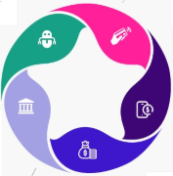
Major Products and Services in FinTech
ROBO-ADVISING |  | PAYMENT GATEWAYS
 |  | MOBILE PAYMENT
CONSUMER BANKING |  | BUDGETING APPLICATIONS

Slide 6
Key FinTech User Category
B2B in Banks and Financial Institutions |  | Business Clients and Financial Institutions
Direct Use by the Consumer |  | B2C for Small Business

Slide 7
Trends of FinTech Global Market
Contactless Payment |  | Digital Lending
Artificial Intelligence |  | Digital and Online Payment

Slide 8
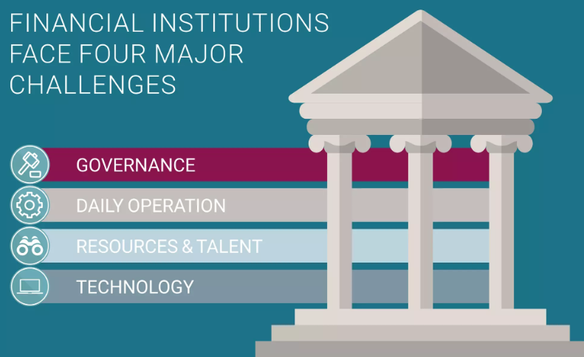
RegTech

Slide 9
RegTech
RegTech is often misunderstood and confused with FinTech.
While FinTech refers to the use of technologies and software to provide financial services, RegTech is the use of new technologies to solve regulatory and compliance requirements more effectively and efficiently.
RegTech is a subset of FinTech that uses innovative and integrated technology to facilitate the delivery of regulatory requirements more effectively and efficiently than existing capabilities.
Using such technology solutions improves the existing methodology of risk remediation and regulatory compliance, thus enhancing efficiency and reducing cost.

Slide 10
RegTech
Concept and Challenges
The concept is simple and attractive:
Automate regulatory compliance, reducing substantial costs
Involve use of Artificial Intelligence in regulation
The challenge is putting RegTech into practice:
Regulatory requirements are complex, regulatory reporting but also a wide range of rules and guidance; application requires interpretation and judgment

Slide 11
RegTech Development

Slide 12
RegTech Benefits and Key Drivers

Slide 13
Cryptocurrency
Cryptocurrency is a digital asset designed to work as a medium of exchange that uses cryptography to secure its transactions, to control the creation of additional units, and to verify the transfer of assets.
Not issued by any central authority
Not backed by assets
No geographical boundary
Difficult to counterfeit
No or minimum transfer fees
Examples of cryptocurrencies are Bitcoin, Ethereum, Ripple, Litecoin, etc.

Slide 14
How does Cryptocurrency system work
Private issuer
central bank
Banks
Business
Public
Skipped
No control of central bank which disrupts the transmission of Monetary Policy

Slide 15
Why did Cryptocurrency become popular
White Reasons | Dark Reasons
No central Authority No central Issuer No intermediaries and extra cost No border Cheap Speed Secure Anonymous Underlying technology i.e. DLT and Blockchain | Speculation/ High rate of return Greed Anonymity Transaction of illegal proceeds Money Laundering

Slide 16
Regulatory Stands on Cryptocurrency
Country | Status
USA, Canada, Japan, France Germany, Switzerland | No hard and fast rule. Designate as commodity, not as currency Capital Gain tax applicable Policy for Exchanges
Australia, Sweden, Finland, Singapore, Malaysia | In the process of developing guidelines. Designate as commodity, not as currency Capital Gain Tax applicable. Under strict monitoring subject to AML
Belgium, Estonia Bangladesh | Discourage use of Crypto Aware general public about the risk No Taxation till now
Denmark, India, Columbia, Ecuador, China | Banned use of Crypto

Slide 17
Central Bank Digital Currency (CBDC)
Central Bank issued legal tender having all the properties of money but issued and used only digitally without any tangible physical presence.
CBDC acts like a digital representation of a country’s fiat currency, and is backed by a suitable amount of value like gold or Forex.
CBDC unit can be used as a mode of payment, a store of value and a unit of account.
Technological efficiency, Financial inclusion, Tracking for Tax Collection and Combating crime, Protection of money as a public utility, Safety of payments systems, Banking competition, Smooth Monetary policy transmission are some potential benefits of CBDC.

Slide 18
CBDC – Status around the Globe
Status | Country/Region
Launched | Bahamas, Jamaica
Pilot | Canada, China, France, India, Ghana, Nigeria, Saudi Arabia, Uruguay
Proof of Concept | Brazil, Iran, Japan, Malaysia, New Zealand, Norway, Kazakhstan, Russian Federation, South Korea, Sweden, Thailand, Turkey, Ukraine
Research | Algeria, Australia, Bangladesh, Honduras, Iceland, Germany, Mexico, Mongolia, Peru, Poland, South Africa, UK, USA,
Cancelled | Denmark, Ecuador, Finland, Philippines, Singapore

Slide 19
Crypto vs CBDC
Cryptocurrency | CBDC
Some Regulators do not recognize crypto as a currency at all Some has given it the status of asset but not currency Some has completely banned its use | At a very early stage Mostly experimental Bangladesh is keeping a keen eye on global development If and when required, Bangladesh Bank may consider on introducing CBDC

Slide 20
ESS… Thank you!

