Slide 1
Risk Based Audting Approach(RBAA)
What is Risk?
What are the different auditing approach?
What is Risk Based Approach?
What is the causes and benefits of RBA?
What are the Methodology of RBA?

Slide 2
What is Risk?
In simple terms, risk is the possibility of something bad happening. Risk involves uncertainty about the effects/implications of an activity with respect to something that human value, often focusing on negative, undesirable consequences.
Risk implies future uncertainty about deviation from expected earnings or expected outcome.
In finance, risk refers to the degree of uncertainty and/or potential financial loss inherent in an investment decision. Risk measures the uncertainty that an investor is willing to take to realize a gain from an investment.
Mathematical Expression of Risk:
Risk = Probability/Likelihood *Impact/Consequence.

Slide 3
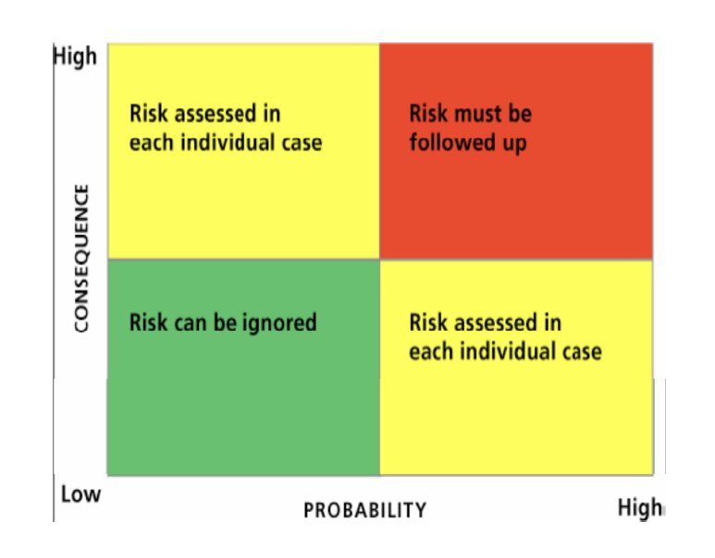
Risk Matrix

Slide 4

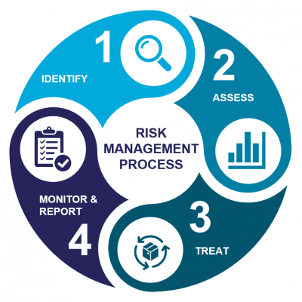
Managing Risks

Slide 5
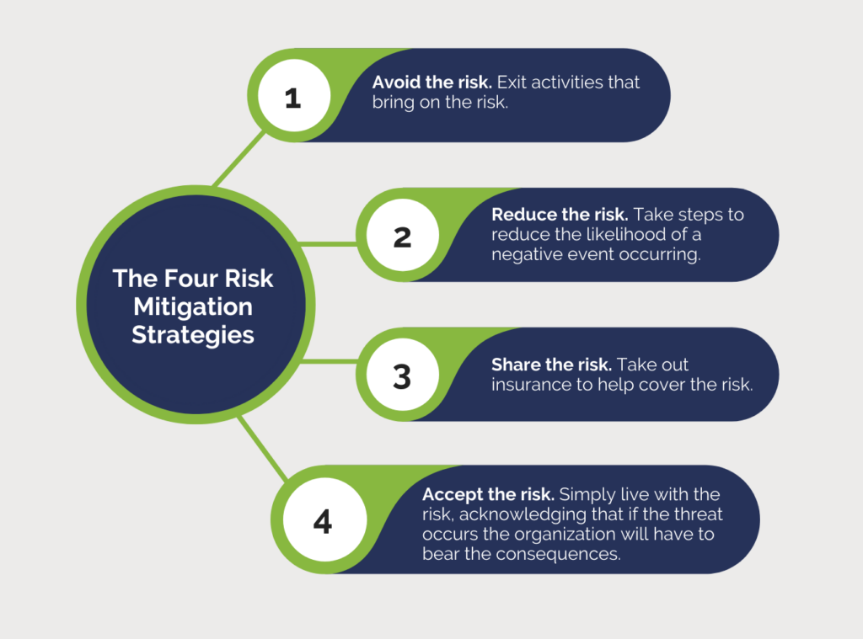

Mitigatio/Treatment of Risk

Slide 6
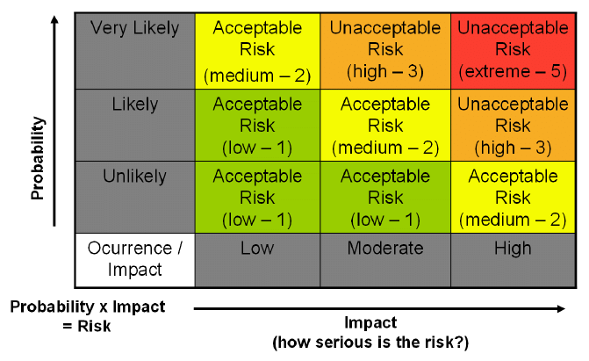

Slide 7
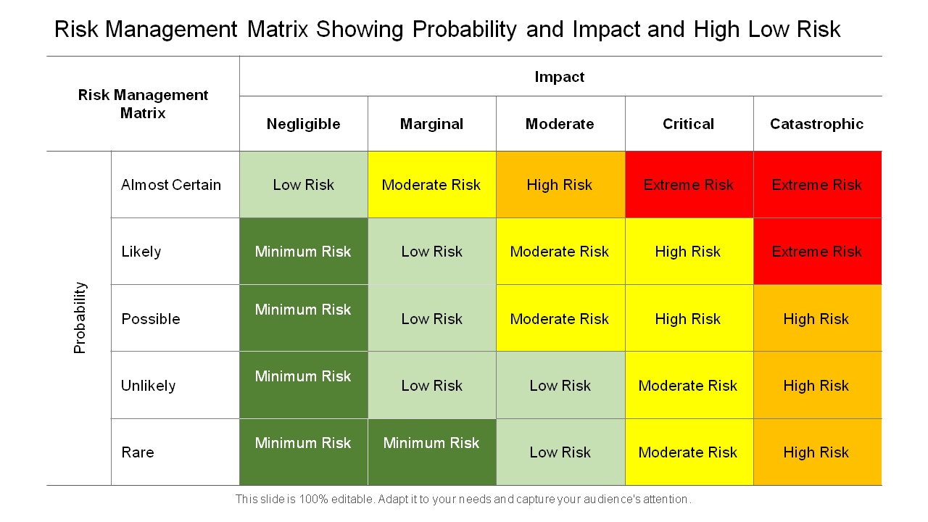

Slide 8
Types of Auditing Approaches
An important aspect in deciding the outcome of the audit is the approach that the auditing firm uses to complete a given audit assignment. Audit failure is more likely if auditors don't use the right auditing approach, which might result in a damaged reputation and even expensive litigation against the company.
Hence, audit firms take 4 different types of audit approaches to tackle this complexity.
    Balance sheet approach
    Systems-based approach
    Substantive procedures approach
    Risk-based approach

Slide 9
Types of Auditing Approaches
1. Balance Sheet Approach:
Focus: Accuracy of Balancesheet
Objective: to reduce the risk of error or misstatement in income statement accounts
2. System-based Approach:
Focus: Organization's ystems of generating financial information and reporting
Object: To identify any areas of risk or opportunities for improvement.
3. Substantive Procedures approach:
Focus: testing and verifying the amounts and disclosures presented in financial statements through procedures such as reviewing documentation, testing samples of transactions, etc.
Object: Ensuring the integrity of financial reporting and promoting transparency and accountability in organizations. It involves testing and verifying the amounts and disclosures presented in financial statements through procedures such as reviewing documentation, testing samples of transactions, etc.
4. Risk Based Auditing Approach:
This approach involves identifying the areas of the financial statements that are most susceptible to material misstatement, and then designing audit procedures that are tailored to address those risks. By focusing on the areas that present the highest risk, auditors can more efficiently allocate their resources and efforts to areas where there is the greatest likelihood of detecting errors or fraud. (Best utilization of resources)

Slide 10
What is Risk-based Auditing?
Risk-based auditing is an approach to auditing that focuses on identifying and prioritizing areas of risk within an organization, and then designing an audit plan to address those risks. It is a method of auditing that is driven by the level of risk associated with a particular area or process within the organization.
This conventional audit approach is focused on transactions to create financial statements such as the balance sheet. This auditing approach is used to identify risks with the greatest impact. Strategic risk analysis would include political and social risks, such as the effect of regulations and sociological change.
Risk-based audits begin by assessing the risks faced by a business or the company and attempt to correct and redefine the controls based on the urgency and the possibility of a loss of the risks.
In simpler terms, Risk-based auditing provides auditors a prominent role in minimizing the risks. Beyond just assessing the problems, they gradually become a part of creating effective controls and maintaining efforts in risk management.

Slide 11
Risk based Internal Audit (RBIA)
Risk based Internal Audit (RBIA) is an internal methodology which is primarily focused on the inherent risk involved in the activities or system and provide assurance that risk is being managed by the management within the defined risk appetite level.
Risk based internal audit is conducted by internal audit department to help the risk management function of the company by providing assurance about the risk mitigation.
RBIA allows internal auditor to provide assurance to the board that risk management processes are managing risks effectively, in relation to the risk appetite.
A Risk-based audit has a major advantage- it could be modified and adjusted to blend with the risk management process and specific requirements of your company.

Slide 12
Objective of Risk-based Auditing Approach
The objective of Risk-Based auditing approach is to provide assurance that the financial statements of an organization are factually accurate and reliable.
It also aims to improve the efficiency and effectiveness of the audit process by focusing on the areas of highest risk. By doing so, auditors can allocate their resources and efforts more efficiently, which can ultimately lead to a more cost-effective audit
A Risk-based audit approach begins with a risk element for the audit plan. In this approach, the goal of the department is to present the risks of the highest priority.
An ideal risk-based audit approach begins with an evaluation of the top risks of the management. All audits in the plan help to communicate those risks and provide results to the senior management.

Slide 13
What are the benefits of a risk-based approach in auditing?
The Risk-based audit approach helps auditors to work on the organizational risks on time and provide awareness to management in solving issues regularly. For a better understanding, the usage of data is vital. Let us look at the key benefits of risk-based auditing:
1. Consistency: Having a consistent and extensive approach, an organization can easily adjust to changing situations. Modifying the audit schedule according to the risk framework helps you change the techniques quickly based on the business objectives.
2. Clarity: A risk-based audit approach helps auditors to detect the risks correctly and enables management to put suitable internal controls rightly for optimum performance, thus resulting in a better understanding of the risks, and allowing the organization to manage the better way.
3. Accuracy: Grading and aligning the risks with the risk-based audit approach allow you to allocate business activity and funds to critical areas requiring utmost attention, developing a unique risk management audit schedule rather than depending on external plans and suggestions.

Slide 14
Benefits of Risk Based Internal Audit
Risk based internal audit is a valuable tool for companies seeking to improve their risk management practices. Some of the key benefits of this approach are:
1. More effective risk management: By identifying and assessing potential risks, companies can take proactive measures to mitigate those risks and improve the overall efficiency of their operations. This approach helps companies to stay ahead of potential risks, reducing the likelihood of financial loss or reputational damage.
2. Improved internal controls: The risk based internal audit process provides an opportunity for companies to assess the effectiveness of their internal controls. By identifying weaknesses in the control environment, companies can take steps to strengthen their internal controls and reduce the likelihood of fraud or errors.
3. Better decision making: Risk based internal audit provides decision makers with reliable and timely information on potential risks and vulnerabilities within the organization. This helps to inform strategic decisions and supports more effective risk management practices.
4. Enhanced stakeholder confidence: The risk based internal audit approach provides stakeholders with greater confidence in the company's risk management practices. This can enhance the company's reputation and help to attract investors and customers.

Slide 15
Reasons for RBA:
Limitation of Manpower
Large and Increasing number of audit units
Expediency (eligibility) for Audit Report
Foster dedicated audit coverage to high risk areas (for minimising audit risk)
Disciplined approach to evaluating audit universe
Highlight potential risk otherwise unknown
Allocate resources where payback is greatest (for quality of audit report)

Slide 16
Steps to Take Risk-based Auditing Approach
1. Understand the Business & risks: The risk-based audit demands that you understand the strategies, goals, and objectives of the company. As an auditor, you or the audit committee must have deep knowledge about the business, such as its strength, weaknesses, and challenges so that the auditors could focus on the most crucial risk areas. Especially, the risks in the banking and financial services sector include both conventional types of risk, such as legal/regulatory, reputational, liquidity, market, operational, and reputational risk, as well as non-conventional types of risk, such as performance risk measurement, human resource development and retention, customer loyalty and retention, product/service development, and ethics/integrity.
Once you have a clear understanding of the risk, you must evaluate those risks to assess the possibility of occurrence, its impact on the organization, and efforts taken to minimize the risks. This information should be noted in the risk register of your company to easily share and distribute among the employees.
2. Involve the management(Contrary to the Indepence): As an auditor, you should work closely with the senior management to organize business strategy and risks with your auditing and monitoring plan. The management could then help you conduct risk assessments more accurately for various business areas. One of the vital factors that make risk-based auditing different from the traditional approach is the involvement of the management. Your team knows the business risks better than anybody else, and with this knowledge, you could develop an effective auditing system that suits every business!

Slide 17
Steps to Take Risk-based Auditing Approach-Cont’d
3. Preliminary Risk Assessment:
The purpose of preliminary risk assessment is to determine the degree of risk and sufficiency of controls in the various functional processes of a business unit. To identify the areas of highest risk, the evaluation focuses on the company profile, management structure, organizational changes, and specific management and audit committee issues. The risk assessment determines how well the control design for each function mitigates inherent risk. The internal auditor then examines the outcomes of this evaluation and awards a low, moderate, or high-risk rating to the particular business processes. There are three types of risk one should keenly focus on in a business while taking a risk based auditing approach. They are,
    Financial Risk
    Business Risk
    Operational Risk
4. Assess your risk maturity
Risk appetite describes how much risk exposure your company would accept. Risk tolerance refers to the degree to which your company could change from the existing risk appetite.
You need to identify and understand the risk management strategies, with the risk appetite along with organizational process stages. You also should determine the tolerance of the management and board to identify the starting point for independent risk assessments.

Slide 18
Steps to Take Risk-based Auditing Approach-Cont’d
5. Develop an Audit Plan
An audit plan for a projected time period is produced based on the preliminary risk assessment, which sets the auditable business processes inside a risk matrix based on low to high risk. Every year, during the update phase of the risk assessment process, the three-year audit plan should be reviewed, and any necessary revisions should be made based on any new or altered risk factors.
6. Execution of Internal Audit Program
Once the audit plan is finalized, the audit fieldwork can begin. The audit process is guided by a standard audit program, which establishes which audit procedures should be done depending on the risk assessment level. During audit fieldwork and prior to the exit meeting, any potential audit concerns should be thoroughly reviewed with operational employees and line management.
7. Report and Communication
When the draft is complete, the report should include findings and suggestions that are classified as high, moderate, or low risk. At this point, there shouldn't be any disputes about the report's facts because everyone should have agreed on them throughout the fieldwork and risk assessment phases.
Then, the final report is issued with the findings and recommendations of the internal auditor included, as well as the Management Action Plan (MAP). This report should be sent to the relevant operating, senior, and executive management, as well as audit committee members.

Slide 19
Score based selection of audit Units
Risk Factors (Suggestive)
◦ Volume of Transaction (Budget and actual amount of expenditure),
◦ Complexities involved,
◦ Control Environment,
◦ Past Experience with audit unit
Classify audit units for audit purposes
Consider the coverage of all audit units in specified period of time (Say 3 years)

Slide 20
