Slide 1
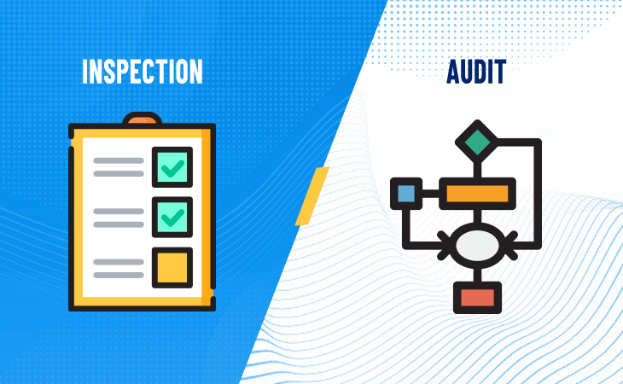
Md. Safayet Hossain,
GM and Principal
Rupali Bank Training Academy
Rupali Bank PLC
Audit and Inspection

Slide 2
Content of the Topic
1. Meaning, Types, Scope and Purposes,
2. Importance of Internal Audit
3. Function of Auditors
4. Roles and Responsibilities of Auditors
5. Ethics in Auditing
6. Risk Based Auditing

Slide 4
Introduction
Bank deals directly with cash and public money
Protection of public interest is the top priority of regulator and statutes
Advent of new technologies in the financial sector exposed the banking credibility at risk
Fraud and Forgeries are an increasing phenomena in the banking sector
Business of banking is susceptible to frauds. It is therefore necessary to have an internal control and supervision mechanism for ensuring that no one person is in a position to violate procedures, rules, regulations, guidelines, do an unauthorized act detrimental to the organization which remains undetected for an indefinite period or long time.
Credibility of an institution, particularly that of financial institution depends on its internal control and supervision mechanism which can promptly detect irregularities, if any, and take corrective measures and ensure non recurrence of irregularities.
Bangladesh Bank, MoF, BSEC, BFIU, BIS, WB, IMF persistently insist on transparency and accountability and protection of public interest.
Therefore, inspection and audit plays crucial role in success of banking operations

Slide 5
Majore Measures For Protection of Public Money:
1. Financial
2. Non-financial

Slide 6
Majore Measures For Protection of Public Money
Financial Protection:
CRR and SLR
Deposit Insurance
MCR and Buffer Capital
Provision against CL
Statutory Reserve
Interest and finance
Non-financial:
Inspection and Monitoring by internal people
Auditing Regularly by external people
Regulatory oversight

Slide 7
Internal Control System :
Internal control is a process effected by a bank’s board of directors, management and other personnel, designed to provide reasonable assurance regarding the achievement of objectives relating to operational efficiency, reporting accuracy and effective compliance.
Defense Mechanism of ICC:
1st Line of Defense: Business Line
2nd Line of Defense: Compliance and Risk Mgt.
3rd Line of Defense: Internal Audit Function
“Control Functions” of banks are:
1. Risk Management,
2. Compliance,
3. Internal Audit.

Slide 8
Internal Control Process in Bank
Detective Role: Audit and Inspection Unit
Curative Role: Compliance Unit
Punitive Role: Discipline Div
Preventive Role: Monitoring Unit

Slide 9
Derivatives of the Term Audit:
The term Audit is derived from the latin term Audire, which literally means, to hear
Meaning of the term Audit:
The word “audit” is a very generic word, it essentially means to examine something thoroughly. But as it relates to accounting and the finance world, so audit meaning is the thorough inspection of the books of accounts of the organization.
This involves the examination of vouchers, records, books of accounts and the verification of various assets (Value or Quality) of the organization.

Slide 10
Definition of Audit?
The International Federation of Accountants(IFA) has given the following definition of an audit, “audit is an independent inspection(?) of the financial information of any organization, whether profit-oriented or not profit-oriented, irrespective of its legal form, status or size when such examination is conducted with a view to express an Opinion thereof ”.
According to Montgomery (USA), “Auditing is a systematic examination of the books and records of a business or other organization in order to ascertain or verify to report upon the facts regarding its financial operation and the result thereof -অর্থাৎ নিরীক্ষা হলো এমন একটি পদ্ধতি যাতে ব্যবসা প্রতিষ্ঠানে ব্যবহৃত যাবতীয় হিসাব-বহি ও নথিসমূহে রক্ষিত হিসাব বিবরনী পরীক্ষা করা হয় এবং যে কার্যক্রমের ফলে প্রতিষ্ঠানের আর্থিক লেনদেনের সঠিক চিত্র প্রতিফলিত হয়”
স্প্যিয়ার এন্ড প্যাগলারের মতে, নিরীক্ষা হলো ব্যবসায় ব্যবহৃত হিসাবের বহি, নথি, কাগজপত্র ইত্যাদির বিশদ পরীক্ষা যাতে নির্ভূলভাবে একটি ব্যবসা প্রতিষ্ঠানের স্থিতিপত্র তৈরি করা যায় এবং প্রতিষ্ঠানের আর্থিক লেনদেনের একটি সুস্পষ্ট ও স্বচ্ছ প্রতিচ্ছবি ফুটে উঠে”

Slide 11
Definition of Audit cont’d:
As per ICC Guidelines-2018, the term audit is defined as- Audit is event to event detailed scrutiny of all aspects under the coverage of related laws, acts, rules and regulations.
So we can define audit as:
Audit is a systematic and independent examination of books of accounts, transactions records, documents and vouchers of an organization to ascertain how far the financial statements, as well as non-financial disclosures, present a true and fair view of the concern, assess the validity of it with set standards, ensure the books of accounts are properly maintained by the concern as required by law and summarizes its finding with an opinion thereof.

Slide 12
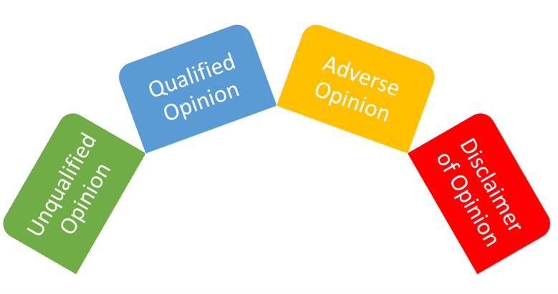

Slide 13
Types of Audit:
Type A: For any organization, corporate or non-corporate
Internal Audit: Done by internal audit personnel
External Audit: Done by listed CA firm
Type B: Both Financial and Manufacturing Entity
First Party Audit:
Second Party Audit:
Third Party Audit:
Type C: For manufacturing company
Product /Item Audit
Process Audit:
System Audit:
Finance and Accounts audit:

Slide 14
Types of Audit:
Type D: For any conern
Financial Audit
Operational Audit
Statutory Audit
Compliance Audit
Forensic Audit
Value for Money Audit
Tax Audit
Management Audit
Public Sector Audit
Information System Audit
Environment and Social Audit
Integrated Audit
Special Audit
Mission Audit

Slide 15
Derivatives of the Term :
The term Inspection is derived from the Latin word inspectio, which literally means, examination, looking into, observing.
Meaning of the term Inspection:
An inspection involves checking something, i.e., examining and assessing something. The inspectors need to ensure that nothing is faulty and that nobody is breaking any laws.

Slide 16
Definition of Inspection:
Inspection is a careful/customized way of examination by an official, popularly known as inspector, to check that rules, norms and policies are being obeyed, followed or maintained in all activities and operations of administration, management, accounting, record keeping and preservation of things as per set rules or Checklist .

Slide 17
Types of Inspection:
Internal Inspection: Done by inside personnel
Regular inspection: Both Head office Team/Local Team
Surprise inspection- Controlling office (HO/DO/ZO)
Controlling office Inspection: Central Team
Special inspection: Vigilance team, MD’s special squad, MD’s Monitoring cell.
Concurrent inspection(Audit): Concurrent Inspector as assigned by HO
External Inspection: Done by External Personnel or Body
Bangladesh Bank Audit(?) team
Commercial Audit(?) team

Slide 18
Scope of Inspection in Bank
External and Internal environment of the concern (Cleanliness, signboard, regulatory instructions and Safety measures, gun, fire extinguisher , paglaghonta, etc )
Cash and cash transactions, record, vault limit, key register, duplicate key, remittance tendency, inward-outward remittance
Account opening and maintenance with BFIU Requirements
Account transaction, Balancing and issue of balance certificate
Annual budget, business target and achievements
Loan and Advance:
Process and procedures
Approval, Documentation, documents verificationand authority/discretion
Insurance and Stamp
Godown, key holding, register (in and out) and stock verification
Transaction, regularity and overdue/over-limit
Preservation of file, papers, documents and deeds, safe custody register and documents maintenance
CL status, reporting, provisioning and recovery measures

Slide 19
Scope of Inspection
Expenditures: Approval, Budget, Purchase procedure
Maintenance and issuance of security stationary
Inter branch transactions and Reconciliation
Irregular account payments and settlement
Unadjusted sundry debtors/creditors entries
Settlement and operation of court cases, time barred loan
Foreign exchange transaction and overdue bills/PAD etc
Employee and administration related affairs (benefits, salary and allowances, TA/DA, Leave, Posting, Job rotations etc)
Branch Rent agreement
AML and CFT and ITP related affairs, Self assessment and ITP
Compliance of previous audit (Internal and external) and inspection objections
DCFCL, QOR, LDC, Anti-fraud and health report
Many other things

Slide 20
Making difference between Audit and Inspection
Audit:
A systematic process of examination
Done by independent personnel
Done on the basis of closing date of accounts
Focus on financial transactions and accounting procedures
Addresses mainly of corporate governance
Done on population basis
Passes disclaimer report
Executed on done activities
Usually Done Yearly
Reported to shareholders
Mainly check the compliance of set standard
Audit is forward looking, sometimes called climbing a tree
It is a statutory/regulatory requirement
Audit add value to the shareholders
Opinion passed on facts to expose the true view of the accounts and operation
an audit is a much more formal and documented process than an inspection.
An audit usually looks at the processes within a company
The primary purpose of an audit is to improve processes
Audits focus on the future by identifying weaknesses in the system and looking at opportunities to improve processes
Inspection:
A customized process of examination
Done by both independent and dependent personnel
Done on the basis of a period of activities
Focus on rules, norms and Operations
Addresses mainly of internal control
Done on sampling basis
No disclaimer
Executed on process activities
Done routinely and regularly
Reported to Management Authority
Mainly check the compliance of of set checklist
Inspection is backward looking sometimes called playing on the grass
It is a management requirement
Add protection to the organization
Reporting passed on errors and anomalies to correct the operational and compliance deviation
an audit is a much more formal and documented process than an inspection.
an inspection usually focuses on the product or service being provided.
inspection is typically used to determine whether the product or service meets specifications.
On the other hand, inspections are focused on the past performance of the process.

Slide 22
Other Differences Between Audit And Inspection
Audits typically focus on an organization’s compliance with standards, and inspections typically focus on an organization’s performance.
Audits are typically much broader in scope than inspections, as they seek to assess an organization’s compliance with standards across all areas of operation.
Audits are typically much more detailed and comprehensive than inspections, as they seek to provide a complete picture of an organization’s compliance with standards.
Audits are typically conducted yearly, while inspections are usually conducted more frequently, such as every six months.
Audits are typically conducted by external parties, such as government agencies or independent auditors, and inspections are typically conducted by internal parties, such as managers or supervisors.
Audits typically utilize various methods, such as interviews, surveys, and document reviews, and inspections typically utilize a single method, such as observation.
Audits typically result in a formal report issued to the organization being audited, and inspections typically result in a more informal report shared with the relevant managers or supervisors.
Another key difference between an audit and an inspection is their purpose; while the purpose of an audit is to assess whether an organization is adhering to standards, the purpose of an inspection is to determine whether an organization is performing up to par.
Audits can be quite costly due to the need to hire external auditors and the comprehensive nature of the assessment. At the same time, inspections are typically much less costly, as they are usually conducted by

Slide 23
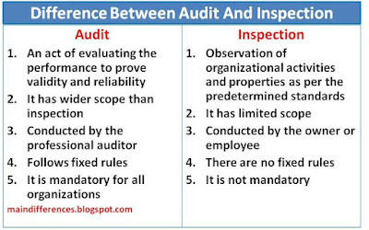
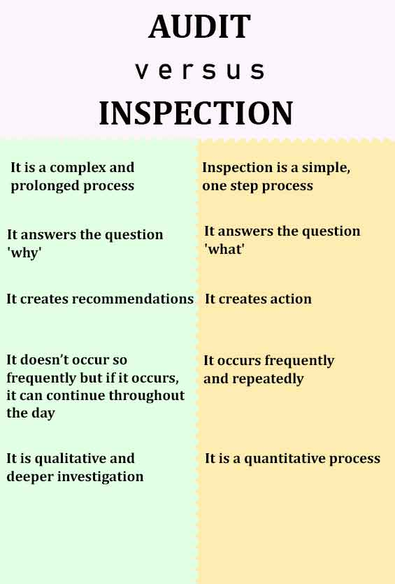
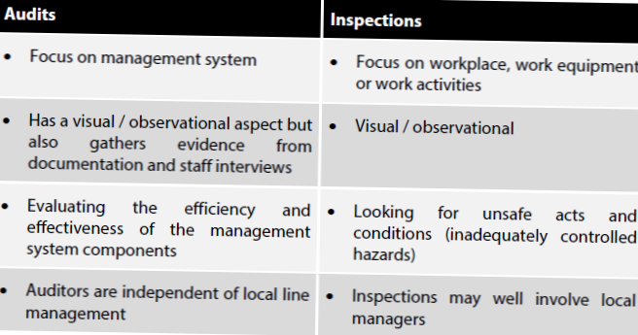

Slide 24
Qualifications and Qualities of Auditor/Inspector:
Proven working experience as Internal Auditor or Senior Auditor
Advanced computer skills on MS Office, accounting software and databases
Ability to manipulate large amounts of data and to compile detailed reports
Proven knowledge of auditing standards and procedures, laws, rules and regulations
High attention to detail and excellent analytical skills
Sound independent judgement
Knowledge of accounting
Knowledge of Audit related laws and norms
Intelligent and tactfulness
Responsible and vigilance
Honesty and Integrity
Impartiality and Fairness
Transparency and Independence
Positive attitude
Diligence
Confidentiality
Well communicative

Slide 28
Scope of Internal Audit

Slide 29
Objectives of internal audit
১। ব্যাংকিং কার্যক্রমে সুশৃঙ্খলা প্রতিষ্ঠা করা।
২। প্রচলিত হিসাব বইয়ের যাবতীয় আর্থিক লেনদেনের সঠিকতা যাচাই করা;
৩। ভুল-ভ্রান্তি সংঘটিত হয়েছে কি না তা উদঘাটন করা ও তা রহিত করণে সহায়তা করা।
৪। জাল-জালিয়াতি উদঘাটন করা ও তা প্রতিরোধে সহায়তা করা।
৫। অসাধু কর্মকর্তা/কর্মচারীদের মধ্যে মানসিক চাপ সৃষ্টি করা
৬। ঝুঁকির পরিমাণ নিরূপন করা ও এর মাত্রা হ্রাসকরণে সহায়তা করা।
৭। জবাবদিহিতা প্রতিষ্ঠা এবং কাজে গতিশীলতা আনয়ন করা।
৮। উন্নত গ্রাহক সেবা নিশ্চিত করা।
৯। আর্থিক ক্ষতি ও অপচয় রোধ করা।
১০। দায় ও সম্পদের নিরাপত্তা বিধান করা।
১১। ব্যবস্থাপনা কর্তৃপক্ষকে সহায়তা প্রদান/ব্যবস্থাপনায় উৎকর্ষ সাধন করা।
১২। প্রতিষ্ঠানের লক্ষ্য ও উদ্দেশ্য অর্জনে সহায়তা করা।
১৩। হিসাব মানের সঠিকতা নিশ্চিত করা ও হিসাব আইন ও বিধি অনুসরণ করে হিসাব প্রণয়ন বাধ্যতামূলক করা;
১৪। সরকারের পাওনা (ভ্যাট, ট্যাক্স, উৎসে কর) সঠিকভাবে পরিশোধে সহায়তা করা;
১৫। প্রতিষ্ঠানের প্রতি গ্রাহকদের আস্থা সূদৃঢ় করা;
১৬। সঠিক রিপোর্টিং নিশ্চিত করা ও শক্তিশালী তথ্য ব্যবস্থাপনা ব্যবস্থা প্রতিষ্ঠায় সহায়তা করা।

Slide 30
External Audit-Definition
External audit is an audit conducted by outside peronnel/ individual or firm that is independent of the company being audited.
Independent auditors audit the books of a company generally once per year after the completion of the company’s financial year.
Their role is to give an opinion of the financials statements reflection of the status and operations of the company being audited.
Although a financial statement audit is the most common type of external audit, external auditors may also conduct special purpose audits which might include: performing specific tests and procedures and reporting on the results, a less intensive review, and compilations

Slide 31
Scope of External Audit
The scope of an audit is determined by the auditor with regards to:
a) the terms of engagement
b) requirement of the relevant legislation (Statutory Requirement)
c) the pronouncement of ICAB.
However, the audit should adequately cover all aspects of the organization which are relevant to the financial and accounting statements under audit.

Slide 32
Importance of audit are…….
1. It helps in protecting the interest of persons who are not directly associated with enterprise like partners, shareholders, creditors, debtors etc.
2. It helps at the time of taking government grants.
3. It acts as a moral check on employees.
4. Helps to settle trade disputes.
5. Helps to settle accounts at the time of retirement, or death of partners. And also at the time of liquidation of any company.
6. Helps to settle tax liability, helps for taking refunds of tax etc.

Slide 33
Duties and Responsibilities of internal Auditor
দায়িত্ব:
শাখা প্রধানকে অযাচিতভাবে বিরক্ত না করা;
হিসাবের যাবতীয় রেকর্ডসমূহ সঠিক ও সুষ্ঠুভাবে যাচা্য় করা;
হিসাবের ভূল-ত্রুটি থাকলে তা সঠিকভাবে সনাক্ত করা;
হিসাবের বিভিন্ন এন্ট্রির সঠিকতা নিরূপণ করা;
হিসাবের খাতসমূহের ব্যালেন্সিং নিয়মিত করা হয় কিনা তা যাচা্য় করা;
শাখার যাবতীয় বহি, রেজিষ্টার, কাগজ ও দলিলপত্র সঠিকভাবে প্রস্তুত, পরিচালনা ও সংরক্ষণ করা হয় কি না তা যাচায় করা;
অনিয়ম, প্রতারণা, জাল-জালিয়াতি প্রভৃতি ঘটনা উদ্‌ঘাটনে অনুসন্ধিৎসু দৃষ্টি দিয়ে পরীক্ষা করা;
কাজের গুণগত ও পরিমাণগত মান পরীক্ষা করা;
প্রতিষ্ঠানের আর্থিক ক্ষতি বা সুনাম নষ্ট হওয়ার মত কোন বিষয় বিদ্যমান আছে কি না তা পরীক্ষা করে বের করা এবং তা থেকে প্রতিষ্ঠানকে রক্ষা করা;
সন্দেহ প্রবন না হয়ে সতর্ক দৃষ্টি দিয়ে হিসাবরে উপাত্ত ও তথ্যসমূহ যাচায় করা;
শাখা ব্যবস্থাপকের সাথে কাজকর্ম , ভূল-ত্রুটি সম্পর্কে খোলামেলা আলোচনা করা

Slide 34
Duties and Responsibilities of internal Auditor
কর্তব্যঃ
সহনশীলতা ও ধৈর্য্যশীলতা দ্বারা শাখা প্রধানদের আস্থাভাজন হওয়া
পরদির্শনকালে কোন পদ্ধতিগত ত্রুটি দেখা দিলে তা তাৎক্ষণিকভাবে শোধরে দেয়া
ভূল সনাক্ত হলে তাসেংশোধনের সুযোগ দেয়া
হিসাবের সকল খাতের ব্যালেন্স নিশ্চিত করা
শাখার রেকর্ড ব্যবস্থাপনা বা নথিপত্র সংরক্ষণের ক্ষেত্রে প্রয়োজনীয় নির্দেশনা প্রদান করা
জাল-জালিয়াতি পরিলক্ষিত হলে দায়ী সঠিক ব্যক্তিকে চিহ্নিত করা ও সুস্পষ্ঠ দায় নিরূপন করা
ডকুমেন্টেশনের ক্ষেত্রে কোন ত্রুটি বিচ্যুতি দেখা গেলে তা শোধরে দেয়া ও পরবর্তীতে যাতে সঠিকভাবে করতে পারে সে বিষয়ে মেন্টরিং করা
কর্মকর্তাদের কাজের দক্ষতা উন্নয়নে পরামর্শ দেয়া
গুরুতর অনিয়ম উদ্‌ঘাটিত হলে স্থানীয় জোনাল ম্যানেজার/বিভাগীয় প্রধানের গোচরে নিয়ে প্রয়োজনীয় পদক্ষেপ গ্রহণ করা
প্রয়োজনীয় ক্ষেত্রে প্রশিক্ষকের ভুমিকা পালন করা এবং বিভিন্ন সার্কুলার ও নির্দেশনা সম্বলিত ডকুমেন্ট দিয়ে শাখাকে সহযোগিতা করা
কমপ্লায়েন্স এর বিষয়ে সুস্পষ্ট দিকে-নির্দেশনা প্রদান করা
সর্বদা সততা ও নৈতিকতার মধ্যে থেকে কাজ করা এবং কোন অনৈতিক সুবিধা গ্রহণ না করা।

Slide 35
Further Role of the Auditor
Review the Bank’s Business Processes/Banking Processes.
Evaluate the risk Management Procedures.
Protect against errors, fraud-forgery and theft of the Bank’s assets.
Ensure that the bank is complying with relevant rules, regulations, laws, circulars etc.
Check the Departmental Control Function Checklist (DFCL, LDCL).
Give the right picture of the bank to Management.
Make recommendations on how to improve Audit and Inspection Processes.

Slide 36
Legal & Regulatory Aspects of Audit and Inspection for Bank
The Banking Companies Act, 1991 (Section: 48(Inspection) and Section: 39(Audit))
Financial Reporting Act, 2015 (Section: 36, 36(2), 38 , 40)
Guidelines on External Audit of Banks, 2016
The Companies Act, 1994(Section 210, 211, 212, 213), (Section 210(2)), Sec 213(3)
PPA, 2008, PPR, 2009
ICT Act, 2006 and Digital Security Act, 2018
Government Service Act, 2018
Public Money and Budget Management Act, 2009 ( Commercial Audit), Allocation of Business among the different Ministries and Divisions, Audit and Accounts order,1952 and Treasury Rules
FERA, 1947 and GFET of BB
BSEC Act, 1993, Regulations, 1996, Rules thereafter
Listing Rules of DSE and CSE
MLPA, 2012 and BFIU Master Circular 26/2020 (ITP and Self Assessment)
Bangladesh Financial Reporting Standard (BFRS)
Bangladesh Standard on Auditing (BSA), South Asian Federation of Accountants (SAFA) Code of Ethics, International Ethics Standards Board for Accountants (IESBA)
ICC Guidelines of Bangladesh Bank
Bank’s Internal Audit Policy

Slide 37
What is a Systems Audit
The audit of systems involves the review and evaluation of controls and computer systems, as well as their use, efficiency and security in the company, which processes the information.
In short, the systems audit consists of:
Verification of controls in the processing of information and installation of systems, in order to evaluate their effectiveness and also present some recommendation and advice
Verify and judge the information objectively
Examination and evaluation of the processes in terms of computerization and data processing. In addition, the amount of resources invested, the profitability of each process and its effectiveness and efficiency are evaluated
The analysis and evaluation carried out through the systems audit must be objective, critical, systematic and impartial. The final audit report should be a clear example of the reality of the company in terms of processes and computerization, to make better decisions and improve the business.

Slide 38
Objectives of the Systems Audit
Objectives of the systems audit are:
Improve the cost-benefit ratio of information systems
Increase the satisfaction and security of the users of these computerized systems
Guarantee confidentiality and integrity through professional security and control systems
Minimize the existence of risks, such as viruses or hackers, for example
Optimize and streamline decision making
Educate on the control of information systems , since it is a very changing and relatively new sector, so it is necessary to educate users of these computerized processes.

Slide 39
Who are the Auditors
Bank’s Regular Employee with no specialization
Bank’s Regular Employee with specialized knowledge
Outsourced personnels

Slide 40
Formations of Internal Audit Unit
Audit and Inspection Division shall conducts regular/periodic and special audit/inspection of the bank/branches/divisions/controlling offices.
They will act as the contract/communicating point and helping hand for external audit and inspection (BB, Commercial audit etc)
Audit and Compliance Division may be further divided in to the following units-
1. Audit Division-1: To carryout audit on Branch offices(Non-AD & SME/Agri. branches).
2. Audit Division-2:To carryout audit on All ADs, Corp. Br. Circle, Zonal Office, Subsidiaries & H/O(divisions/dept).
3. Audit Division-3: To carry out specialized ara (IT/IS) and vigilance audit.
Compliance of Audit:
4. External Audit Compliance Division : To monitor compliance activities of branch and office under internal audit.
5. Internal Audit Compliance Division: To monitor compliance activities of branch, Office and sub-divisions under external audit (Bangladesh Bank Audit/Inspection, Commercial Audit, External Audit /statutory audit and other regulatory authorities).

Slide 41
Functions of AID-1:
Audit and Inspection unit will formulate an annual audit plan, obtain approval from the authority and conduct audit accordingly.
They will introduce risk based audit/inspection activity giving special attention to sensitive risk areas.
They will adequately monitor the effectiveness of internal control system, test and review information system and recommend corrective measures.
They will scrutinize the verification activity of correctness of books of accounts and review management actions addressing material weakness.
They will inspect all Branches, Local Office, Zonal Offices and Divisional Offices.
They will perform con-current audit and also special audit, surprise inspection etc. when needed.
They will perform pre-audit activities of all purposes (such as cash award for achieving business targets, retirement benefits of the employees, TA bill, expenses of applicable cases etc.)
They will conduct investigation against various complaints if instructed by the higher management.
They will monitor the activities of audit and inspection team of Divisional offices and also inspect their expenditure budget.
They will prepare an “Audit and inspection Guideline/Policy” wherein audit’s purpose, scope, objectives, organization, authority, responsibility and process etc. should be stated clearly. They will be also responsible for timely up-dating and implementation of the guideline/policy.
They will organize training targeting audit/inspection personnel regarding update of regulatory compliance, audit standard, PPR, Tax/VAT, Accounting standard etc.
They will perform any other responsibility assigned by the authority.

Slide 42
Functions of AID-2:
To conduct internal Audit of all Division of RBL Head Office at Least once in every year;
To conduct System Audit of IT Division of RBL Head Office through system auditors at least once in every year;
Arrange & manage the foreign exchange audit in all AD branches at Least twice in a Year;
To monitor & review the effectiveness of the bank’s divisional internal audit function;
To arrange for approving the risk assessment basis strategies divisional internal audit plan, scope and budget;
To arrange for approving the departmental audit charter and the code of ethics of the divisional internal audit function;
To review and discuss departmental internal audit reports with top management;
To ensure that the divisional internal audit function maintains open communication with senior management and the audit committee;
Review of accounting and other records and the internal control environment;
To review detections of fraud and non-compliance/violations of laws & regulations as raised by the other authorities’ audit function;
Follow up recommendations made in previous reports;
To perform any other responsibilities as and when assigned by the management of the bank, etc;

Slide 43
Auditing Process
Audit Planning: Each year Audit division will set out a yearly audit plan based on banks risk profile (Risk Based Audit Plan) evaluating the branches and controlling offices/divisions/subsidiaries annually.
Formation of audit team: For execution of audit in branches or controlling office several audit team will be formed on the basis of nature and volume of activities of the branch/division to be audited.

Slide 44
Audit Execution:
- Selecting unit to be audited
- Selecting areas to be audited
- Fixing time /Period to be employed for auditing
- Preparatory work:
- Starting audit activities: checking, cross-checking,
assessing, collecting evidences etc
- Drafting findings
- Consulting with head of branch/office being audited
-Report writing
Submission of Audit Report: After compiling Final Report submit it to the appropriate authority

Slide 57
Scope of Internal Audit

Slide 58
Scope of External Audit
The scope of an audit is determined by the auditor with regards to:
a) the terms of engagement
b) requirement of the relevant legislation (Statutory Requirement)
c) the pronouncement of ICAB.
However, the audit should adequately cover all aspects of the organization which are relevant to the financial and accounting statements under audit.

Slide 59
Internal Auditor vs. External Auditor
There are also several differences between an internal auditor and an external auditor, for example:
Internal auditors are generally internal company employees while external auditors are always a third-party to the organization and their clients.
Internal auditors generate reports for the use of management, while external audit reports are prepared for use by external entities (e.g., investors, clients, lenders, and other stakeholders).
Internal auditors can also serve as internal consultants. Whereas external auditors are prohibited from providing attestation and consultative services to the same organization.

Slide 61
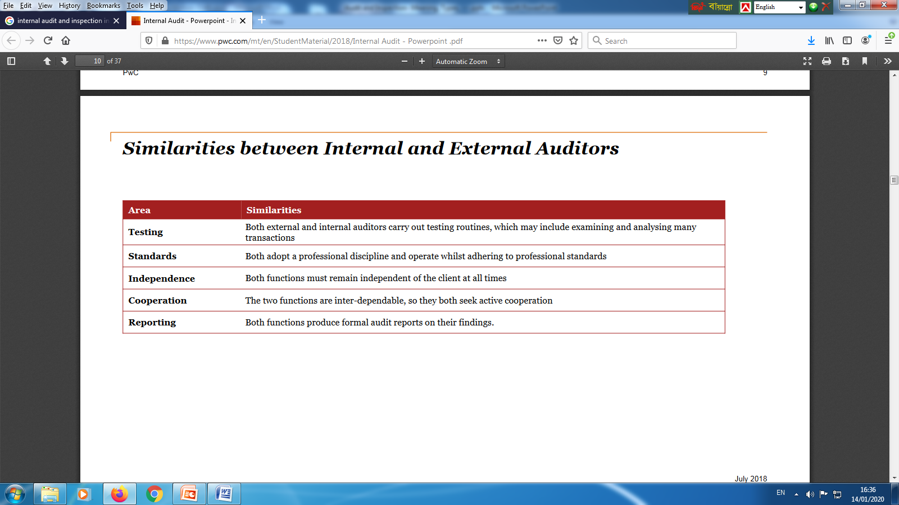

Slide 62
The Institute of Internal Auditors(IIA), USA

Slide 63
Ethics in Auditing
As per ICC Policy-2018, ethics of auditors are illustrated as under:
Auditor should be bold, honest and truthful
Should keep strict confidentiality of information found during auditing and should not use those information for personal gain or revengeful view
Should avoid conflict of interest
Should abide by the bank’s code of ethics
Should act with full professionalism

Slide 64
ছড়ায় ছড়ায় Ethics:
১। “আমার বিবেক আমাকে এই
সঠিক দিশা দিক না,
চাকরি করি বেতন তো পাই
ঘুষ খাওয়া তাই ঠিক না।”
২। “অন্যায় করে পার পেতে পার
জানবে না কেউ কিছু,
কিন্তু তোমার বিবেক রয়েছে
ছাড়বে না সে তো পিছু।”

Slide 65
“আলোর মতো ছড়িয়ে পড়ি
ফুলের মতো ফুটি
ইচ্ছে করে আকাশ সমান
শুদ্ধ হয়ে উঠি।”

